Slide 1
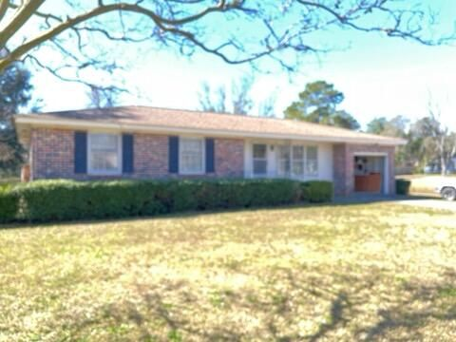
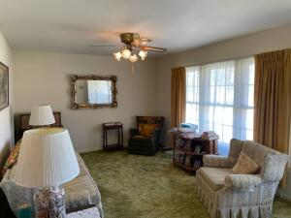
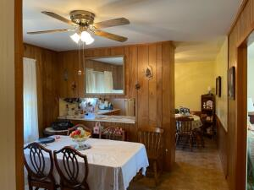
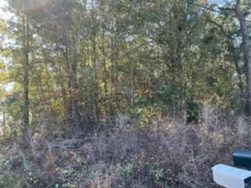
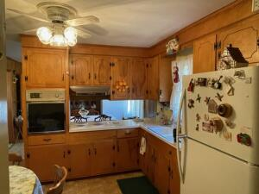
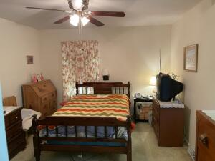
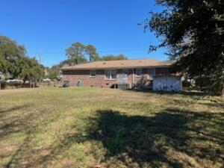
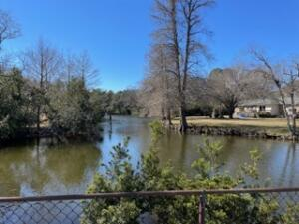


Just Listed on James Island!
Reduced!
1089 Harbor View Road
Lawton Bluff · Charleston, SC 29412
MLS# 22004241 · $415,000
Michael Dew
O 843-769-5100
M 843-870-7000
michaeledew@gmail.com
www.michaeldewrealestate.com
3 bed 1.5 bath brick ranch.
Exceptionally clean! Pond site.
Hardwood floors under carpet in living room and bedrooms.
Smooth ceilings.
Newer roof.
HVAC and duct replaced 2016.
House has been rewired.
Great location!
Convenient to shopping, restaurants, Folly Beach and down town.
AgentOwned Charleston Group
902 Savannah Hwy
Charleston, SC 29407
Real Estate ● Mortgage Insurance ● Business Brokerage

