Slide 1
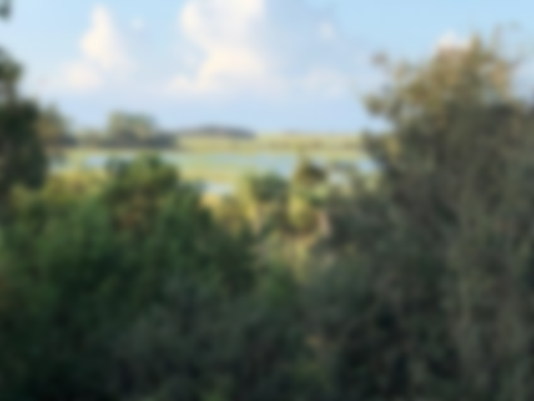
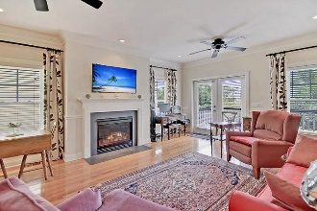
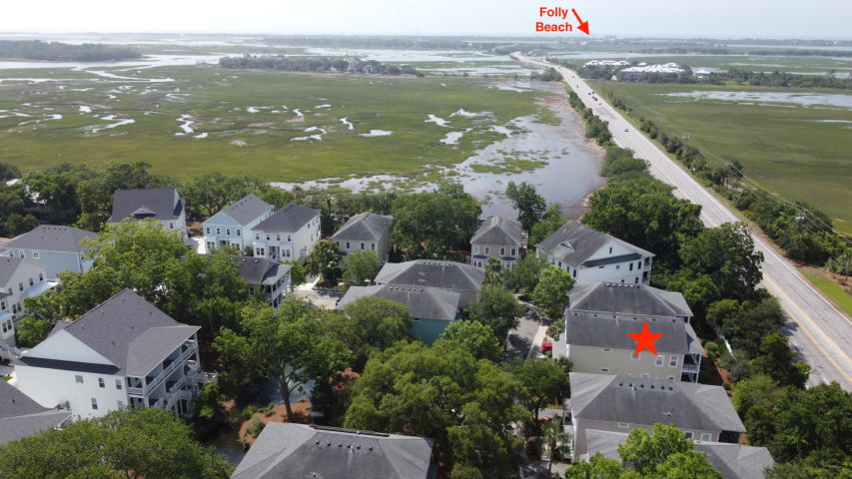
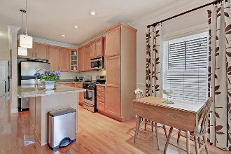
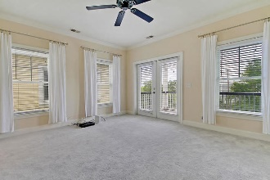
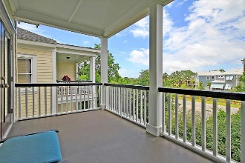
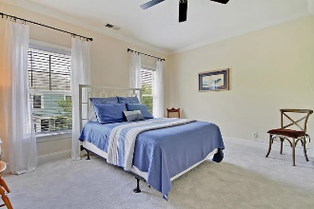
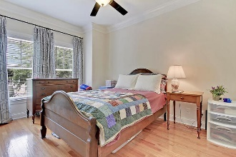
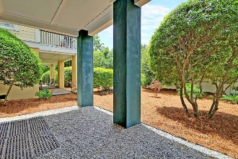
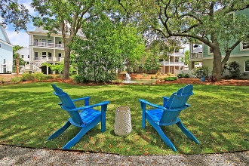


Beach Bound Lifestyle
108 Howard Mary Drive A
Sable On The Marsh
Charleston, SC 29412
MLS# 20013845 | $375,000
This wonderful three bedroom, three full bath townhome lives like a single family home. Enjoy the lifestyle and convenience of being just over two miles to Folly Beach, only eight miles to downtown Charleston, and having retail and restaurants very close by. Features include hardwood flooring, tiled bathrooms, new carpet in the two carpeted bedrooms, and a newer HVAC. There are ceiling fans, crown molding, and great natural light throughout this wonderful home. This duplex has elevated construction that provides an immaculate, roomy garage for parking and storage. The open kitchen features stainless steel appliances with a natural gas range, granite countertops, and beautiful high-end cabinetry. The great room has a natural gas fireplace with a stunning surround, and there are two nice balconies offering sea breezes and peeks at the marsh.
Live virtually maintenance free with the HOA covering the exterior building maintenance, homeowner's and flood insurance, termite bond, pest control, and landscaping/irrigation.
To complete this island lifestyle package there is also a nice backyard area for walking pets, and beautiful common areas to relax in.
Take a virtual tour: https://my.matterport.com/show/?m=Di2y8mKWw47
Lee Lindler
Cell (843) 637-0803 | lee@akersellis.com
Akers Ellis Real Estate LLC | 3730 Bohicket Road, Suite 5 | Johns Island, SC 29455
akersellis.com

