Slide 1
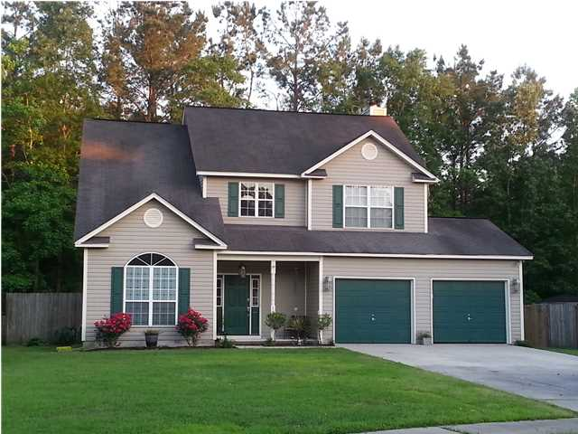
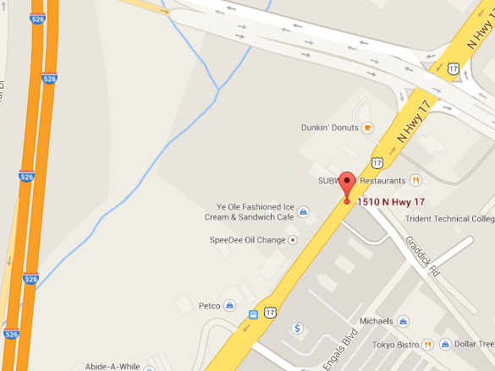
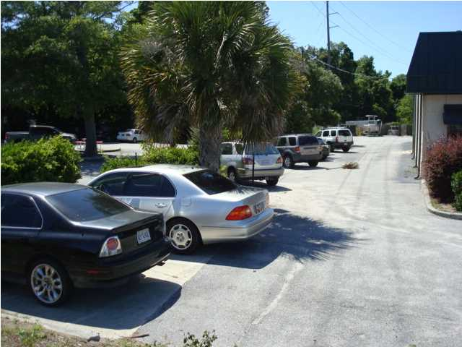
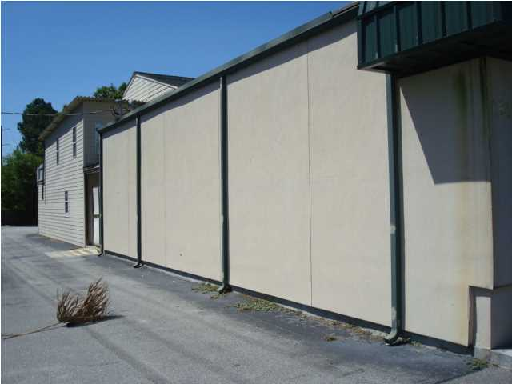
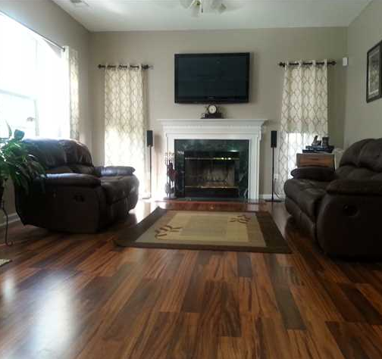
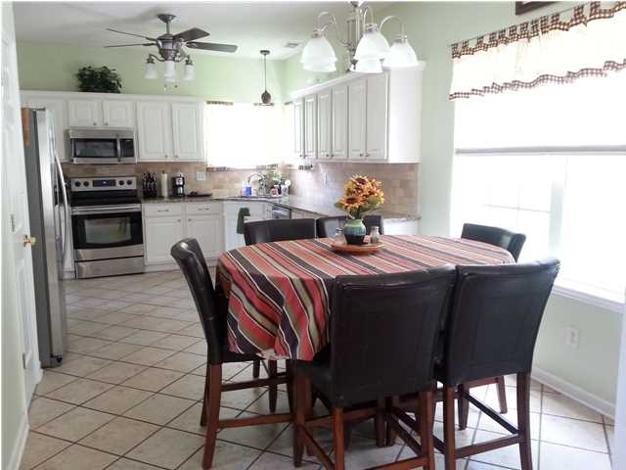
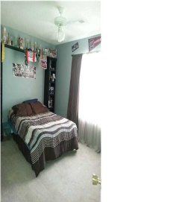
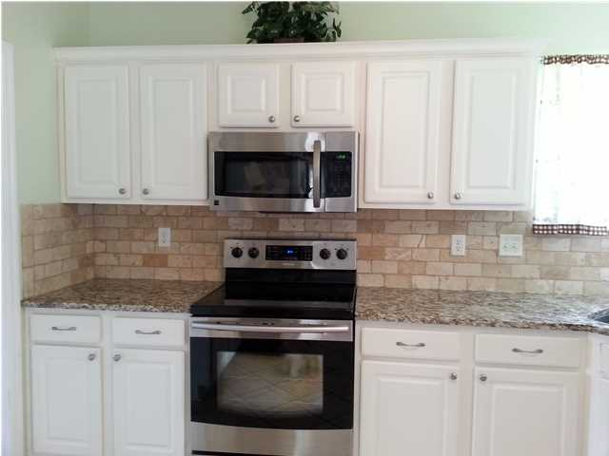
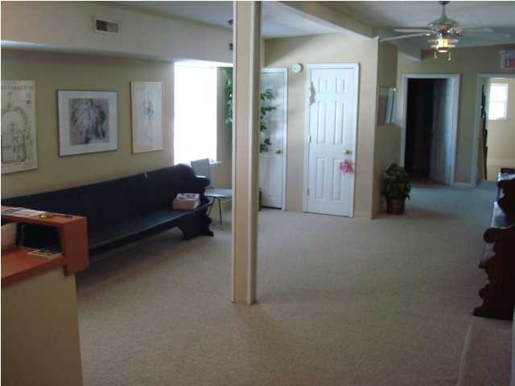
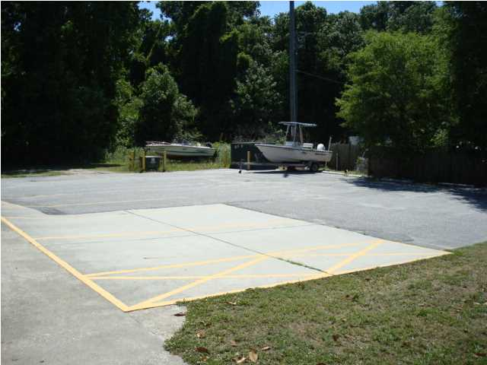
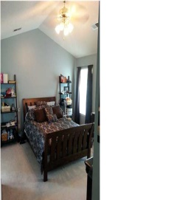
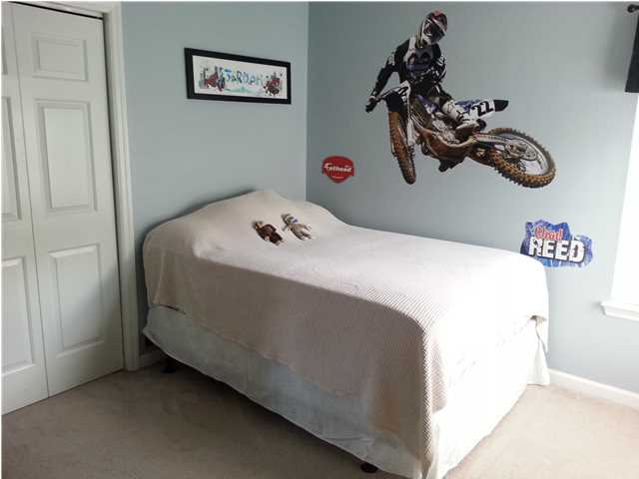
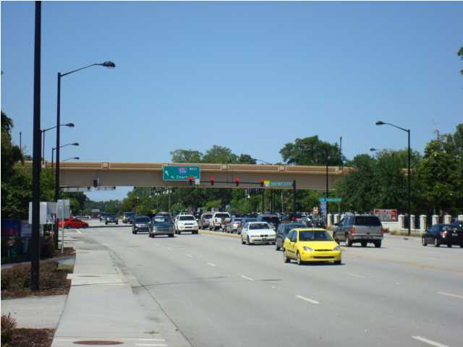
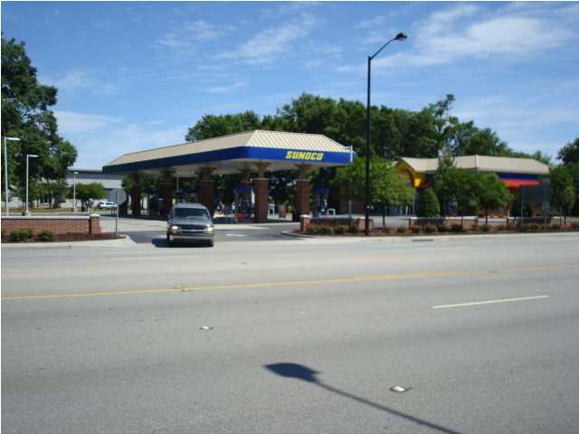
108 Adthan Circle
Crowfield Plantation
Goose Creek
MLS# 1413236
$217,900
Cul-de-Sac Home Just Reduced!
Cul de sac home in beautiful Crowfield Plantation. The kitchen is large and roomy with lots of counter space and cabinet storage. Finished with beautiful new Granite countertops & tumbled marble back splash and stainless steel appliances. Stove, dishwasher and microwave recently replaced. Fridge is brand new and can convey with an acceptable offer. All cabinet doors are being replaced. Wooden steps lead to upstairs bedrooms. Large master bedroom with vaulted ceiling. Master closet has professionally installed closet system. Master bath has dual sink vanity, soaking tub and stand up shower with new glass enclosure. 2 car garage has built in shelving. Backyard is fully fenced with double gate front access and rear single gate access to the park. Most lighting fixtures and fans have been updated throughout the home. Home is equipped with a security system. Crowfield offers miles of walking trails, numerous parks, lakes and ponds, several pools to choose from as well as a golf course and tennis courts all within a city voted as a Best place to raise your kids. Goose Creek has a modern recreation center with full gym and well established youth sports program.
Michelle Riser & Bob Glover
843-860-1229 (Michelle) | 843-693-1837 (Bob)
mriser@ccim.net | bobglover08@gmail.com
Matthew Ryan Company, 104 Berkeley Square, PMB 59, Goose Creek, 29445

