Slide 1
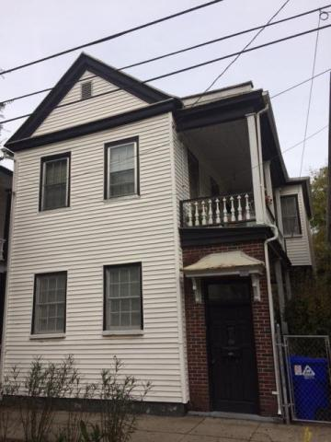

In the heart of the downtown restoration
108 America Street
Downtown
Charleston, SC 29403
MLS# 15029179
$229,900
This property is in the heart of the downtown restoration. There are several new homes in the area. Three bedrooms, one bathroom, living room, dining room, kitchen and den area. Double porches and ample yard for play area. It has central heat and air conditioning. Built in 1885 this house has been renovated, however it needs some roof repair. Easy to show. Call for details.
Terry Seabrook
Mobile 843 607-2490
Office 843 577-2676
seabrookspace@aol.com

