Slide 1
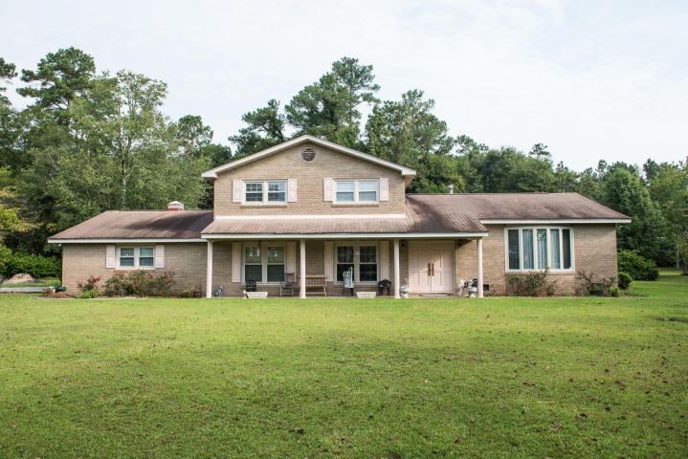
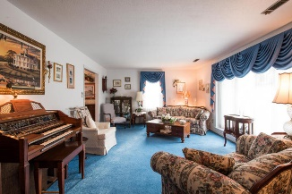
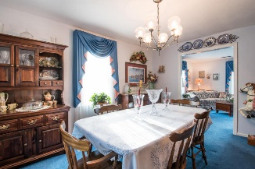
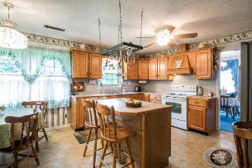
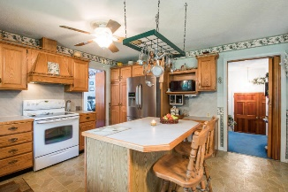
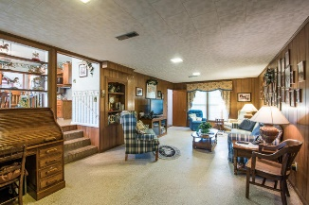
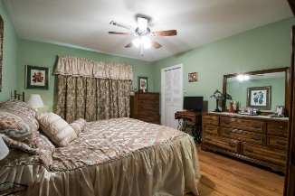
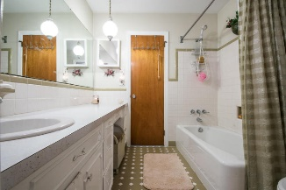
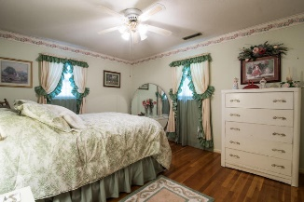
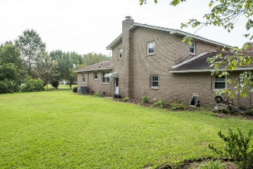
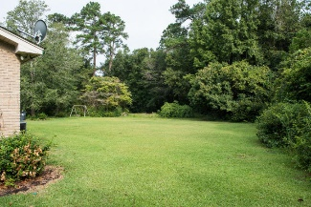

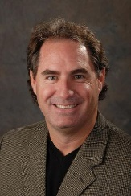
108 Azalea Street Katony ~ Ladson, SC 29456 ~ MLS# 16024924 ~ $269,900
Brick Home, Large Lot, Low Taxes, & Good Schools
Don't miss this unique opportunity to own a nice size home in a great school district, (College Park/Stratford) Berkeley county, low tax district, and no flood insurance. Large corner lot will accommodate your boat, motorhome, other toys. Master bedroom down, all 2nd floor has hardwood floors and tile in baths. There is a formal dining room, living room, and large family room with wood burning fireplace.
Gregg Fesler GRI, CRS, REALTOR
Office (843) 856-3983 | Mobile (843) 797-0000
gregg@greggfesler.com
Carolina One Real Estate | 628 Long Point Rd. | Mt Pleasant, SC 29464-3032

