Slide 1
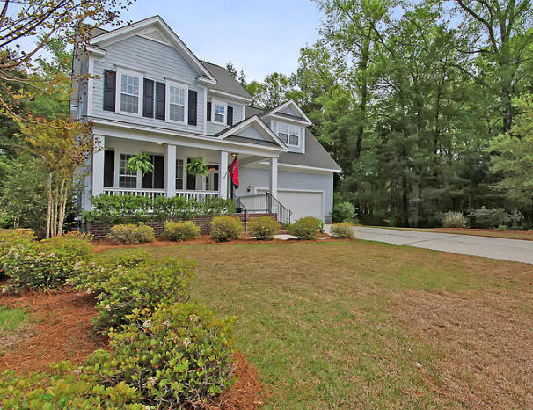
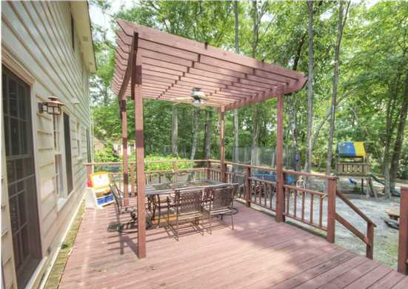
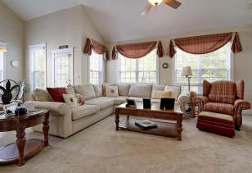
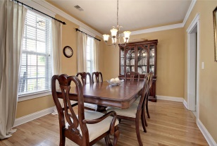
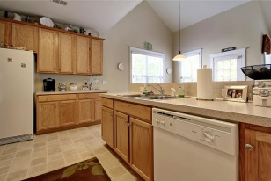
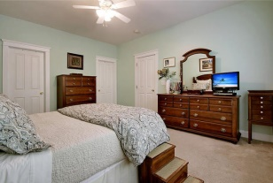
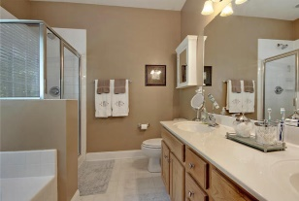
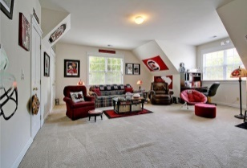
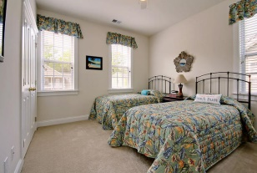
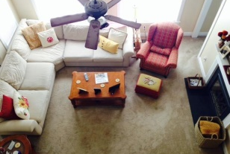
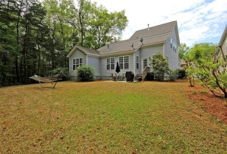
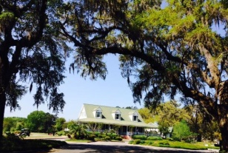
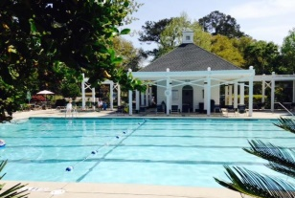
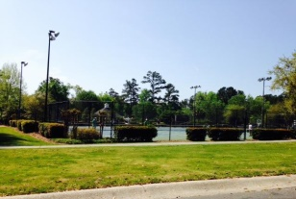


Immaculate Country Club Home
108 Blackwater Drive
Legend Oaks Plantation
Summerville
MLS# 15008923
$259,000
4 Bed | 2½ Bath | 2,310 sf
This 2,310 Sq. Ft. beautiful home is in IMMACULATE condition and ready for new owner to move right in! When buyers enter they will notice hardwood floors in the foyer and dining room. The spacious family room has vaulted ceilings and a gas fireplace. The kitchen offers a breakfast / sitting bar, plenty of cabinetry, eat-in kitchen area and is fairly open to the family room. The master bedroom is downstairs and features a walk-in closet and a master bathroom with dual vanities, shower and separate garden tub. The home is VERY tastefully painted and meticulously maintained and shows great!
Upstairs buyers will find 3 more bedrooms and a full bathroom. The 4th bedroom is a HUGE FROG and can be used for almost anything - media room, playroom, entertainment area or exercise room. The FROG also offers storage in the eves. This home is wooded behind the home and also to the right side of the home making it a very private setting with only one neighbor on the left. The home also offers a back patio and two car garage. Excellent local schools are nearby and this home is a MUST SEE!
Larry & Kathy Mazalatis
Larry Cell 843-693-0529
Kathy Cell 843-693-0159
Office 843-871-9133
AGENTOWNED PREMIERE GROUP | 1800 TROLLEY RD | SUMMERVILLE, SC 29485

