Slide 1

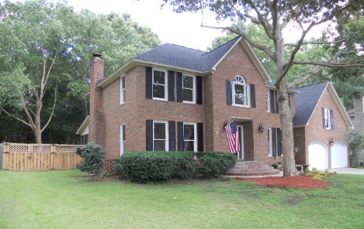
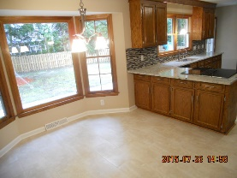
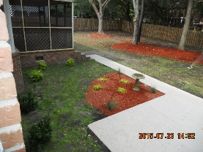
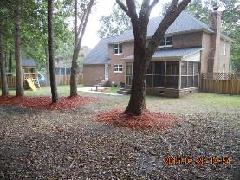
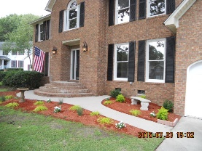
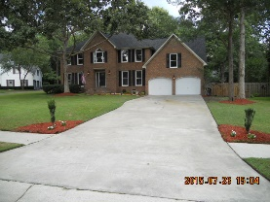
Don C Mason
(843) 364-9090
nibsc@aol.com
$2,500 AGENT BONUS
for a ratified contract by 8/31
108 Brighton Court
Crowfield Plantation | Goose Creek, SC 29445
MLS# 15019592 | $335,000
Wow!! Fresh & clean. Move in ready. Very nice remodel. This a spacious 5 bed 2.5 bath all brick beauty on a very quiet cul-de-sac. A nice screened porch, full privacy fence. A freshly poured patio with a sidewalk to go to the porch. A very nice children's slide & play set. You will love all of the windows. The Kitchen has granite counter tops, with a modern backsplash with stainless appliances that is open to the family room with a real brick fireplace. The kitchen also has 24'' mosaic tiled floor. The master is huge. With a large trey ceiling. The garden tub has modern tile around it. The master bath has separate his & hers vanities. There is a very large frog that could be the 5th bedroom, or bonus room. Home topped with a 30 year architectural shingled roof. New a/c for upstairs. Nice landscaping.
Real Estate Advocates
Palm Beach Gardens, FL 33418
www.realestateadvocates.com

