Slide 1
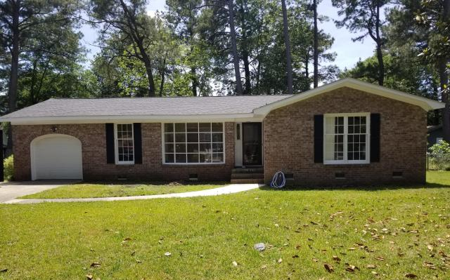
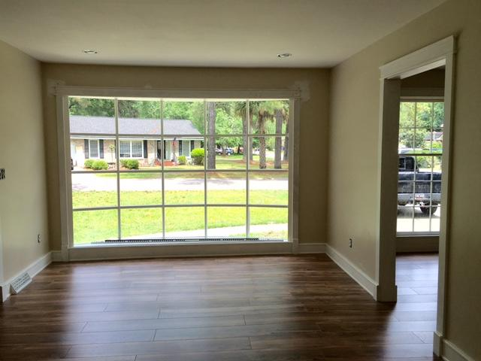
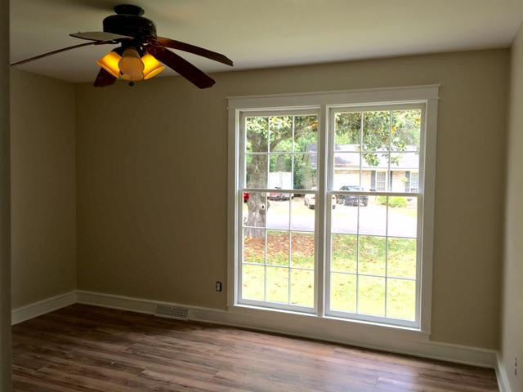
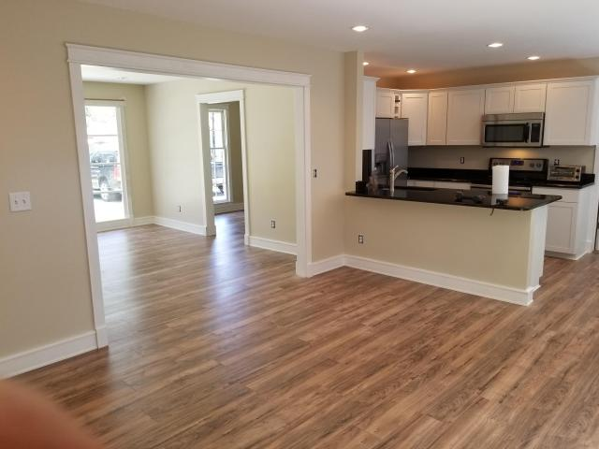
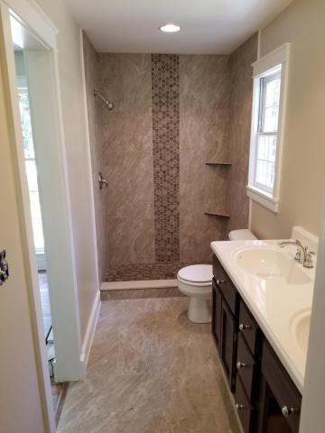
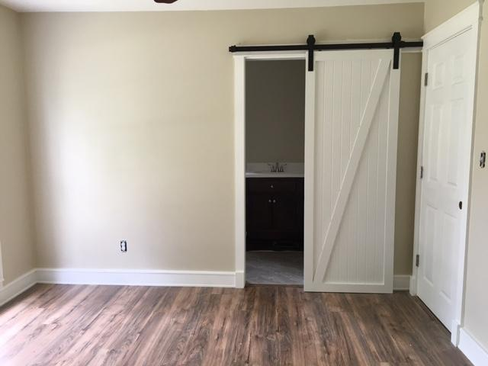
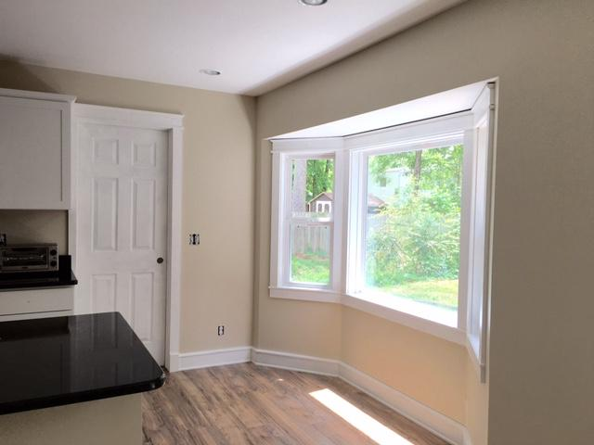
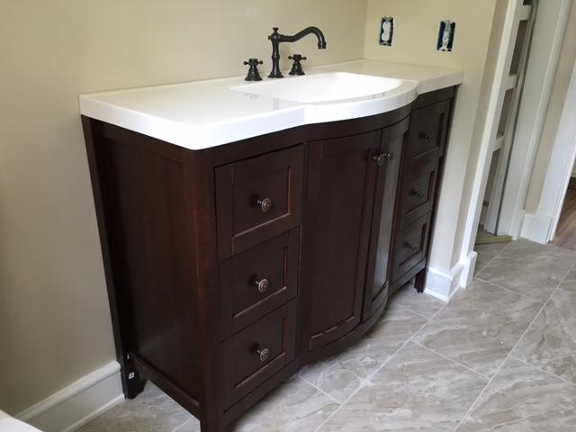


108 Driver Avenue
Corey Woods ~ Summerville, SC 29483 ~ MLS# 18012810 ~ $212,108
$5,000 Price Reduction!
5 Bed / 4½ Bath
3,889 Sq Ft
Custom Home
Desirable Location
Hardwood Floors
2-Story Great Room
Great Backyard
RENOVATED home located 5 minutes from Historic Downtown Summerville in well established neighborhood, Corey Woods. This home is a must see with all new laminate flooring in main living areas and bedrooms, fresh paint throughout the whole house, a New ROOF and NEW WATER HEATER! The newly restructured kitchen features all new stainless steel appliances, granite counter tops, new white shaker style kitchen cabinets and hardware and a breakfast nook with a bay window for extra light. Both bathrooms have been renovated with tiled showers and flooring, new vanities and fixtures. This home also offers smooth ceilings, can lighting, an office/play room and a 1 car garage.
Leah M. Rust
843-709-9211 Mobile
843-856-8800 Office
leahmrust@gmail.com
Coldwell Banker RESIDENTIAL BROKERAGE

