Slide 1
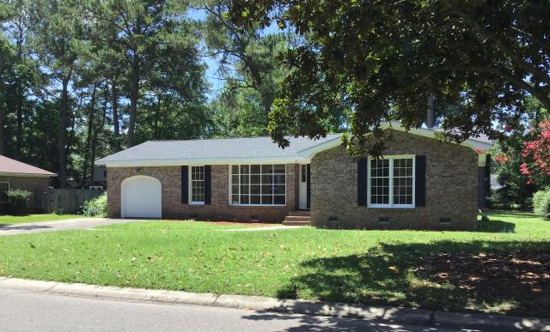
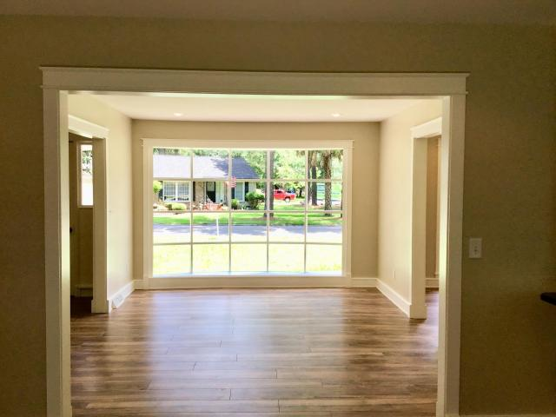
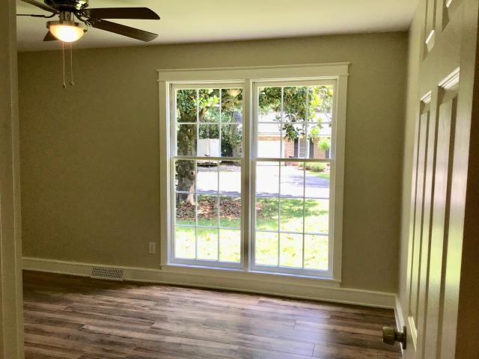
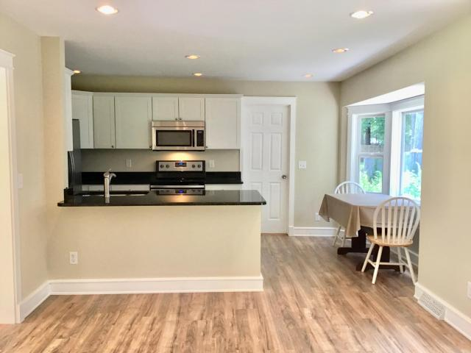
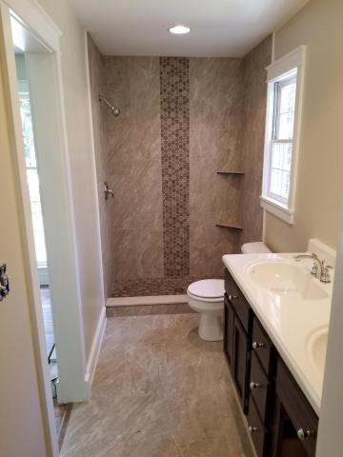
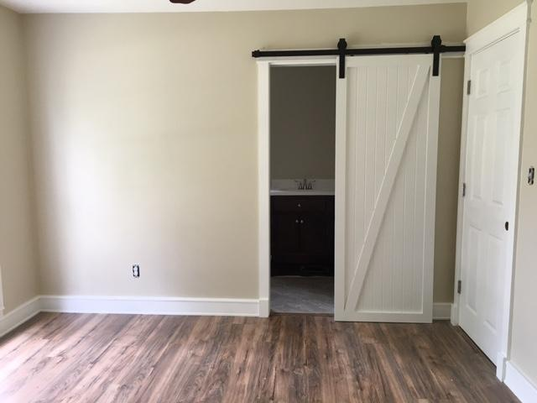
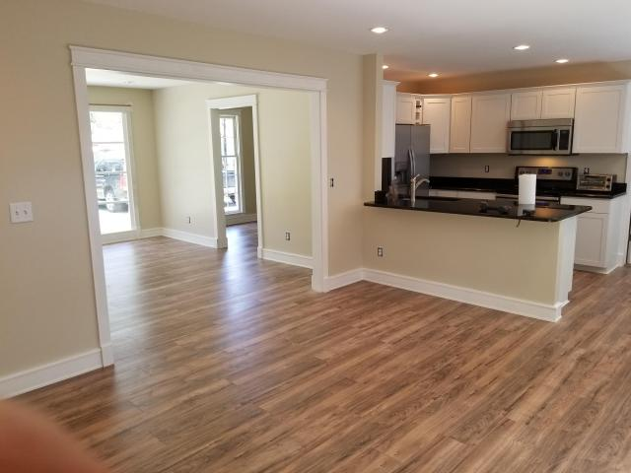
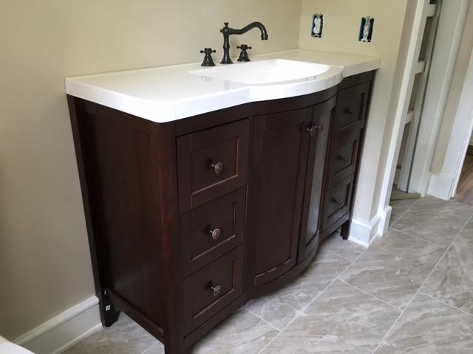


108 Driver Avenue
Corey Woods ~ Summerville, SC 29483 ~ MLS# 18018556 ~ $199,108
Back On The Market...Ready for Quick Sale!!
5 Bed / 4½ Bath
3,889 Sq Ft
Custom Home
Desirable Location
Hardwood Floors
2-Story Great Room
Great Backyard
BUYERS FINANCING FELL APART!! $9,000 REDUCTION...PRICED TO SELL!!! RENOVATED home located 5 minutes from Historic Downtown Summerville. Corey Woods is an established neighborhood within the Dorchester ll school district. This home is a must see with all new laminate flooring in main living areas and bedrooms, fresh paint throughout the whole house, a New ROOF and NEW WATER HEATER! The newly restructured kitchen features all new stainless steel appliances, granite counter tops, new white shaker style kitchen cabinets and hardware and a breakfast nook with a bay window for extra light. Both bathrooms have been renovated with tiled showers and flooring, new vanities and fixtures. This home also offers smooth ceilings, can lighting, an office/play room and a 1 car garage.
Leah M. Rust
843-709-9211 Mobile
843-856-8800 Office
leahmrust@gmail.com
Coldwell Banker RESIDENTIAL BROKERAGE

