Slide 1
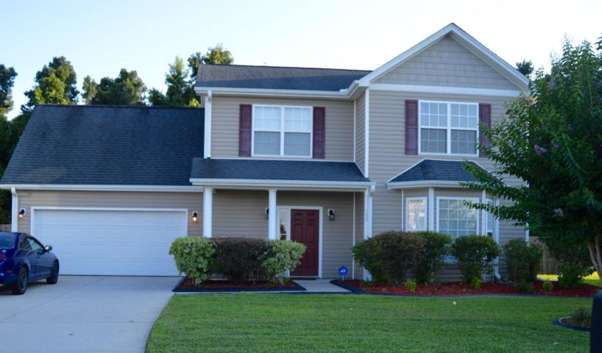
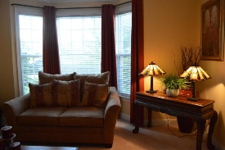
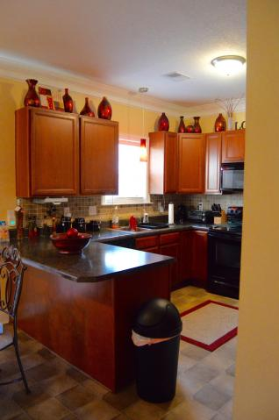
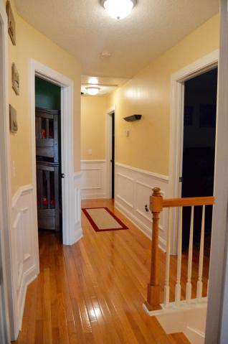
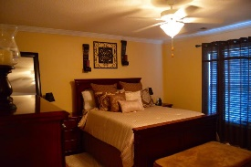


Now Offering a $1,500 Agent Bonus
108 Gavins Way
Montague Pointe · Goose Creek · MLS# 16018422 · $210,000
This home is sitting on a huge third of an acre lot that is also fenced. When you walk into the living room you see the great space with an amazing bay window and built in nook for your tv. The formal dining room with French doors is next to the well laid out eat in kitchen that has black appliances. You walk up the gorgeous stairs to the view of custom wall to wall hardwood floors. The master bedroom is upstairs with a deluxe master bath with double sinks. ALSO HAS A BONUS ROOM that can be either a game room used as a forth bedroom. This home is move in ready and wont be available for long!!!!
Michael Waites
Mobile - (843) 637-1464 | mwaites@ergroupofsc.com
The Elite Realty Group of SC, LLC · 8310-A Rivers Ave · North Charleston, SC 29406

