Slide 1
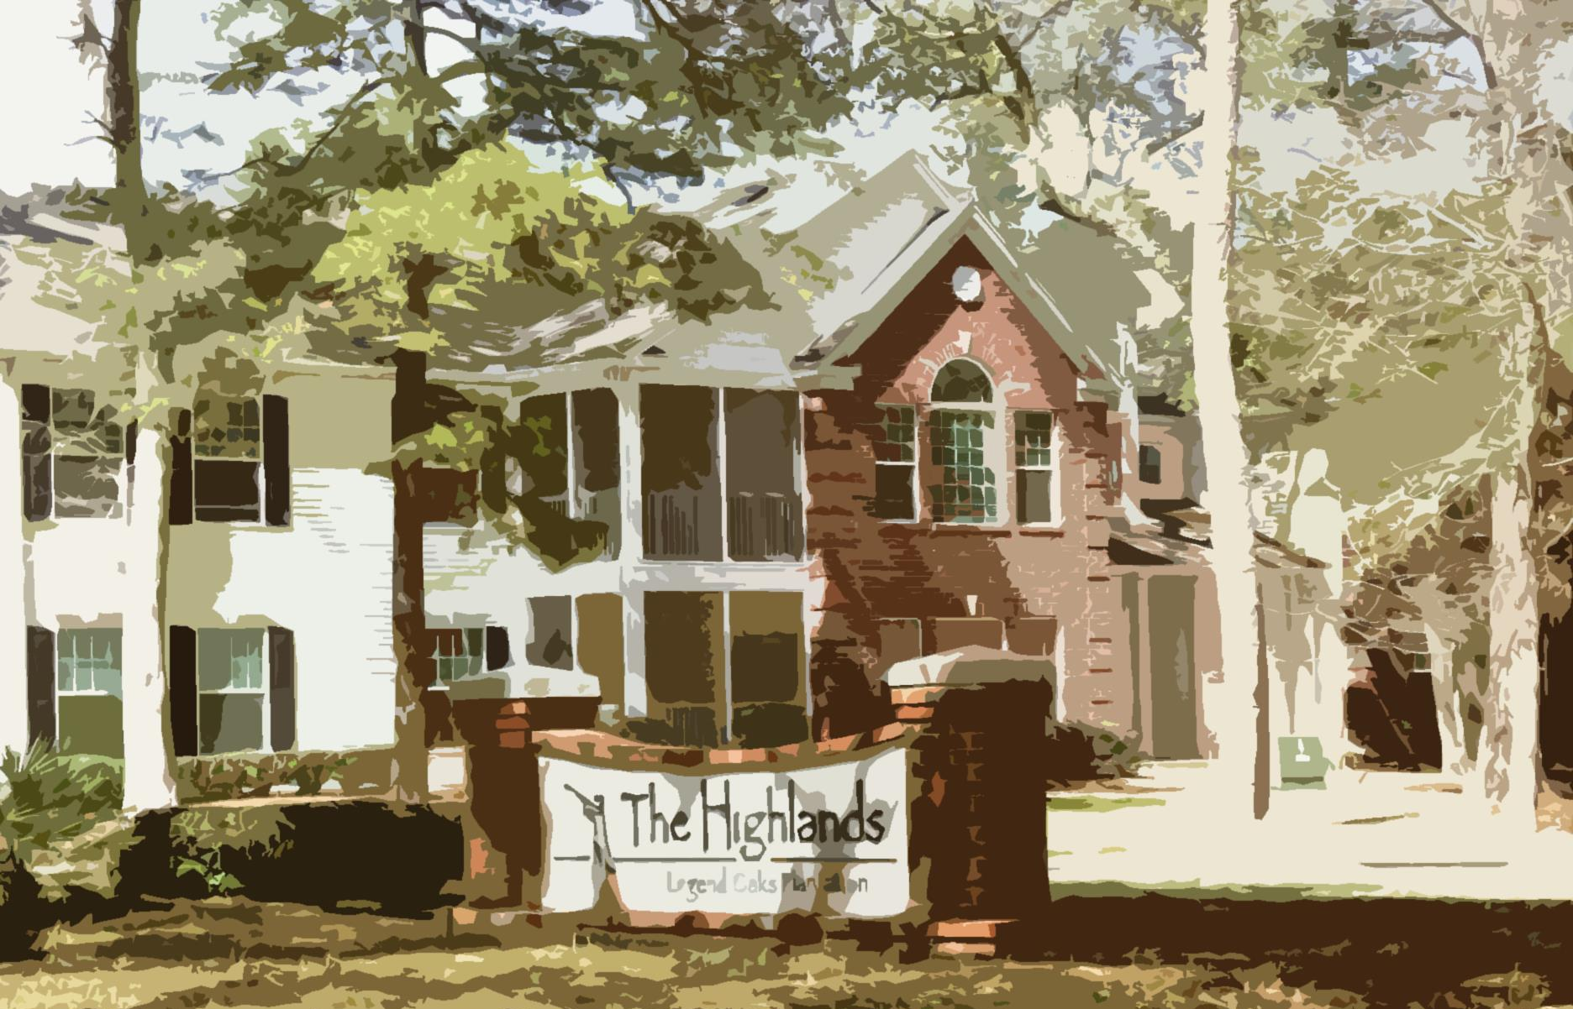
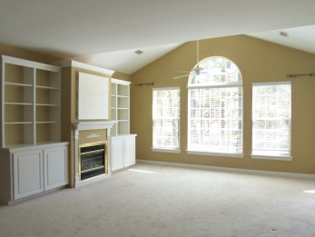
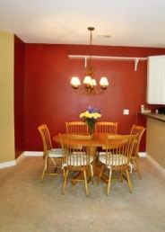
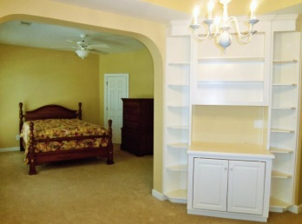
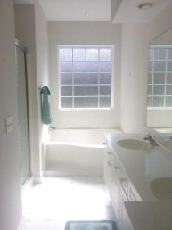
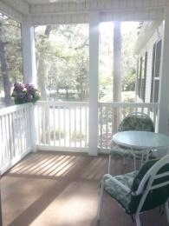
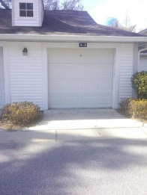


Come live where peace and tranquility abide!
Short-term Lease Available
108 Golfview Lane
Legend Oaks Plantation | Summerville | MLS# 15006747 | $149,500
You are cordially invited to live where peace and tranquility abide! This magnificent two bedroom two bath condominium is splendidly located across from the #9 fairway and green in Legend Oaks Plantation. The Master wing with garden tub & separate shower has a stunning sitting area with built-ins. Closet space galore! The spacious living area has a vaulted ceiling, fireplace, and additional built-ins. Screened-in porch. 1 car garage separately deeded included in the price. Refrigerator, stove, built-in microwave, dishwasher, washer, and dryer all convey!
Tyeshia Folk
843-478-2209
tyeshia.folk@agentownedrealty.com
AGENTOWNED REALTY CO. PREMIER GROUP, INC.
141-A N. MAIN STREET
SUMMERVILLE, SC 29483

