Slide 1
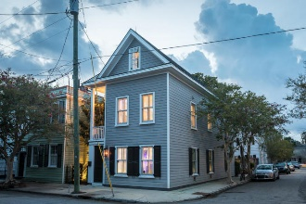
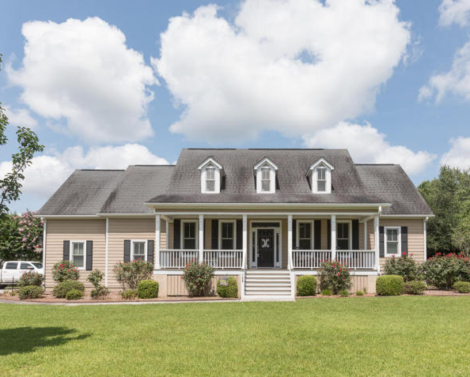
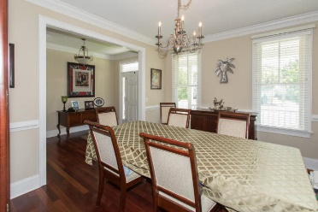
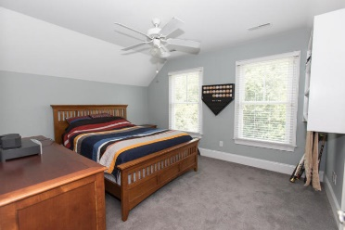
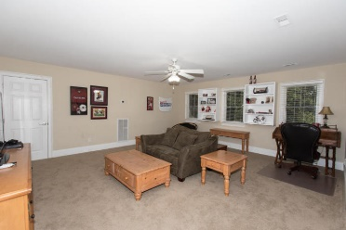
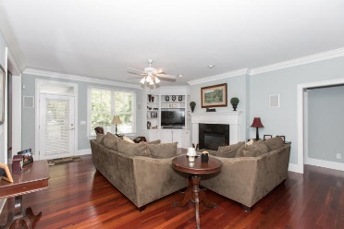
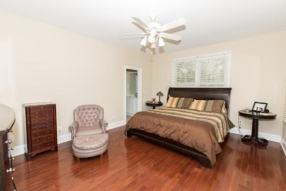
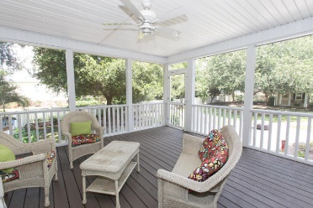
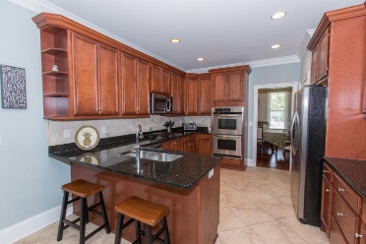
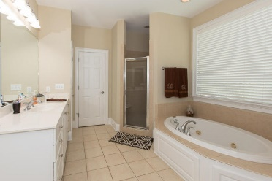
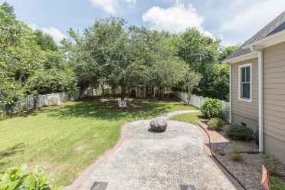


Gorgeous Home in High Meadow Farms
108 High Meadow Farms Road
Summerville, SC 29483 · MLS# 18015610 · $424,900
Beautiful 4 bd + Bonus Room, 4 bathrooms, 2861 SF of indoor living space, and an abundance of porches and storage! Enter the foyer to find gleaming Brazilian Cherry hardwood floors and Formal Dining Room to your left. Straight ahead is the Family Room with gas fireplace, built-in shelving, and windows overlooking backyard and screened porch for an abundance of natural light. The eat-in kitchen is complete with granite counter tops, new travertine back splash, and stainless appliances. Beautiful crown molding and wide baseboards throughout main living areas. Off the kitchen is the hallway to the garage, laundry room, and master bedroom. The master bedroom is located on the rear of the home and features a walk in closet, custom shelving, master bathroom with dual sinks, garden tub, water closet, and stand up shower. There are two additional bedrooms downstairs, each with their own bathroom, located on the opposite side of the home off the Family Room. Upstairs you will find the fourth bedroom and bathroom and a large Bonus Room, both with custom shelving which could easily make a 5th bedroom with great space for a large closet. Off the den is a large screened in porch (added 2009) overlooking a vinyl fenced, meticulously landscaped backyard with custom built garden house/playhouse. There is a large patio great for entertaining summer cookouts or winter firepit gatherings. Extras include central vac, surround sound, yard irrigation system, split bedroom floor plan, double wall oven, walk-in floored attic storage, electric garage door opener/exterior keypad, vinyl clad tilt-in windows. All this within a small 14 home cul-de-sac community on 0.50+ acreage lots. Conveniently located close to award winning schools and I26. This is a gem of a property you do not want to miss!
Michael Dew
O 843-769-5100
M 843-870-7000
michaeledew@gmail.com
www.michaeldewrealestate.com
AgentOwned Charleston Group
902 Savannah Hwy
Charleston, SC 29407
Real Estate ● Mortgage Insurance ● Business Brokerage

