Slide 1
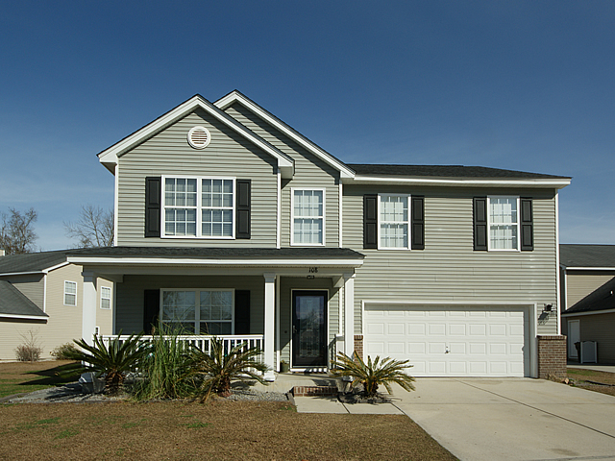
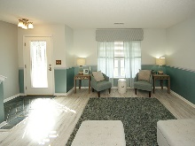
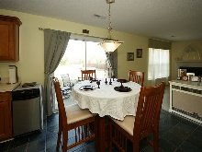
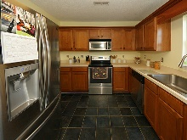
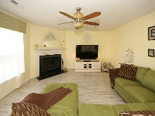
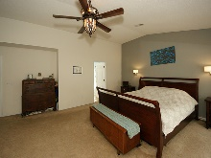
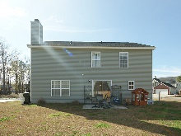
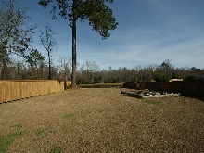
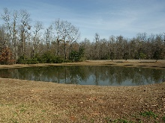
Welcome To Your New Home!! $1,000 Agent Bonus!
108 Latham Lane
Liberty Hall Plantation
Goose Creek, SC 29445
MLS# 16032248 ~ $219,999
Impressive curb appeal with a corner lot on a beautiful pond. Enjoy a spacious 3 bedrooms 2.5 bath home with a loft. New updates to home: a new architectural shingle roof installed in 2017, new water heater, new stove, new sink, High efficiency NEST for HVAC thermostat and freshly painted rooms. Laminate floors throughout downstairs, spacious formal and dining room combo, porcelain tile in entry way, kitchen and powder room. Ceramic tile in guest and master bathrooms. Stainless steel appliances. Sliding glass door. Den with a wood burning fireplace. All bedrooms are located upstairs. A nice size loft great for entertaining or kids plays area. A huge master bedroom. Dual sinks, walk in shower and garden tub in master bathroom with a walk-in closet. Family oriented neighborhood...Enjoy sitting on your porch watching your children play at the park across the street. What more can you ask for!! Call today for a private showing. Convenient location to North Rhett, Naval Weapon Station, shopping and restaurants.
Rita Adkins
yourcharlestonrealestate@gmail.com | (843) 270-8814 | www.yourcharlestonrealestate.com
Brand Name Real Estate | 4 Carriage Lane, Suite 106 | Charleston, SC 29407

