Slide 1
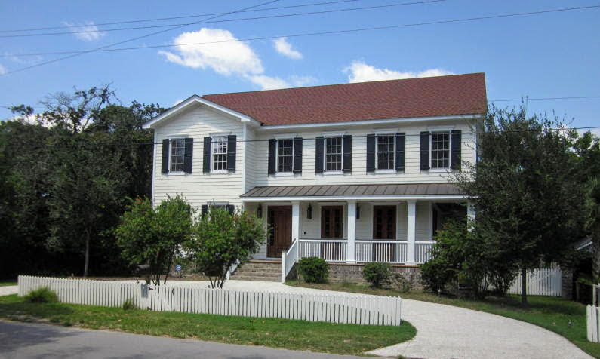
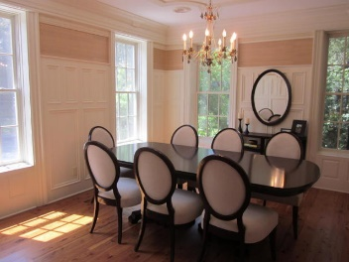
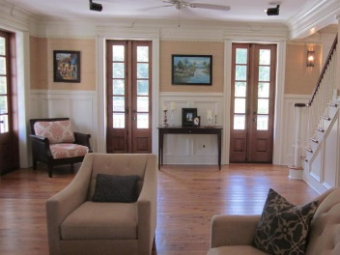
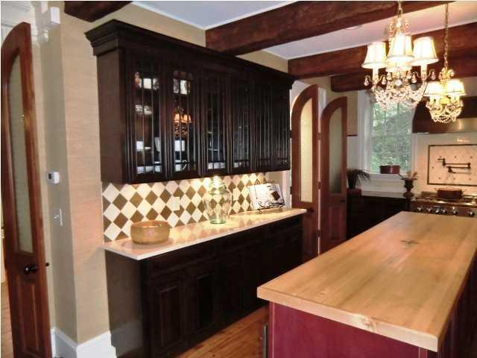
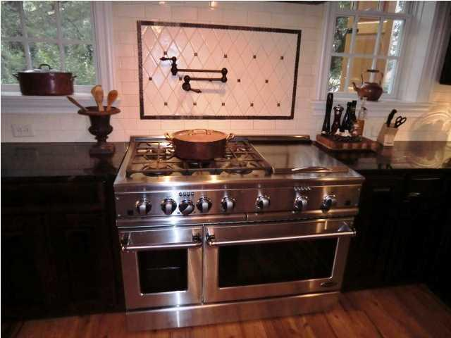
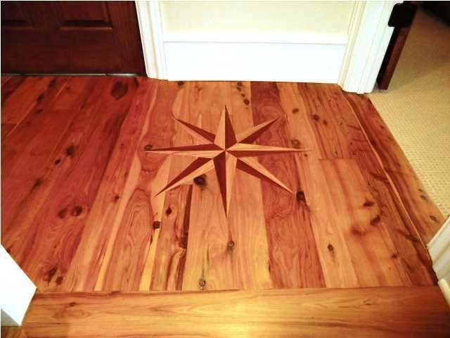
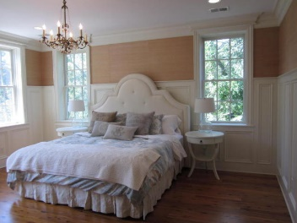
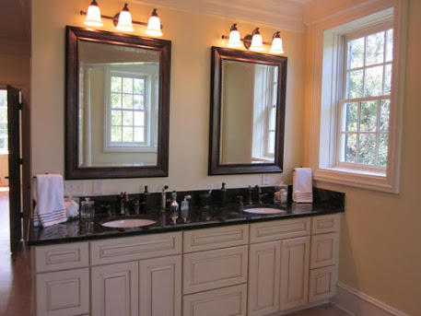
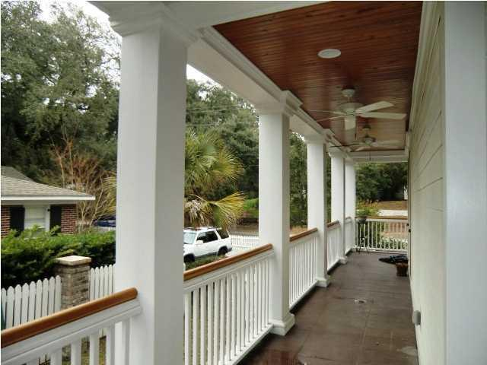
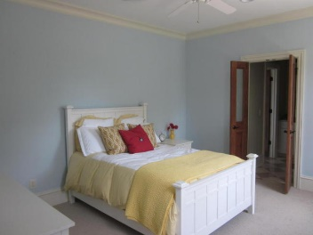
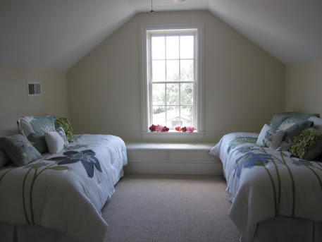



108 Live Oak Drive Old Village Mount Pleasant MLS# 18013557 $1,649,000 3,900 Sq. Ft. | 4 Bed | 3 ½ Bath
Just Listed!
Agent Preview/Luncheon
Preview this great home before going live on MLS!
Wednesday, April 25th ~ 12:00-2:00
Coastal Living at it's Best! This beautiful home is located in the Historic District in Old Village. Steps or a bike ride away from Shem Creek and all the Old Village has to offer. Exquisite moldings, Plantation Shutters, hardwood flooring, great room w/fireplace, French Doors opening to a wrap-around porch and back screened porch. Gourmet kitchen with beams. The second floor offers a built-in office area, large master ensuite, with his/hers closets, double vanities, tub and a large shower. The second floor has two additional bedrooms with a Jack and Jill bathroom. The third floor offers a fourth bedroom with a private bath and an upstairs media room, kid's den, office, whatever you need! Home has 9+ ft. ceilings and an elevator shaft. This home is an ICF (insulated concrete form) built house. It offers significant energy savings, reduced noise transmission, will not support the growth of mold or mildew, built to any seismic or hurricane-storm standard and offers up to a four-hour Fire Resistive Rating. Quality detail and efficiency went into the construction of this home. Minutes to downtown Charleston, Shem Creek, and Sullivan's Island beaches.
Come see this amazing home!
Jennifer Nipper, Realtor®
(843) 478-1800 | jen@AgentOwned.com
www.AgentOwned.com
The AgentOwned Realty Co | 824 Johnnie Dodds Blvd | Mt. Pleasant, SC 29464
Real Estate • Mortgage • Insurance

