Slide 1
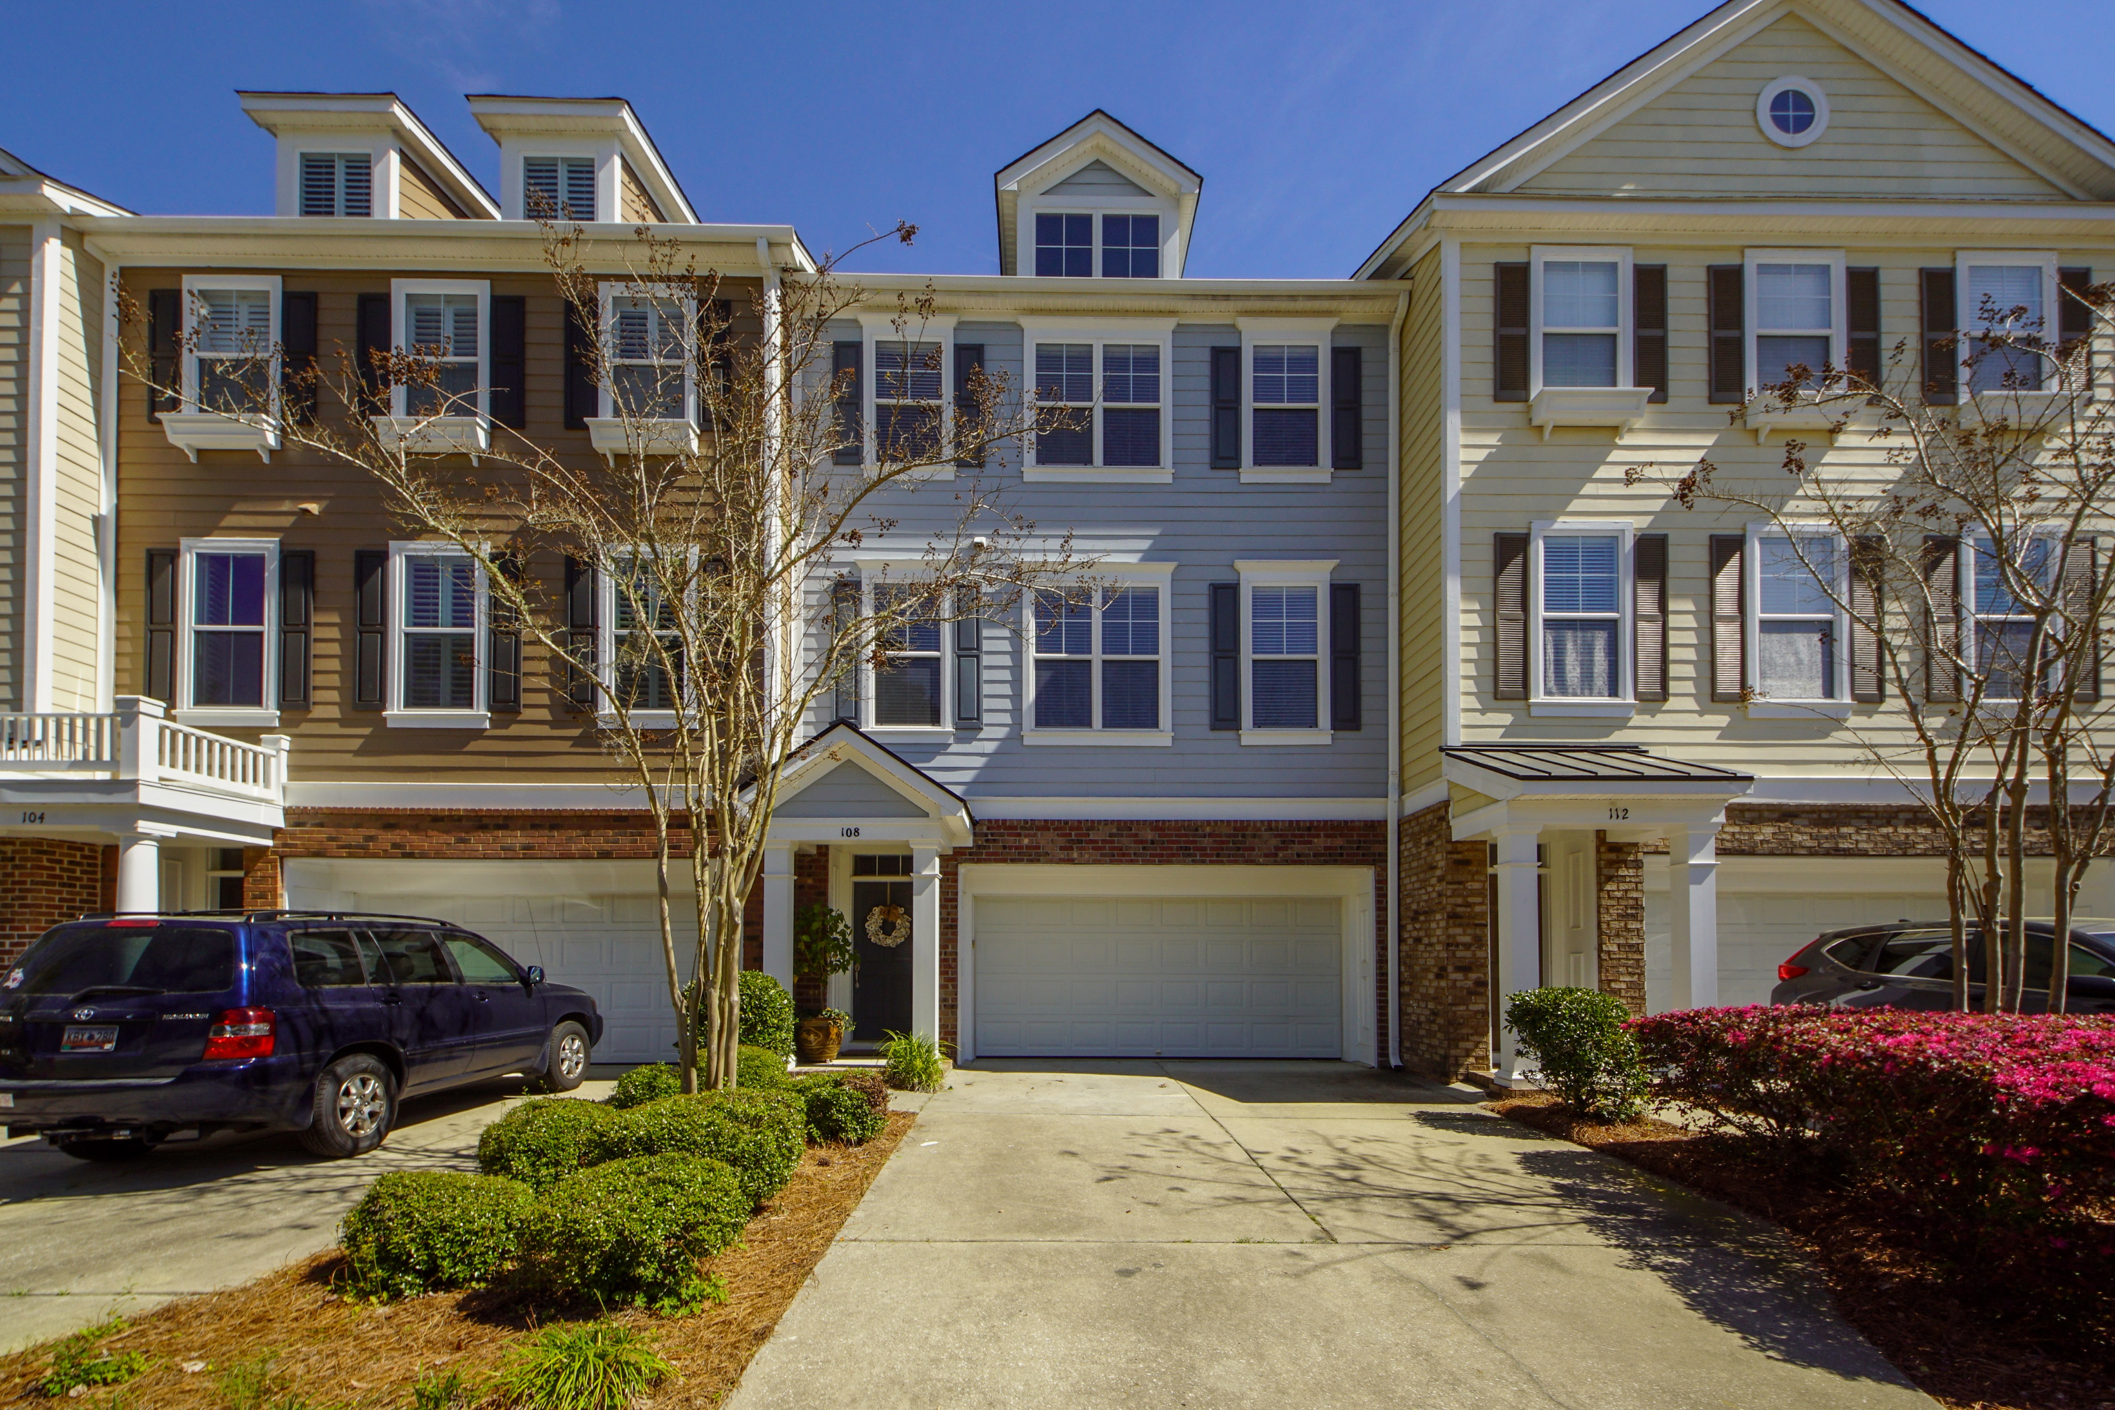
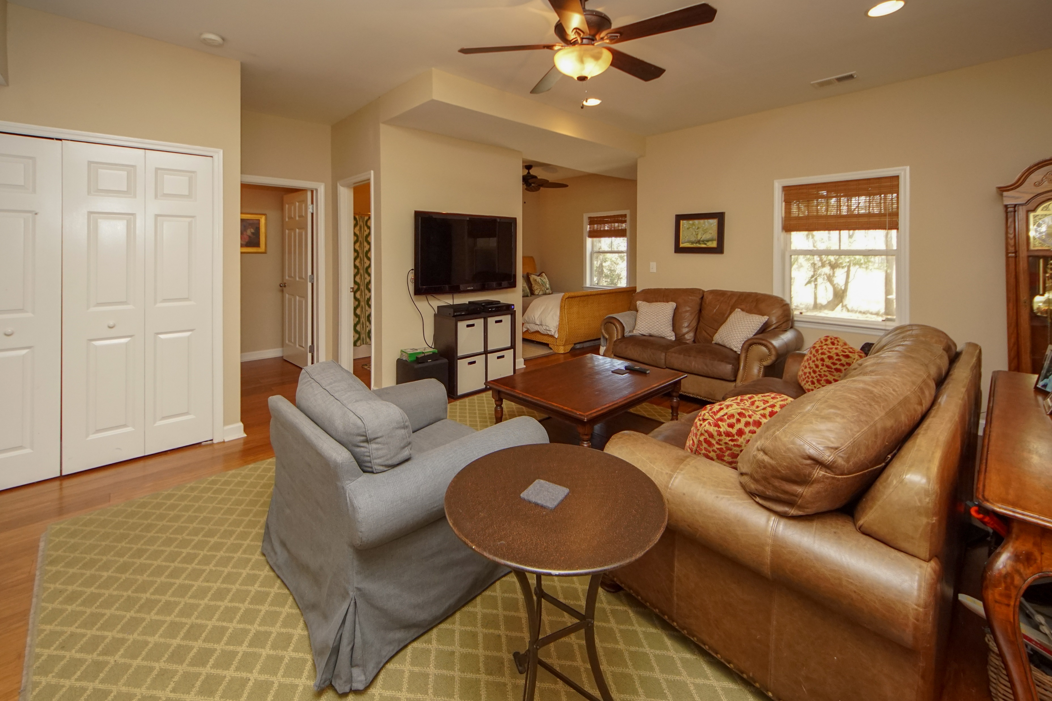
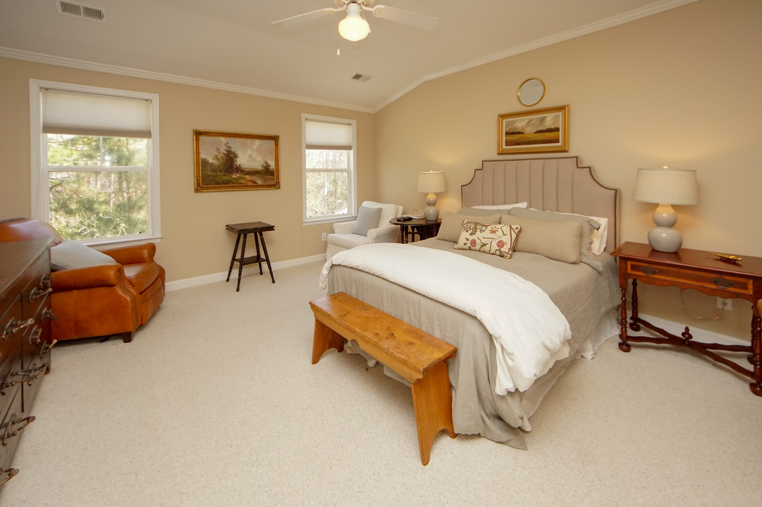
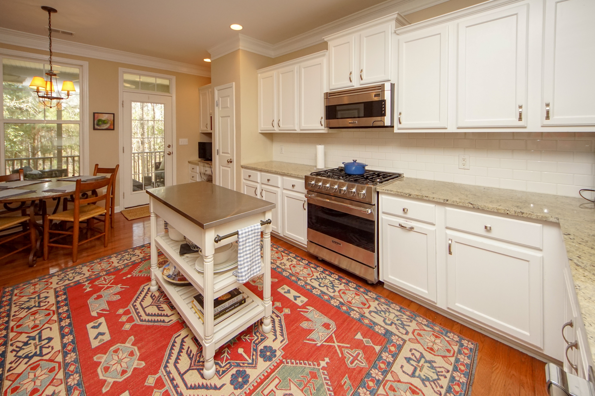
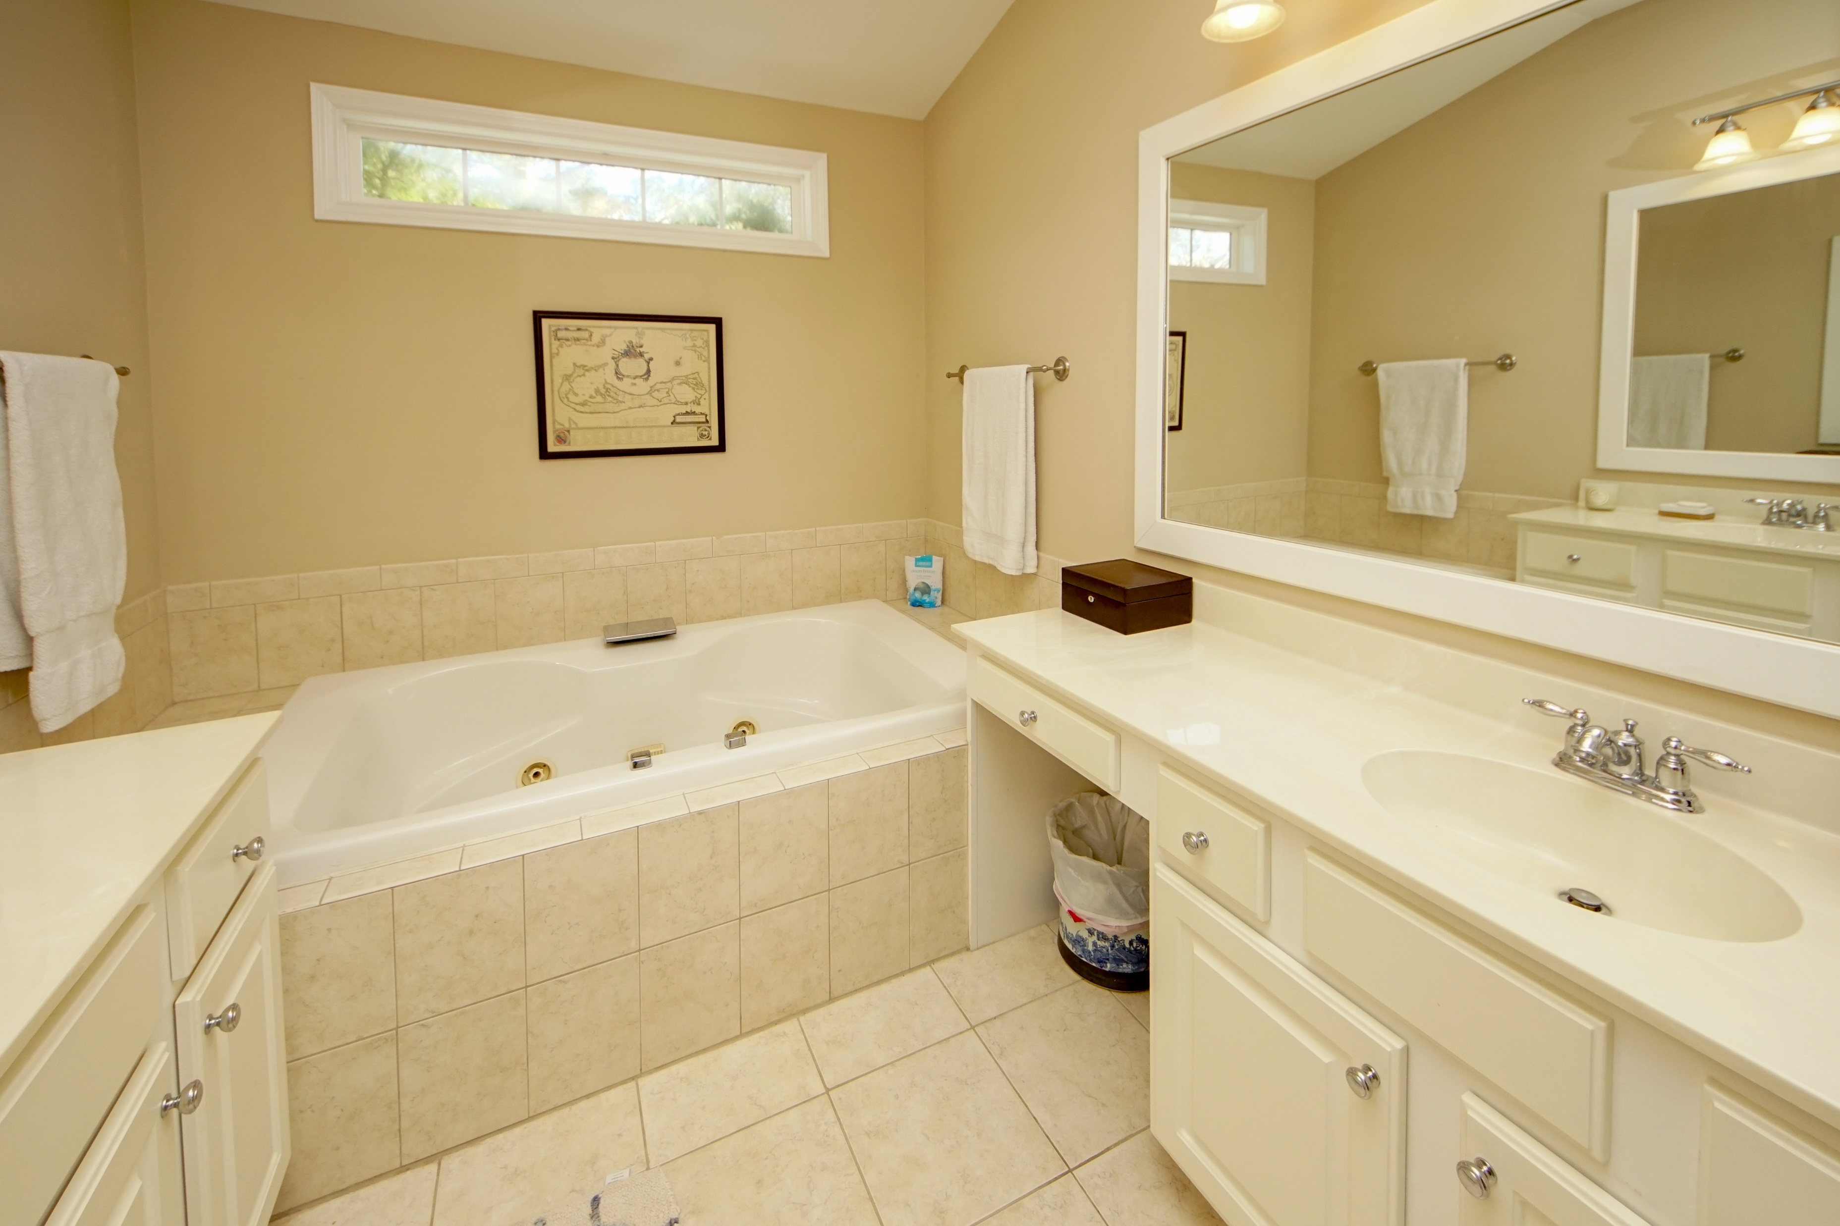
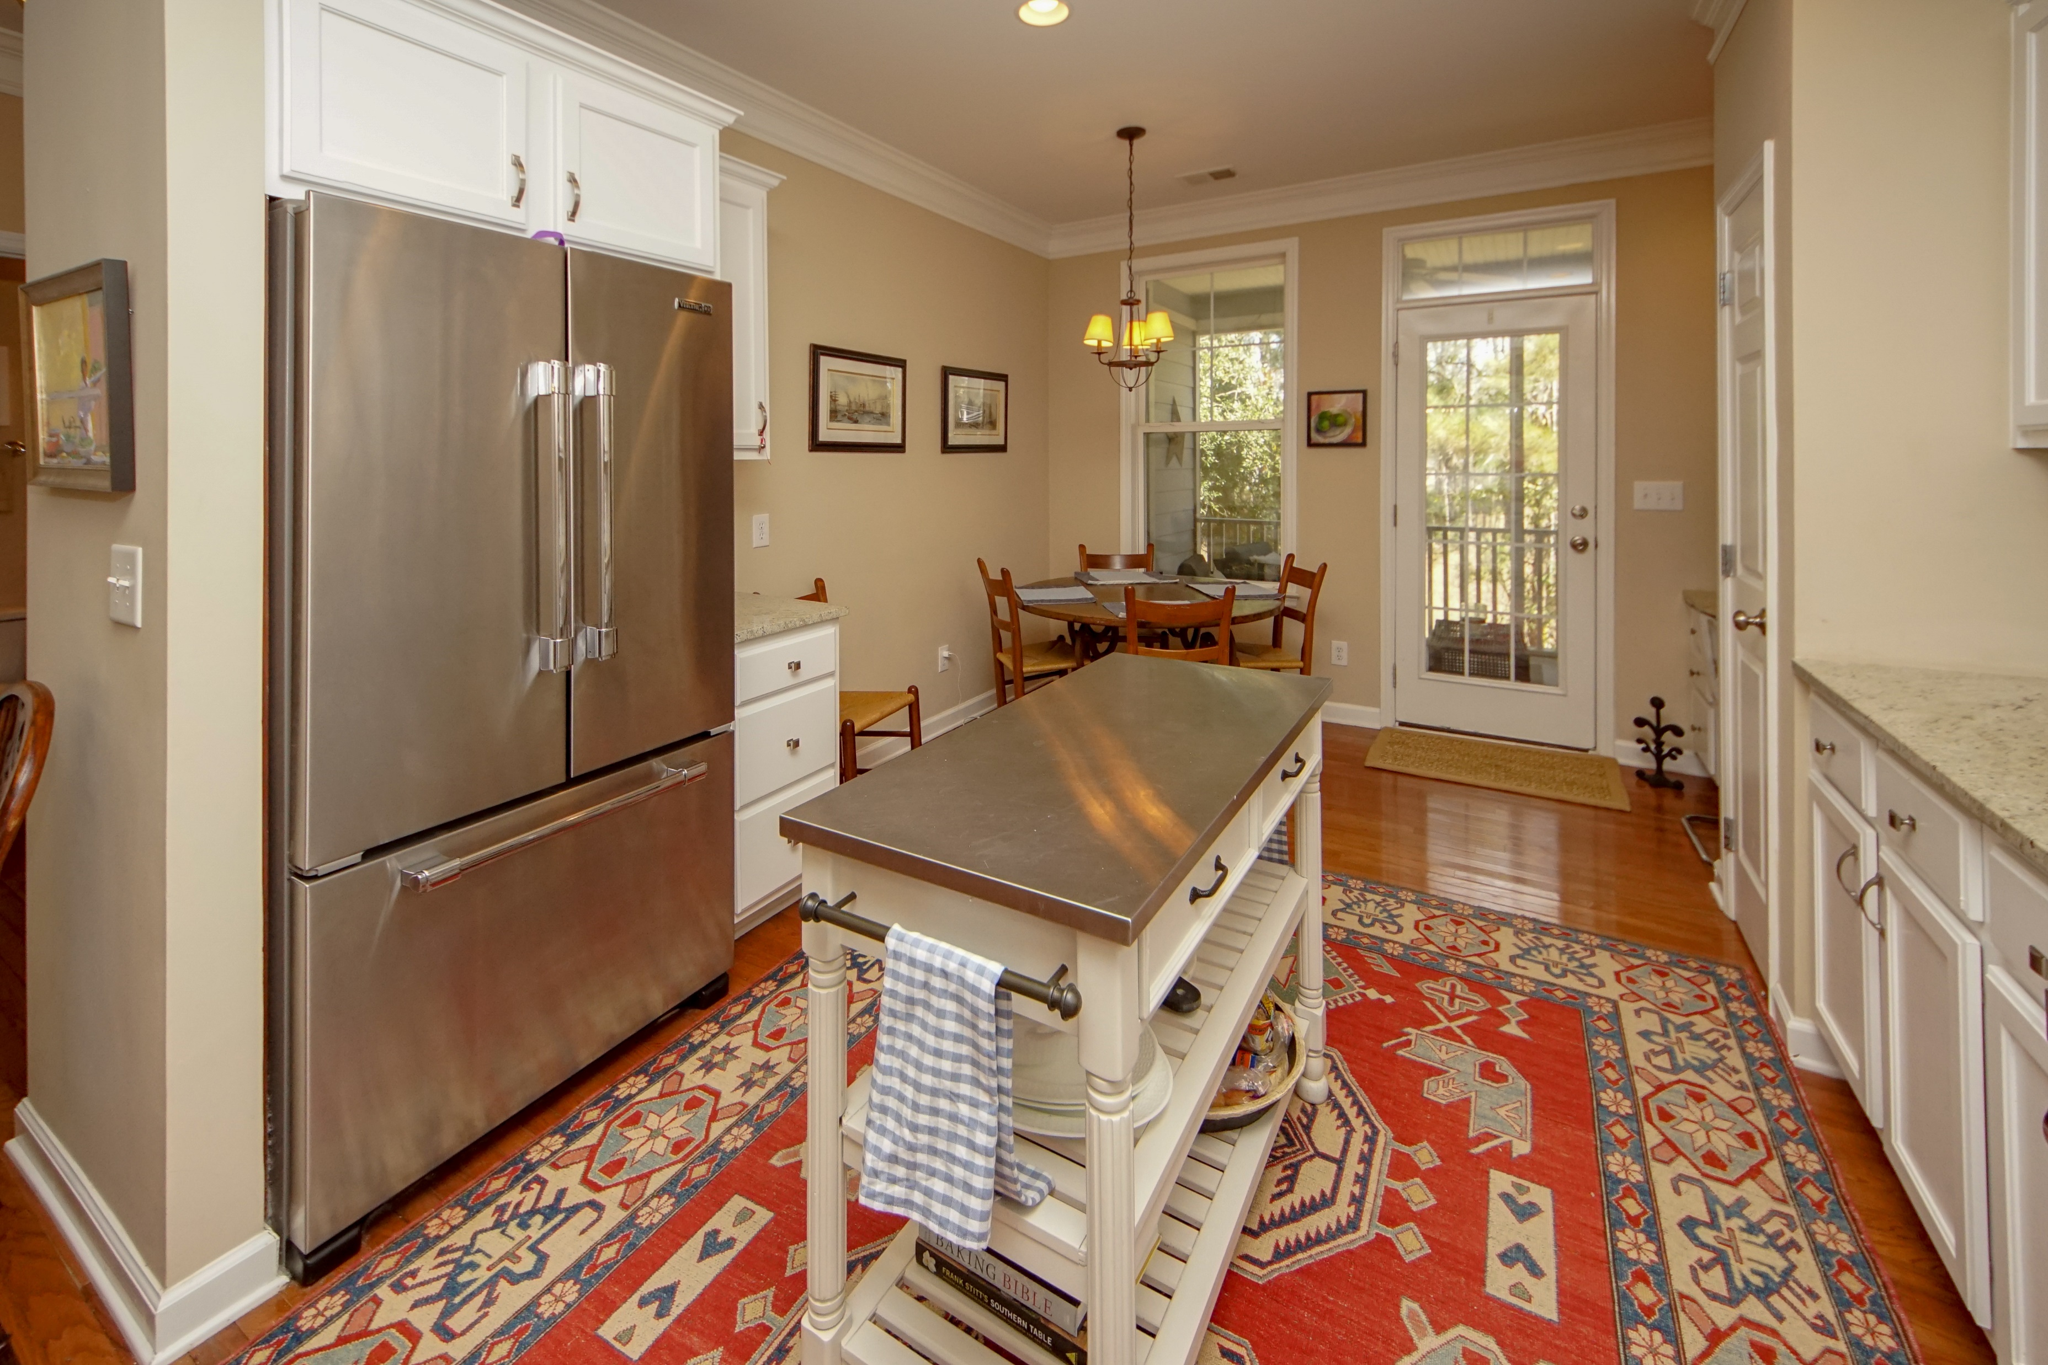
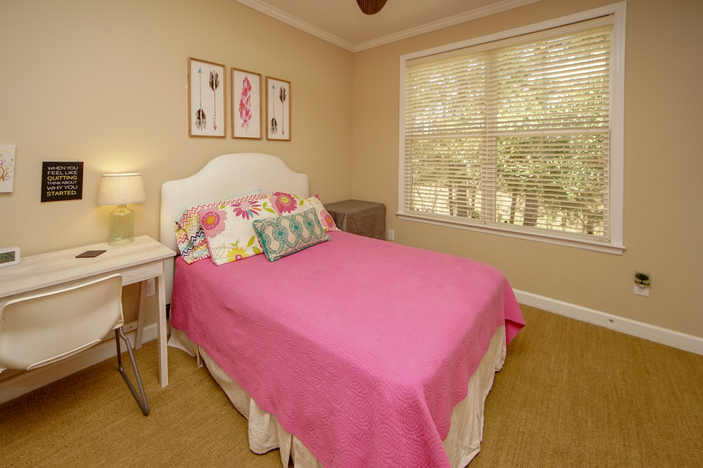
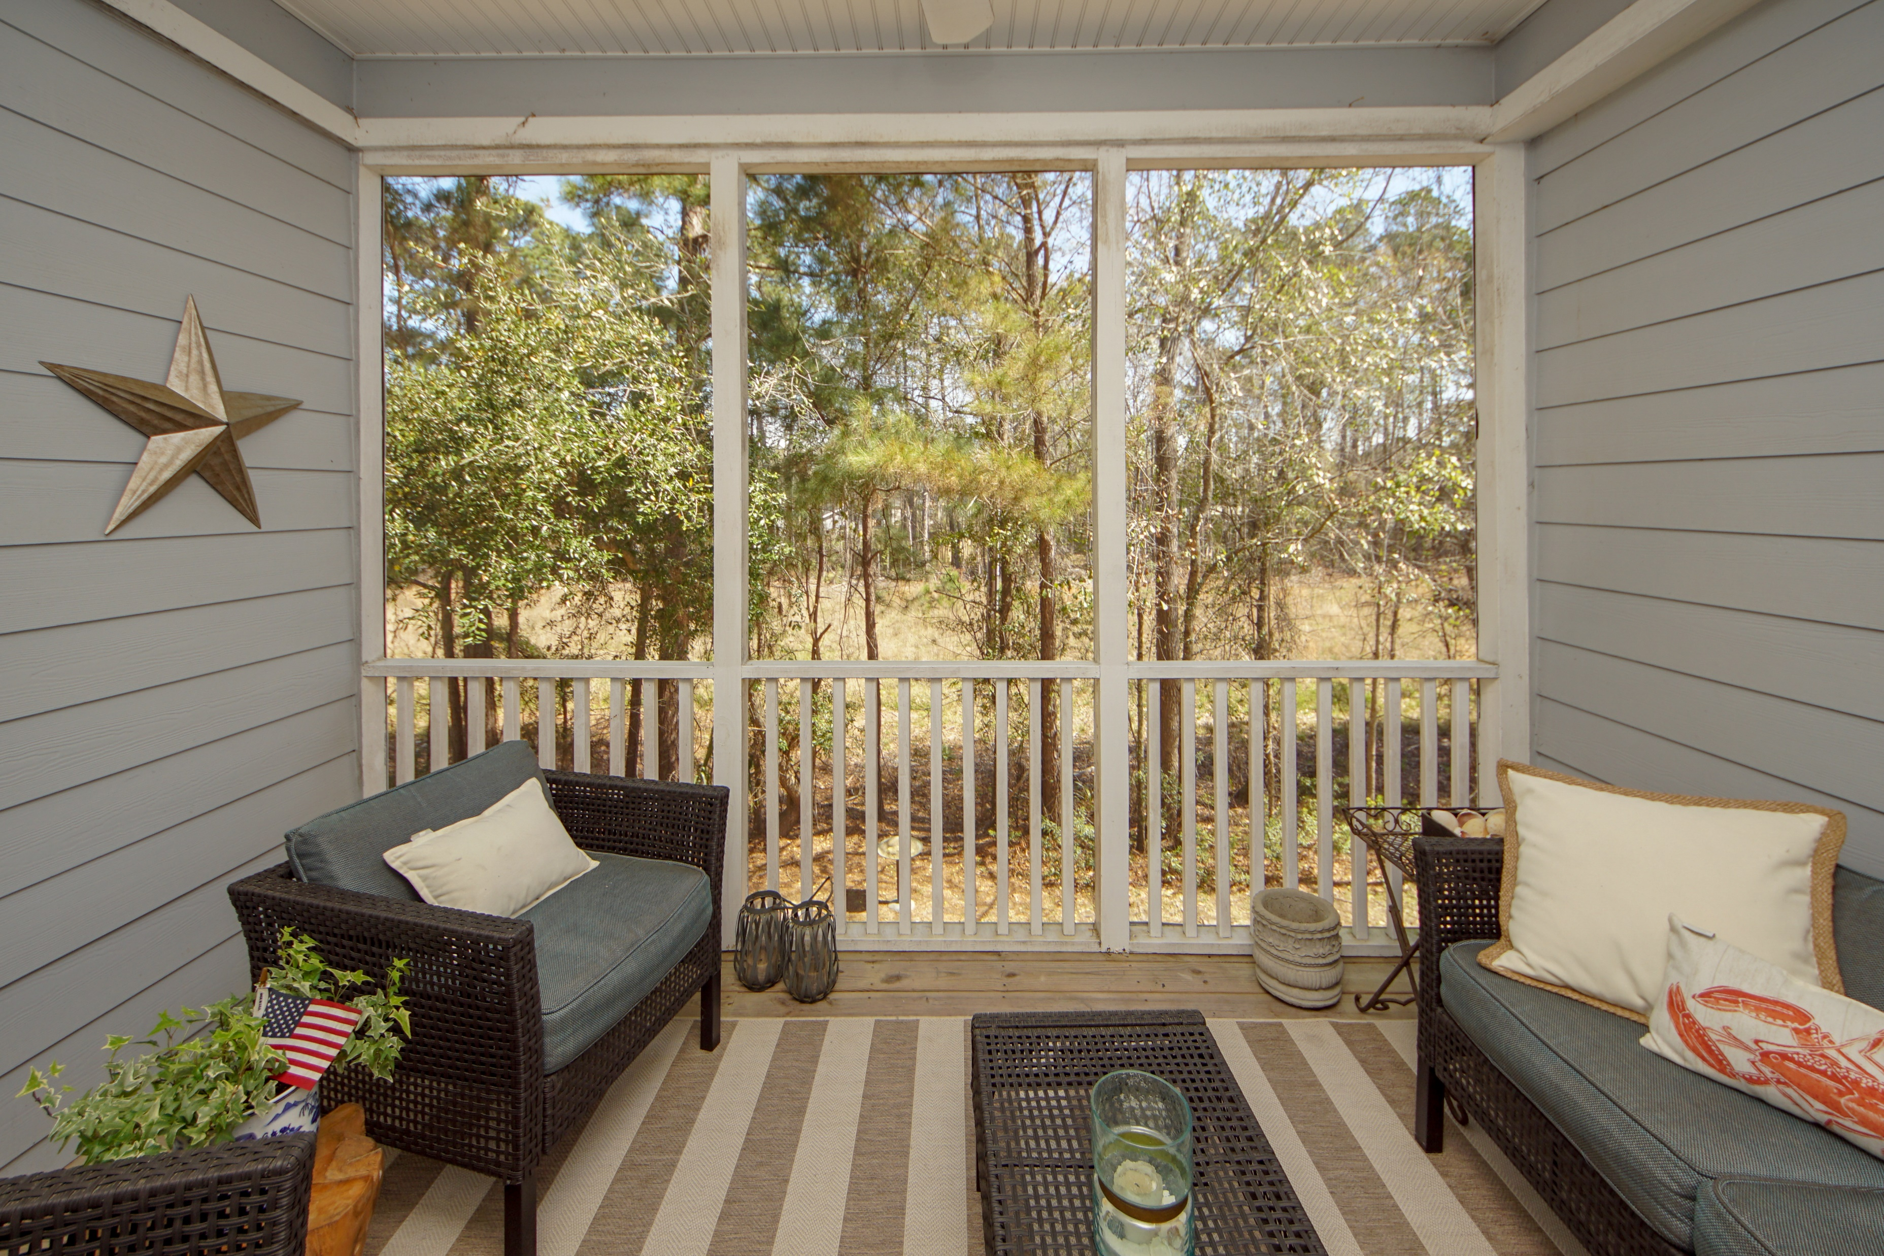
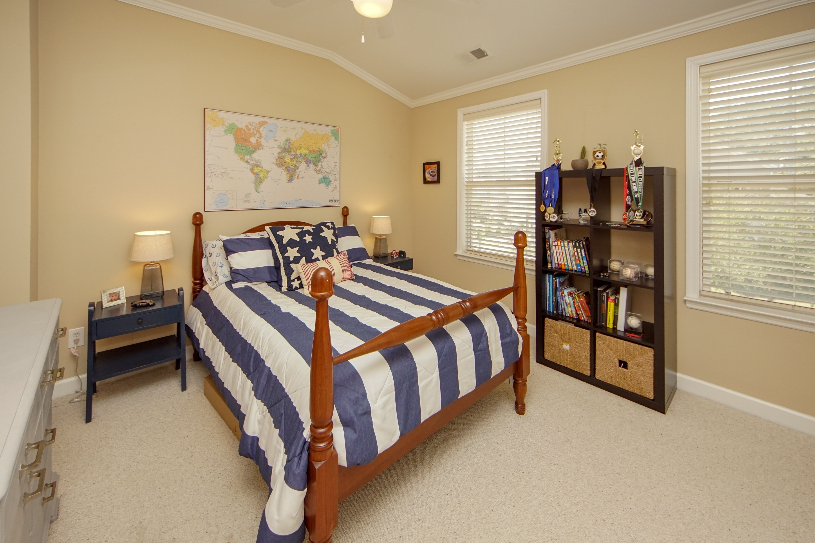
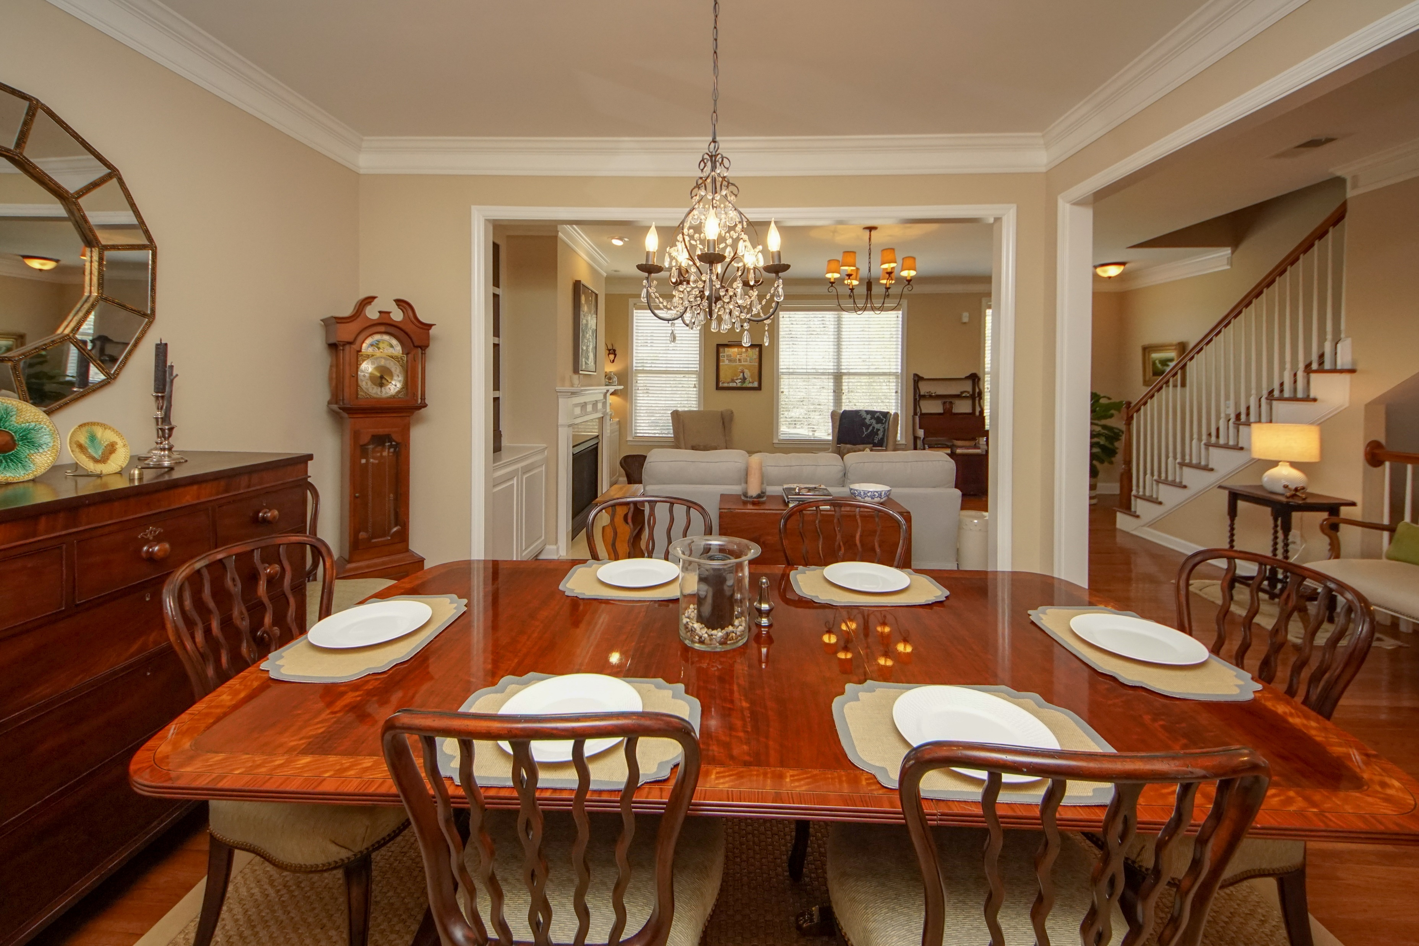
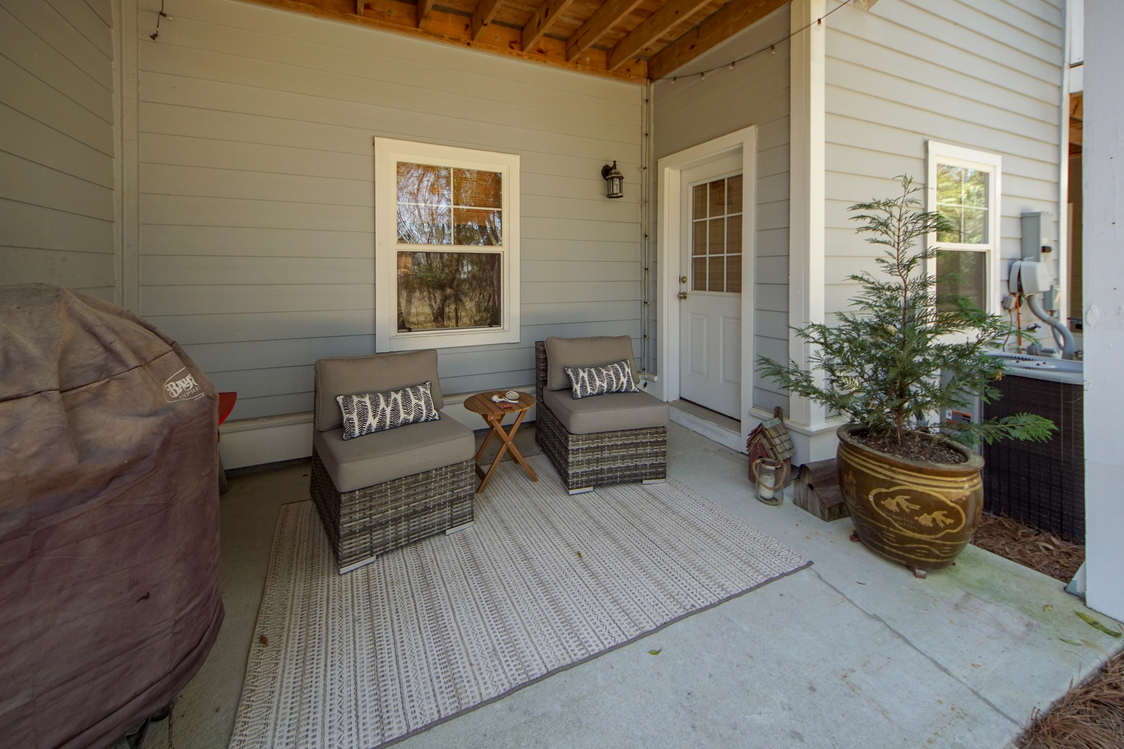
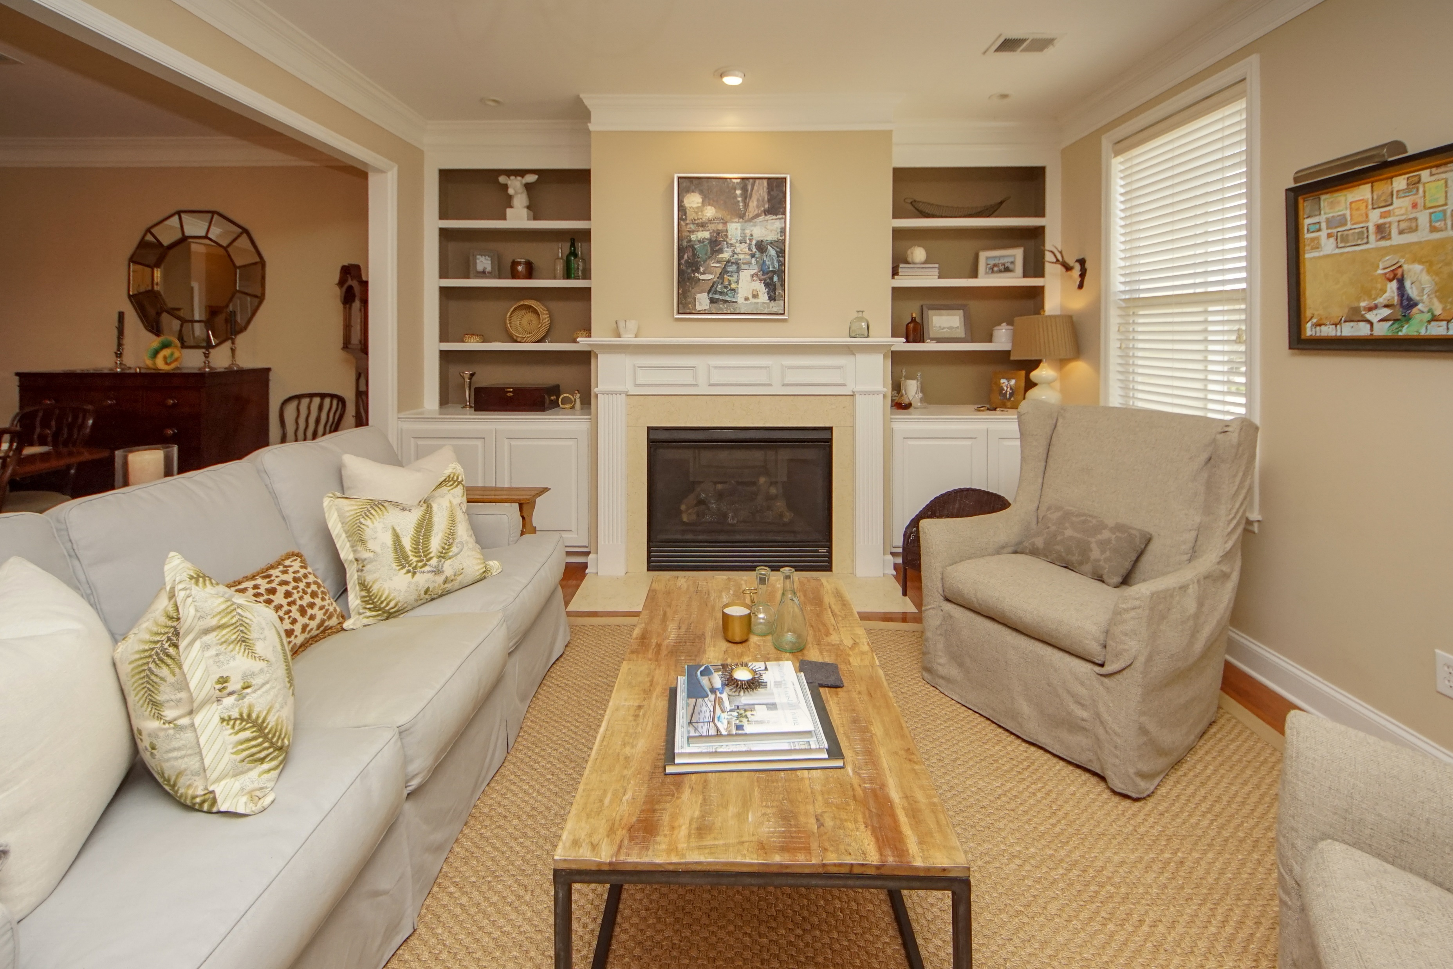
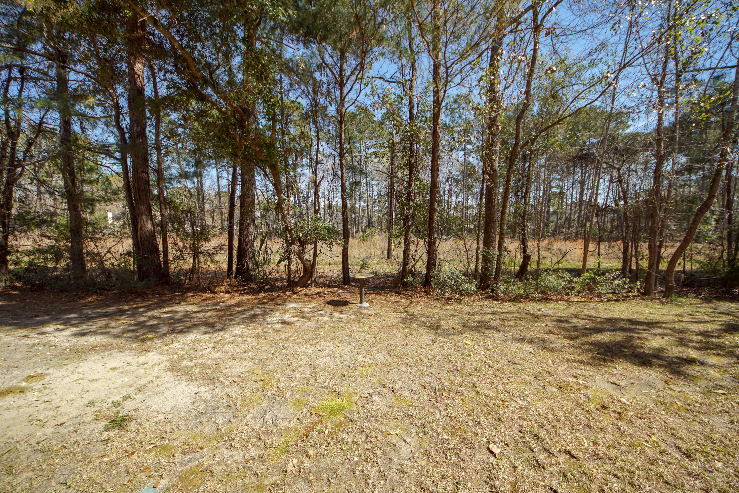


Open House
Wednesday 10:30a-1p
108 Palm Cove Way
Dunes West ~ Mt Pleasant, SC 29466
MLS# 19007351 ~ $410,000
Beautiful 3 story townhome in the award winning gated community of Dunes West. Gourmet kitchen all new Viking stainless appliances, new granite counter tops, and painted cabinets in a open floor plan on the main level. Gorgeous hardwoods throughout the ground and main floors. Finished living area on ground floor is the perfect home office, media room or mother in-law suite. Plenty of storage space with a two car garage. All the amenities you could possibly want and more.
Jason Newhauser
(843) 534-6564
jasonsellscharleston@gmail.com
www.jasonnewhauser.com
Coldwell Banker Residential Brokerage
1127 Queensborough Blvd. 103
Mt Pleasant, SC 29464

