Slide 1
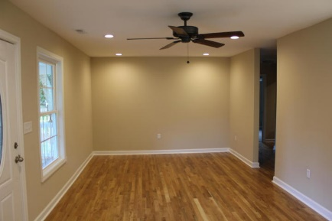
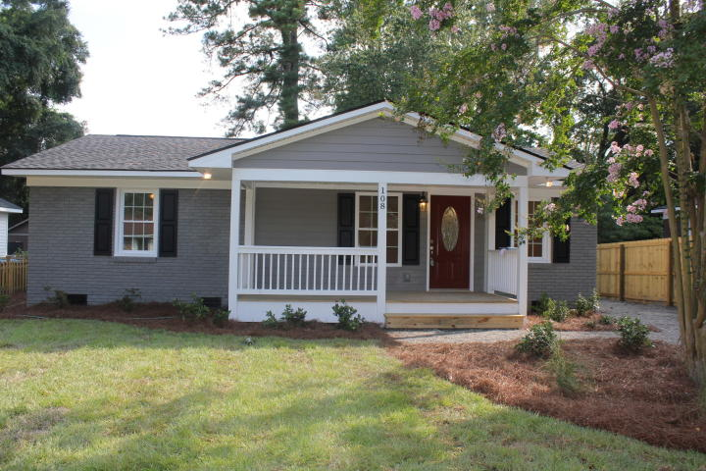
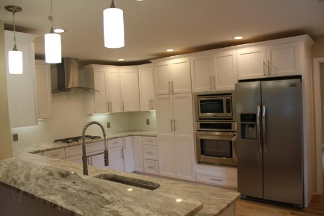
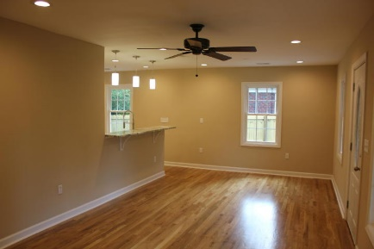
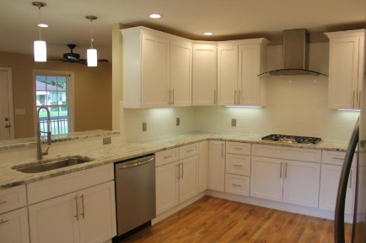
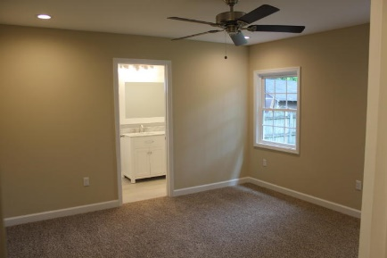
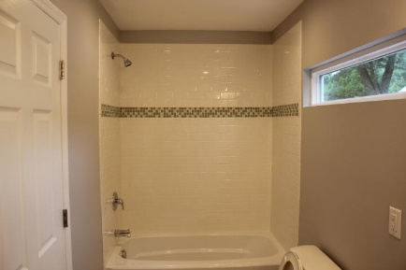
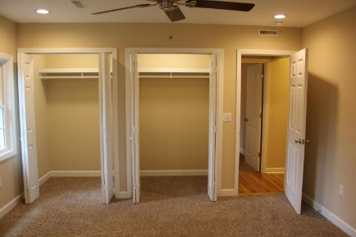
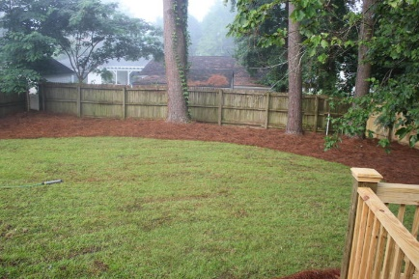


Gorgeous renovation in Downtown Summerville!!
$1,500 agent bonus for contract ratified by August 15, 2015
$2000 Buyer's Agent BONUS!!!
Limited time offer!!
108 Parniece Street ~ Summerville, SC 29483
MLS# 15019024 | $229,900
Beautifully renovated cottage in the heart of historic Summerville! There is brand new plumbing, electrical, hvac, ductwork, insulation, sheetrock, flooring etc. The efficient tank-less Rinnai water heater will accommodate your entire family. Approximately 530sf was just added to this house to make it a spacious 4 bed 2 bath house. As you walk in, you will be amazed when you see the gleaming new hardwood floors, recessed lighting, upgraded white cabinets and premium granite counters in the kitchen. Built-in appliances and a bar top will make this a wonderful living space for your family. There is a separate laundry room through the kitchen that leads to the spacious back deck. The master bedroom features recessed lighting and his and her closets. The master bathroom features a high end double vanity with a gorgeous Carrera marble top. There is beautiful tile on the floor and a custom tile tub-surround. Brand new landscaping was just installed, including a gravel driveway, new sod, and new plants. If you are looking for a like-new home in the heart of Summerville, look no further!
AgentOwned Realty Co.
Premier Group
141 A N. Main Street
Summerville, SC 29483
Michael Marshall
Mobile - (843) 693-5973
michaelbmarshall@gmail.com
www.agentownedrealty.com

