Slide 1

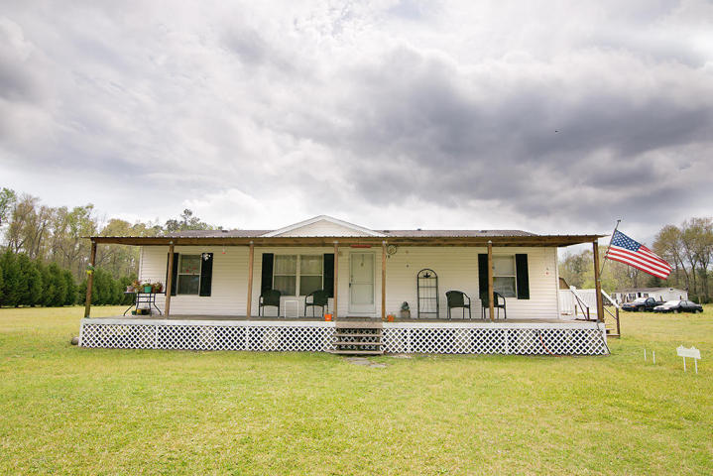
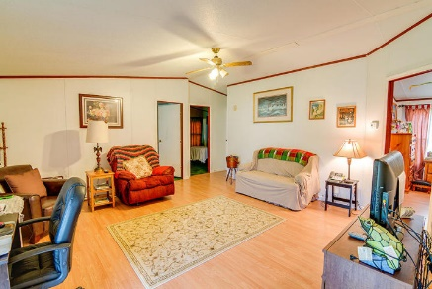
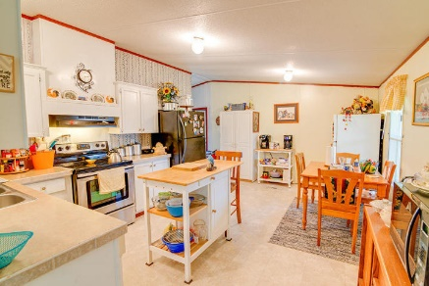
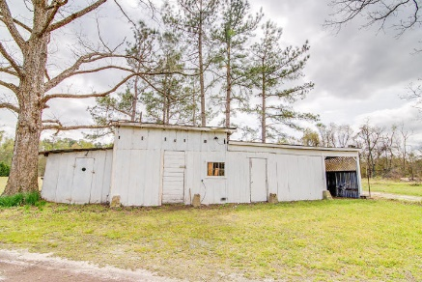

Quiet Country Living
Jacqui Swain
Office (843) 871-1710
Mobile (843) 295-9484
jacquiswainc21@gmail.com
www.JacquiSwain.c21.com
108 Pops Hill Court Ridgeville, SC 29472 ~ MLS# 18015077 ~ $119,000
2,451 sq ft
5 beds · 2 baths
Nestled in a charming country setting this sale includes 2 contiguous parcels that equal 1.78 acres. Home is lovely, 3 bedrooms 2 bathrooms. Large master and good sized secondary bedrooms. Spacious kitchen with eating area. All appliances to convey with sale. Enjoy sitting on your front porch looking over the beautiful scenery. The HVAC system is newer and well pump motor was replaced Oct. 2016. There is also a Metal work shed with carport. Easy access to I-26, shops and restaurants. Property is near the Volvo plant.
Century 21 Expert Advisors | 100 Seven Oaks Lane | Summerville, SC 29485-8514

