Slide 1
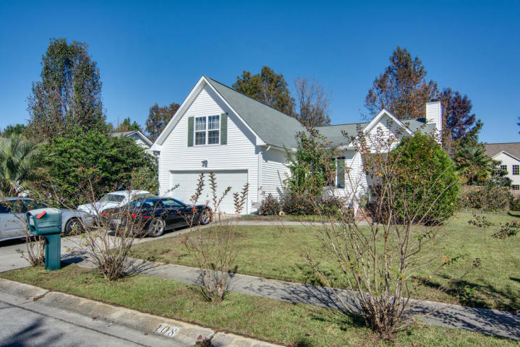
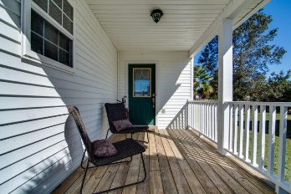
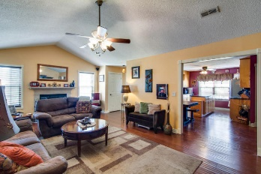
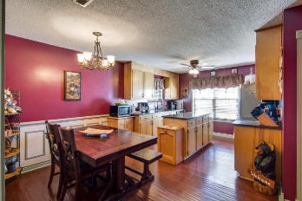
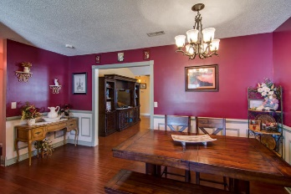
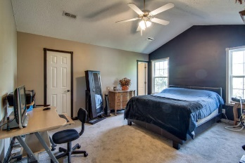
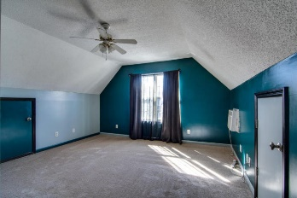
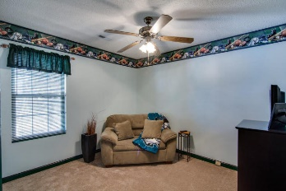
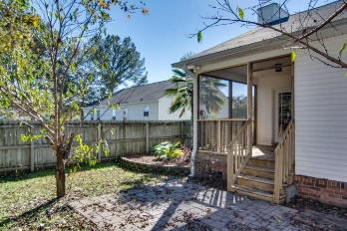
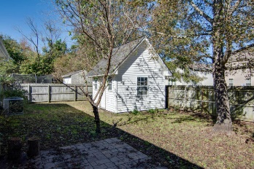
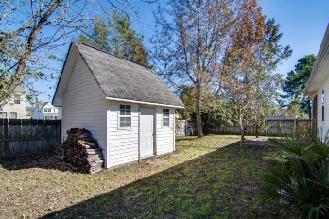


108 Rail Dr
Tramway
Summerville, SC 29483
MLS# 15029503
$164,500
4 Bedrooms | 2 Baths | 1,558 Sq Ft
Charming & Comfortable Living
Available
Nov 1st!
This updated, move-in ready four bedroom, two full bath home with a large eat-in kitchen, large family room with a screened in porch and fenced in back yard with shed that has electricity and is priced below a recent appraisal and is ready to show. As you approach the home, notice how big the freshly painted front porch is. As you enter, check out the hand-scraped hardwood floors, the custom Levelor blinds and that French door that leads to the big back porch which was just re-screened. There is also surround sound all wired in too. ( Speakers do not convey)Then there is that big eat-in kitchen with granite counter tops, huge island, upgraded Moen faucet, brand new garbage disposal, custom Levelor blinds and stainless steel appliances. The roof shingles were replaced within the last six years and the HVAC was replaced in April of 2015. Notice that it has gutters as well. Back porch has new railings and was just rescreened. Be sure to notice the shed matches the house siding. All bedrooms including the frog have brand new carpets. The frog has its own AC/ Heater. There is trim around the windows and doors for added detail. All in all this home has been lovingly cared for and has a lot to offer for the price.
Liz & Bob Simonds
843-437-9696
lizandbob@agentowned.com
AGENTOWNED REALTY CO. PREMIER GROUP, INC.
141-A N. MAIN STREET
SUMMERVILLE, SC 29483

