Slide 1
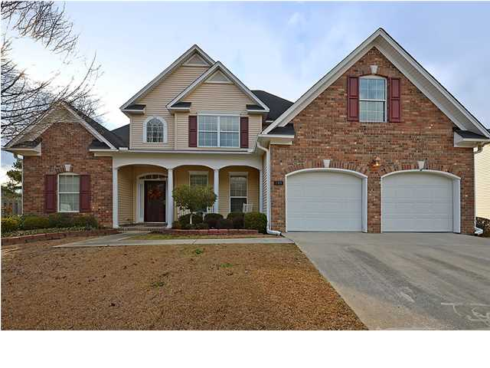
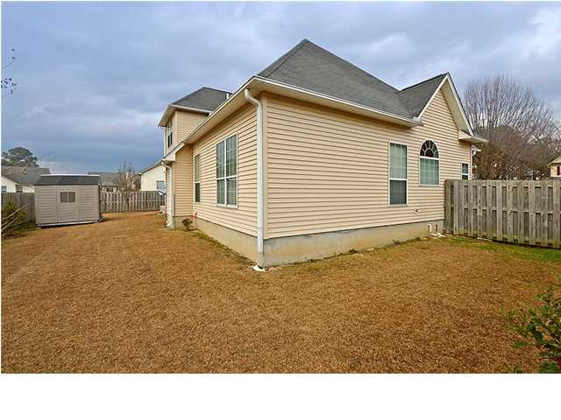
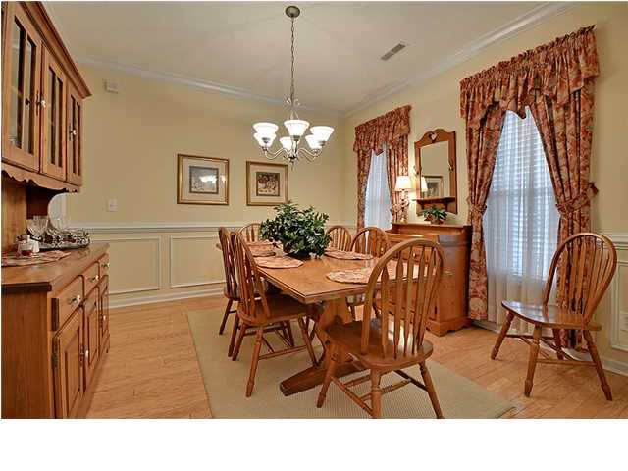
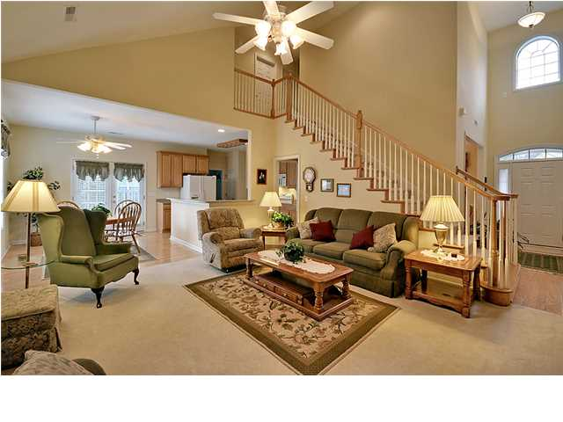
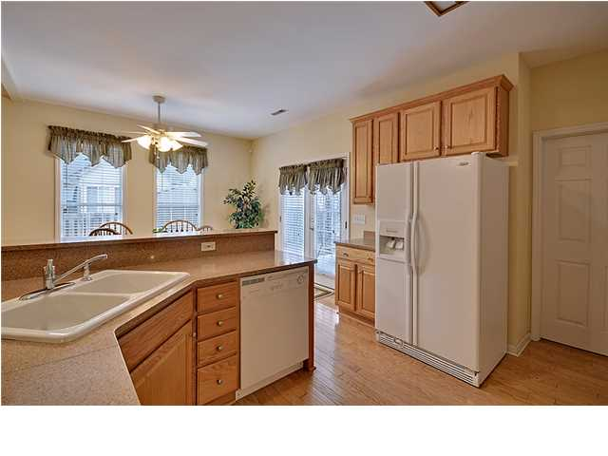
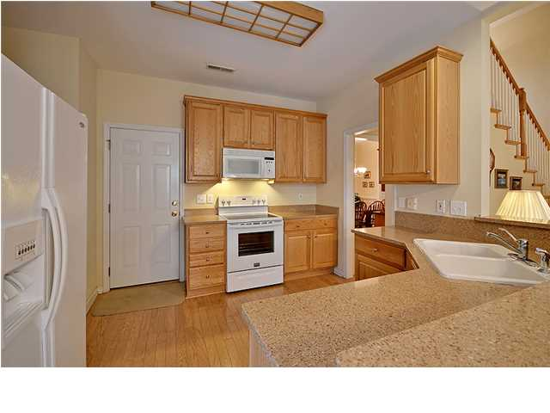
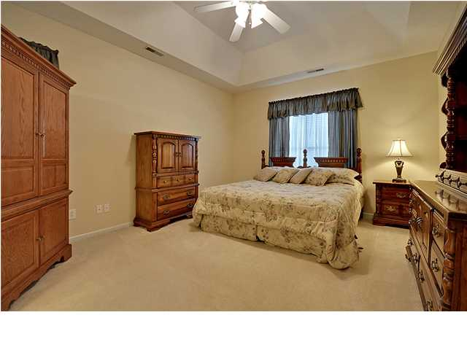
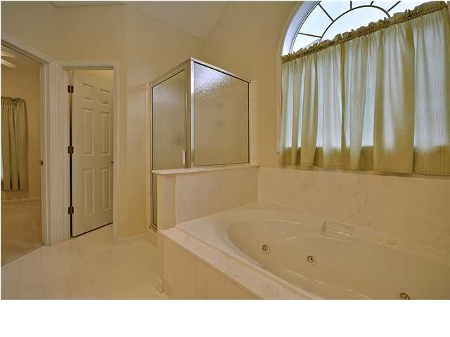
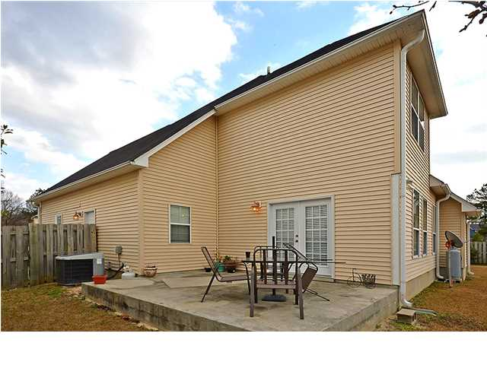

Welcome Home!
108 Seneca Cir ~ Westminster Heights ~ Goose Creek
MLS# 1402058 ~ $209,000
If you've been searching for a home that's warm and inviting, come on in to experience all that this three bedroom, two and a half bath, brick front home in Westminster Heights has to offer. With close to 2,000 square feet of living area, you'll be able to sense the open floor plan as soon as you enter the two story foyer. Walk right into the living room with its soaring vaulted ceiling and the gas fireplace at the heart of the home. An eat-in area off the kitchen allows you to visit with those in the living room and grants access to the outside patio. Hardwood floors continue from the kitchen with it's breakfast bar, right into the formal dining room where chair rail molding and wainscoting make dining a delight. The first floor owner's retreat boasts a tasteful tray ceiling, a gigantic walk-in closet and en-suite bath with a dual vanity, walk-in shower and relaxing garden tub. The FROG can easily be used as a fourth bedroom or makes for a spacious bonus room. In addition to the storage cabinets in the two car garage, the shed located in the fenced-in backyard provides more room to store outdoor equipment. The community of Westminster Heights is conveniently located to shopping, parks, dining and schools, allowing you to spend more time in this peaceful setting and less time on the road. Be sure to come on by and see this gorgeous home before it's gone!
*Seller offering a $2,000 credit for paint and flooring updates with an acceptable offer
Call or email for details: (843) 642-3546 or ben@mattoneillteam.com

