Slide 1
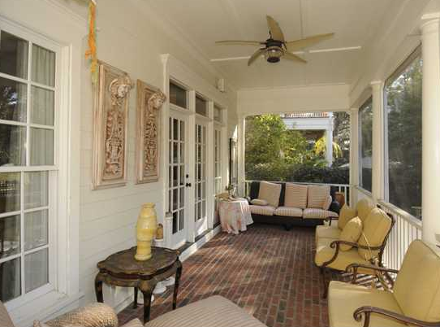
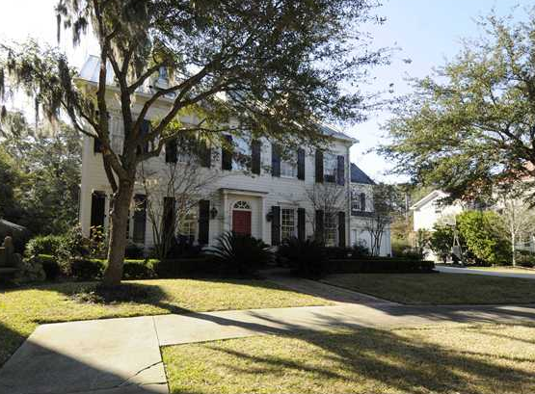
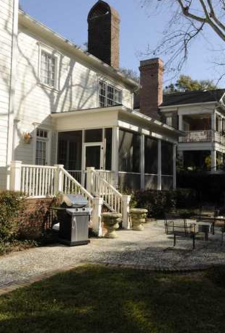
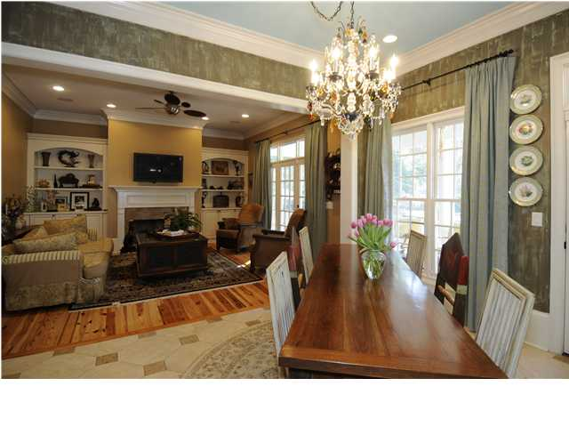
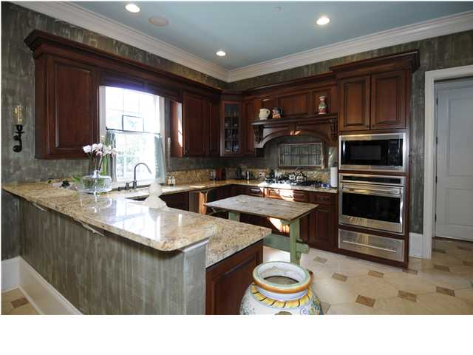



108 Wando Reach Ct, Remley’s Point, Mt Pleasant
Are you looking for a feel of the South? A home with traditional Charleston flare!
Centuries old moss draped oak trees, located near the river, and the ability to be in historic Charleston in minutes or the beach. Picture yourself entering the exclusive Wando River community of Remley's Point through your privately walled cobblestone entrance, passing by an elegant park with fountain and pond, and to top the list...a community dock with stunning views of the Wando River, especially at sunset.
Asking $925,000
MLS# 1301736
4,548 SqFt
6 Bed/6 Baths
Charming garden for entertaining
Don Dawson
3040 Highway 17 North • Mount Pleasant, SC 29466 843-514-0452 • ddawson@carolinaone.com
www.TeamDawsonSC.com

