Slide 1
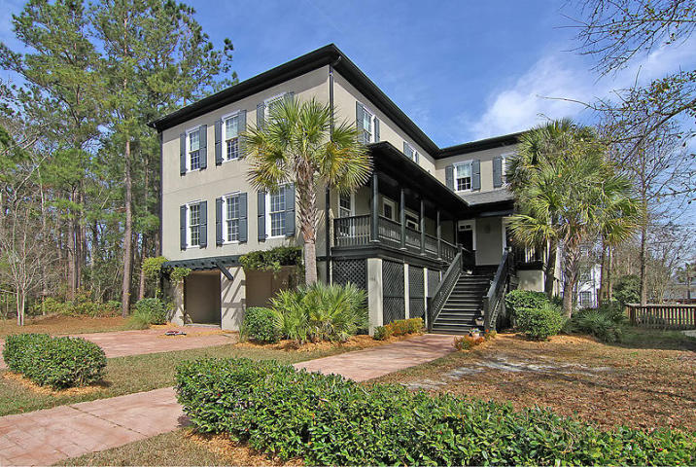
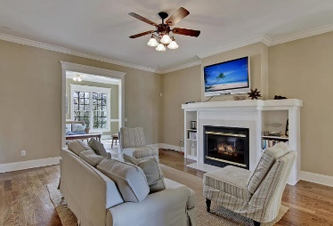
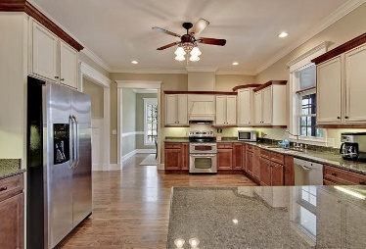
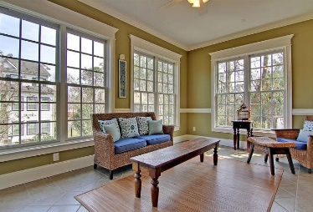
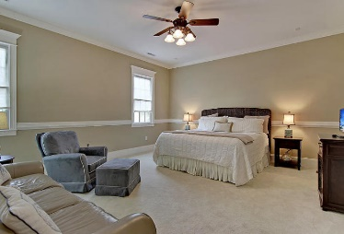
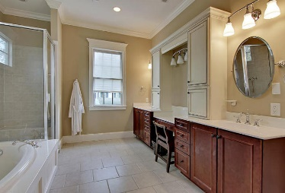
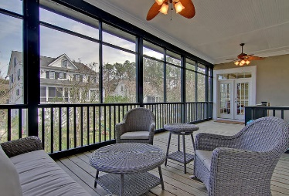
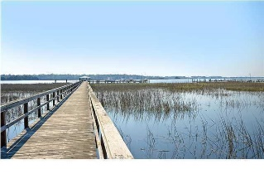

108 Wando Reach Road
Wando Point · Wando, SC 29492 · MLS# 17006012 · $675,000
Loaded with Updates
Loaded with Updates
GORGEOUS 4200 sqft custom built Charleston style elevated home in GATED neighborhood with community dock. This home is a second home and is in great condition. This 4 bedroom, dual masters, 4 full 2 half bath home features four inch hardwood floors throughout first floor, an abundance of natural light, gas burning fireplace, gas tankless water heater, ceramic tile in large sunroom, and room to park 4 cars plus additional storage! Home has formal dining room, den/study, dual masters with his and her walk in closets, upstairs masters suite has a jetted tub. Huge playroom/gameroom/entertainment room. Each bedroom with private bath. Oversized laundry room upstairs with tile flooring. Large screen porch connects to dining room and sunroom.
Kitchen features custom cabinets, granite countertops, Bosch dishwasher, Maytag flat top cook surface with dual convection oven, and huge pantry in kitchen. Home is prewired for security, sound and computer networking. Crown moulding throughout, with fine detail on trim and closets. Exterior features lawn irrigation system, extensive landscaping, front porch with pressed tin ceiling. Working shutters and Charleston style porch give this home a wonderful Lowcountry appeal. Wando Pointe is a gated community with green space and a large community dock! The neighborhood is close to local shopping and is a short drive to downtown Charleston with 5-star restaurants, world class shopping and iconic history and a short drive to the beaches, the airport, and Boeing! New High School to open in August 2017! This home has everything!
Stan Huff
843-670-2835
stan.huff@agentowned.com
Jill Marcacci
843-297-5590
jill@agentowned.com
www.agentownedrealty.com
AgentOwned Realty Co. Preferred Group, Inc. | 824 Johnnie Dodds Blvd | Mt Pleasant, SC 29464

