Slide 1
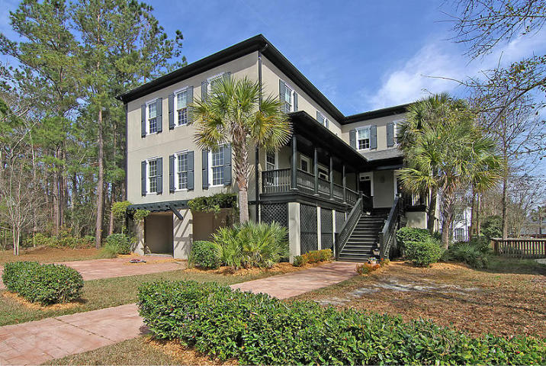
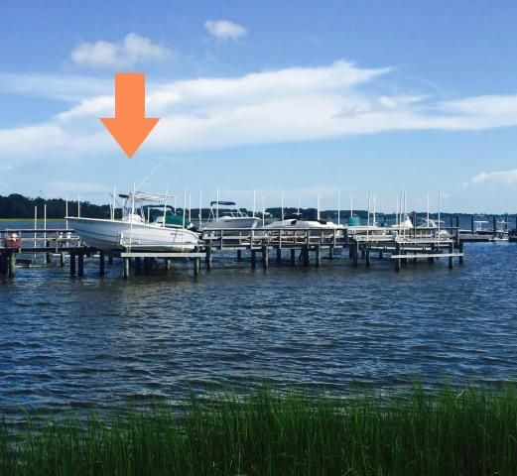
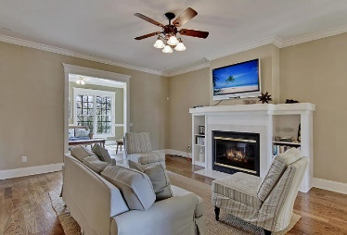
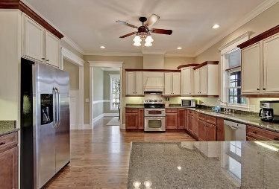
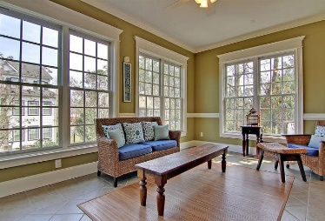
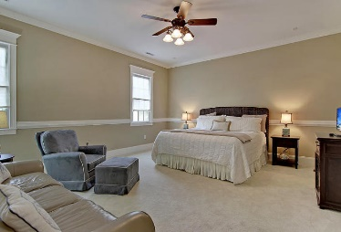
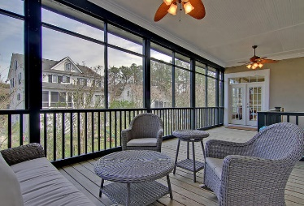
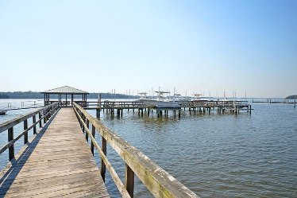

108 Wando Reach Road Wando Point · Wando, SC 29492 · MLS# 17030664 · $775,000
Deepwater Dock & Boat Slip!
Loaded with Updates
GORGEOUS 4200 sqft CUSTOM built Charleston style elevated home in GATED neighborhood with DEEP WATER BOAT SLIP and LIFT at community dock. The lift will accommodate up to a 33 foot, 12,000 lb boat. 4 CAR GARAGE can hold a trailer and NO FLOOD Insurance required! This home is seller's second home and is in great condition. Beautiful 4 bedrooms, dual masters one up one down, 4 full and 2 half baths-home features four inch hardwood floors throughout first floor, an abundance of natural light, gas burning fireplace, gas tankless water heater, ceramic tile in large relaxing sunroom, plus additional storage! Home has formal dining room, den/study, dual masters with his and her walk in closets, upstairs masters suite has a jetted tub. Huge playroom/gameroom/entertainment room. Each bedroom with OWN PRIVATE bath-no sharing required! Oversized laundry room upstairs. Large screen porch connects to dining room and sunroom. Kitchen features custom cabinets, granite countertops, Bosch dishwasher, Maytag flat top cook surface with dual convection oven, and huge pantry in kitchen. Home is prewired for security, sound and computer networking. Heavy crown moulding throughout, with fine detail on trim and closets. Exterior features lawn irrigation system, extensive landscaping, front porch with pressed tin ceiling. Working shutters and Charleston style porch give this home a wonderful Lowcountry appeal. Wando Pointe is a gated community with green space and a large community dock! The neighborhood is close to local shopping and is a short drive to downtown Charleston with 5-star restaurants, world class shopping and iconic history and a short drive to the beaches, the airport, and Boeing!
This home has everything!
Stan Huff
843-670-2835 stan.huff@agentowned.com
Jill Marcacci
843-297-5590 jill@agentowned.com
www.agentownedrealty.com
AgentOwned Realty Co. Preferred Group, Inc. | 824 Johnnie Dodds Blvd | Mt Pleasant, SC 29464

