Slide 1

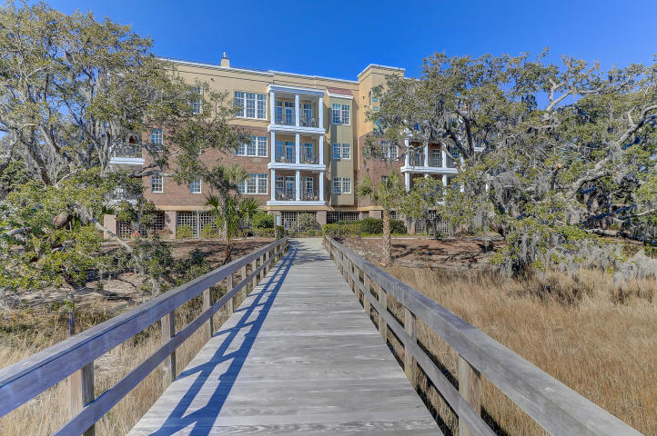
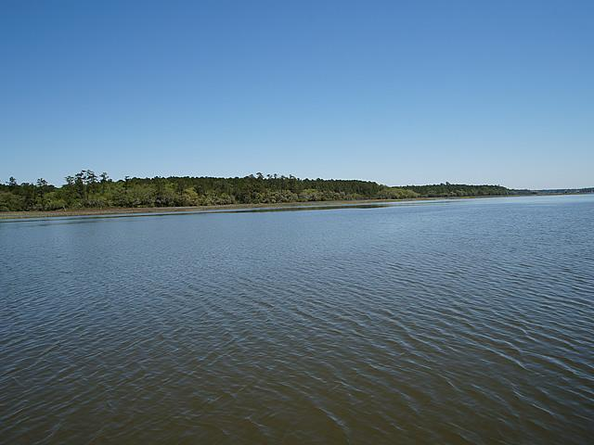
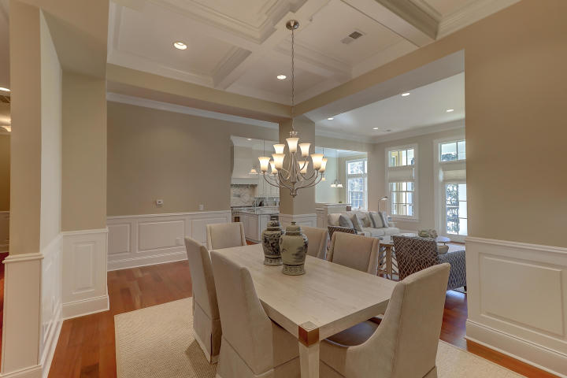
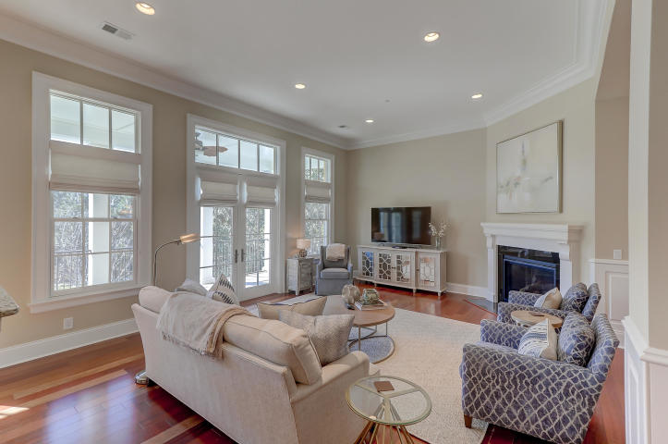
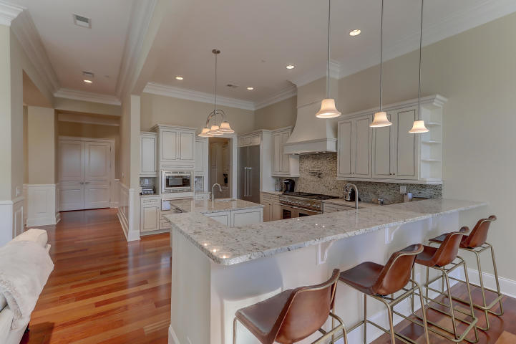
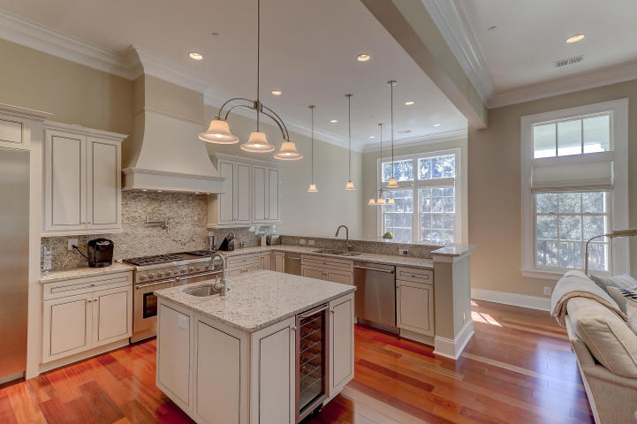
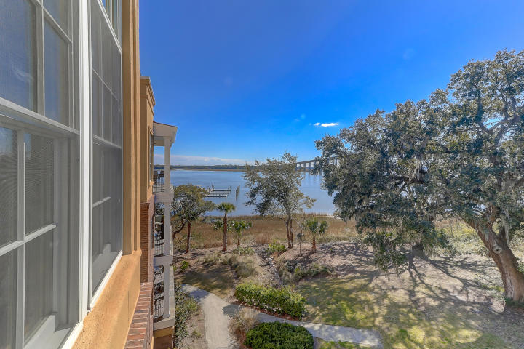
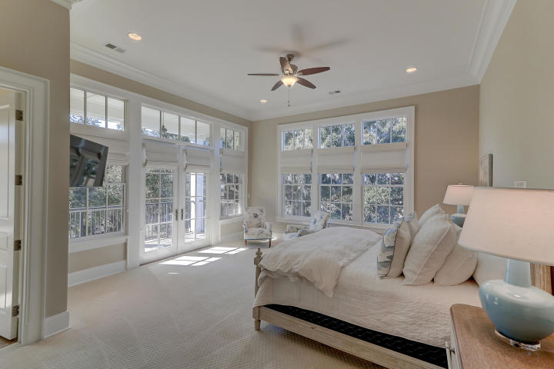
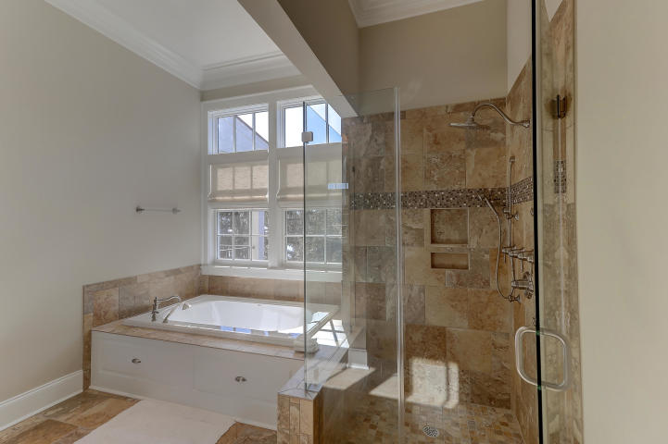
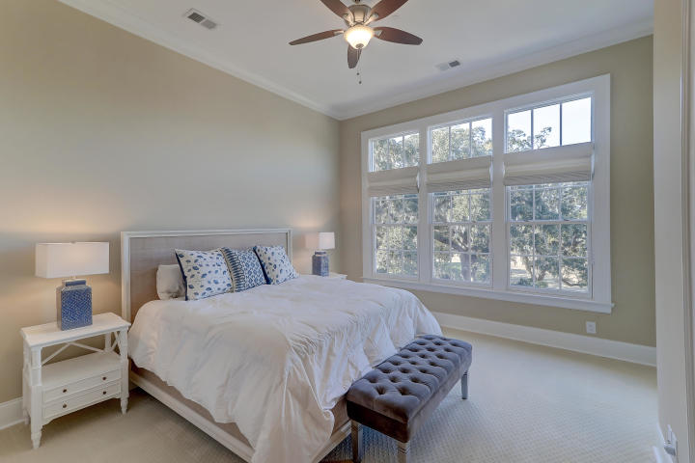
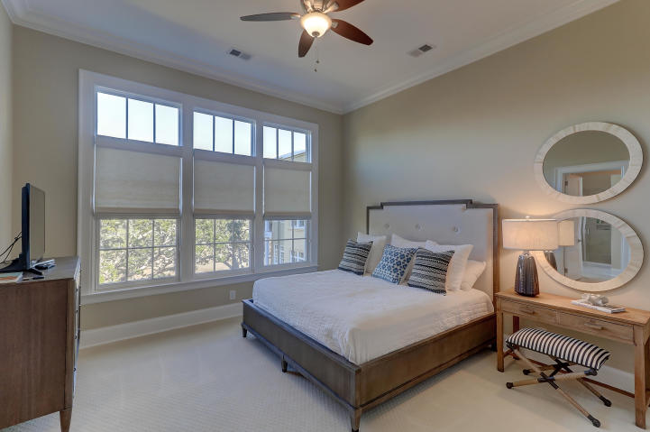
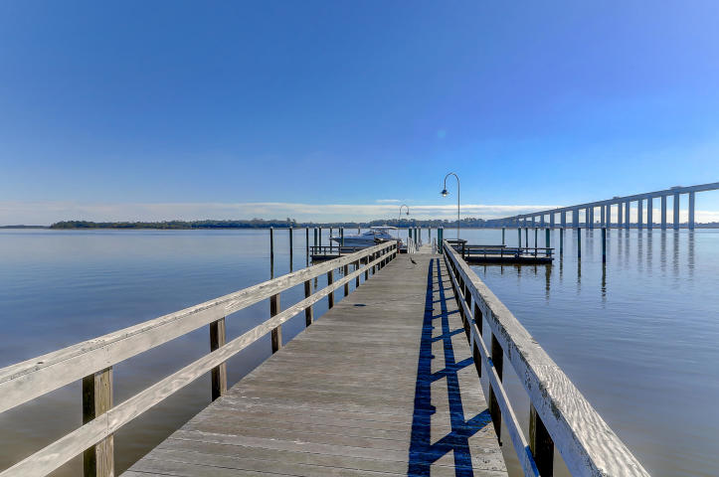
Owner is Anxious!
108 Fairbanks Oak Alley #403
Daniel Island, SC 29492
MLS# 19002665 | $1,295,000
This is a private luxurious condo with views of the Wando River & Marsh, located near shopping, schools, employment, entertainment, & restaurants. Each unit is deeded a 50' boat slip. This condo has a gourmet kitchen featuring a designer appliance package, granite countertops, a ceramic tile kitchen backsplash, & walk in pantry. Enjoy views from the porches with entries from the living room & eat in kitchen. Hardwood flooring, carpet, & ceramic tile. Jetted master tub, glass enclosed shower, & custom cabinets. This unit has 2 secured parking spaces below & an elevator that services the floor. Roof is rubber membrane.
Charles Salmonsen
M (843) 224-0300 | O (843) 388-6613 | charles@salmonsen.com
Salmonsen Realty | 864 Lowcountry Blvd Ste B | Mt Pleasant, SC 29464

