Slide 1
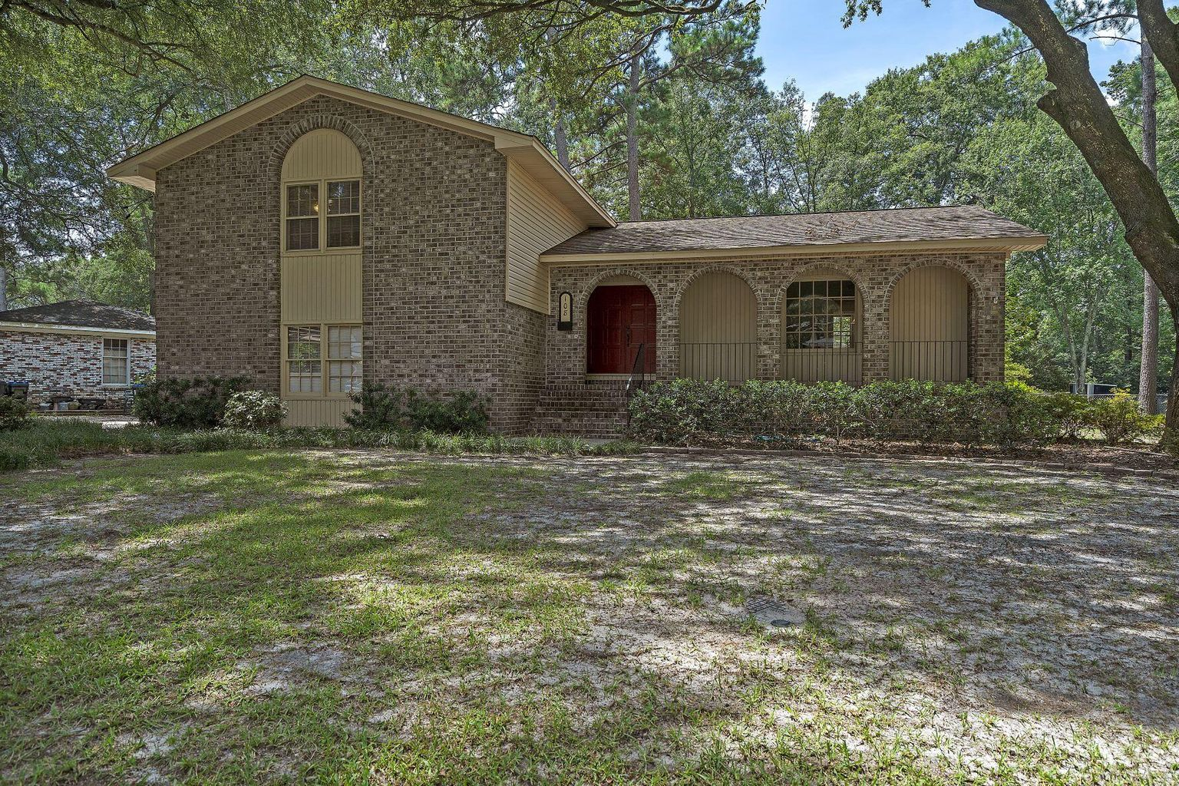
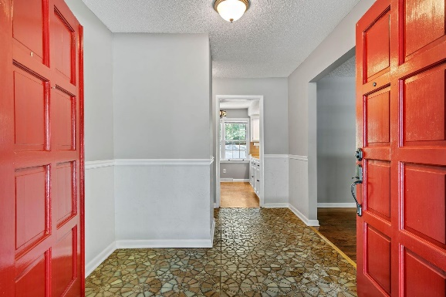
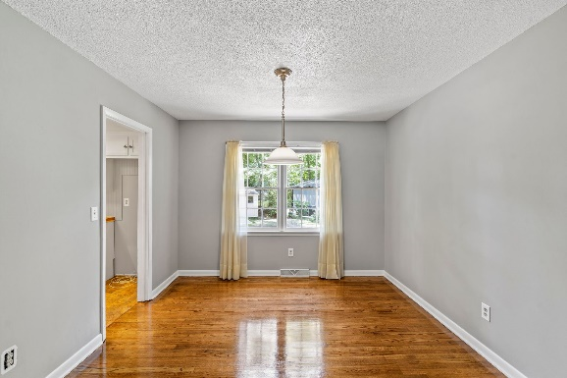
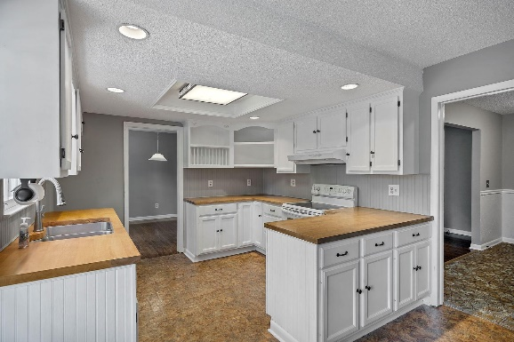
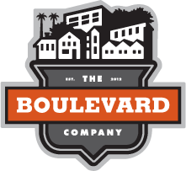

Just Listed, Updated Home In Summerville
108 Arbor Road
Rose Hill | Summerville, SC 29485
MLS# 22021506 | $360,000
Beautiful home on a large lot with many updates, close to everything downtown Summerville has to offer. Brand new HVAC, new paint inside, new carpet, refinished hardwoods, and tons of living space make this home shine. Nestled in a quiet neighborhood surrounded by other well maintained homes, but with multiple ways to exit the neighborhood you can be near shopping, dining, or historic Summerville in just a couple minutes. DD2 school zoning with Summerville Elementary also.
Justin Natale
843-437-9739 | jnatale1982@gmail.com
www.theblvdcompany.com
The Boulevard Company, LLC | 806 Johnnie Dodds Blvd Ste 100 | Mt Pleasant, SC 29464

