Slide 1
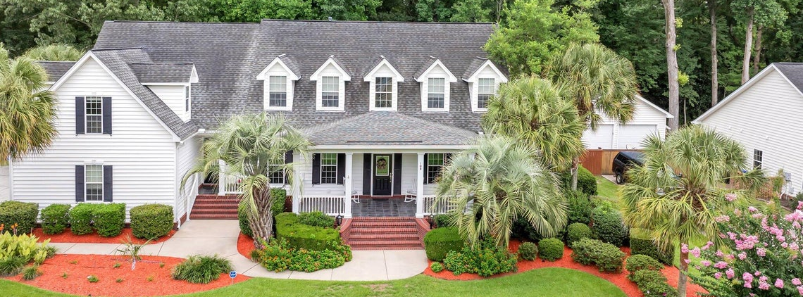
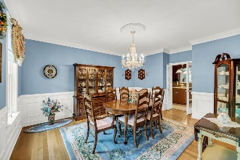
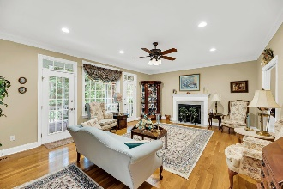
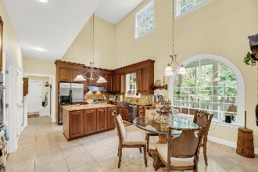
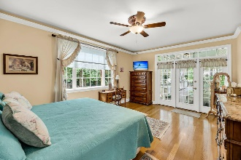
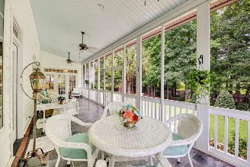
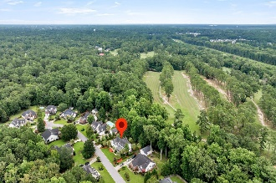
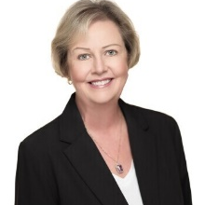

OPEN HOUSE SUNDAY AUGUST 18TH 12-4PM
108 Duck Blind Court
Boykin Creek | Summerville, SC 29483 | MLS# 24018647 | $769,000
This classic gem on 0.84 acres, in a cul-de-sac with only 13 homes, has all the upgrades you could want. This was a builder's home so everything is high-end and custom built including extensive crown moulding, chair rail, wainscoting and rosette-adorned door frames and HUGE WALK-IN ATTIC for storage. The front of the home welcomes you with curved brick stair walls and gas lamps. The full front porch and back screened porch have tile floors. The first floor boasts a 2-story foyer, glistening oak floors, a music room with built-in shelving and cabinetry, formal dining room large enough for a grand-sized table and sparkling crystal chandelier which conveys! The huge family room has a gas-log fireplace and 2 doors leading the screened porch. The fabulous kitchen is a chef's delight with a 6-burner gas cooktop, double convection ovens with warming drawer, farm sink, roho granite countertops and backsplash, island, wet bar with wine rack, breakfast area, microwave, refrigerator and 18" Spanish stone floors in the kitchen, back hallway and laundry room which has a service entrance, built in cabinetry and sink. Washer & dryer convey. The master suite has access to the screened porch, huge walk-in closet and private bathroom complete with marble floors, jetted tub, full-sized shower and dual sink vanity. Dual stairs lead to the second floor with 3 bedrooms, 1 en suite bathroom, 1 hallway bathroom, and HUGE FROG! Bathrooms have marble floors and circulating tubs. The backyard is an oasis including a fountain, lush landscaping, patio, fireplace and gas access for a grill. Iron fencing allows a private view of the golf course. The 2 car garage has epoxy floor, extra storage, cabinet with sink, pegboard and work bench. Energy saving upgrades include a fully encapsulated crawlspace, solar film on [some]windows and tankless water heater. Each floor has its own Gas Pak HVAC - upstairs (2021) and downstairs (2020). HOA has a path to take your golf cart to Summerville Country Club for golf enthusiasts or to take your furry friend for a walk! Don't miss out on this beautiful home. See it today!
VIDEO TOUR | VIRTUAL TOUR
Elise Stutts
843-437-5242
ehstutts@carolinaone.com
www.carolinaonerealestate.com
Carolina One Real Estate | 900 N Main St. | Summerville, SC 29483-6633

