Slide 1
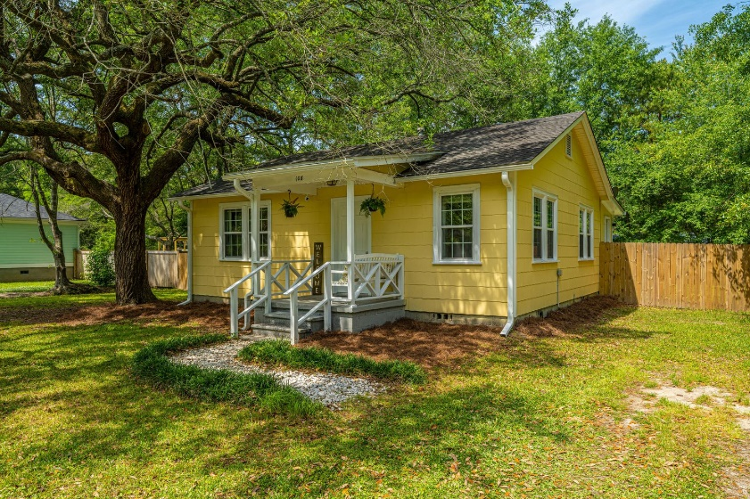
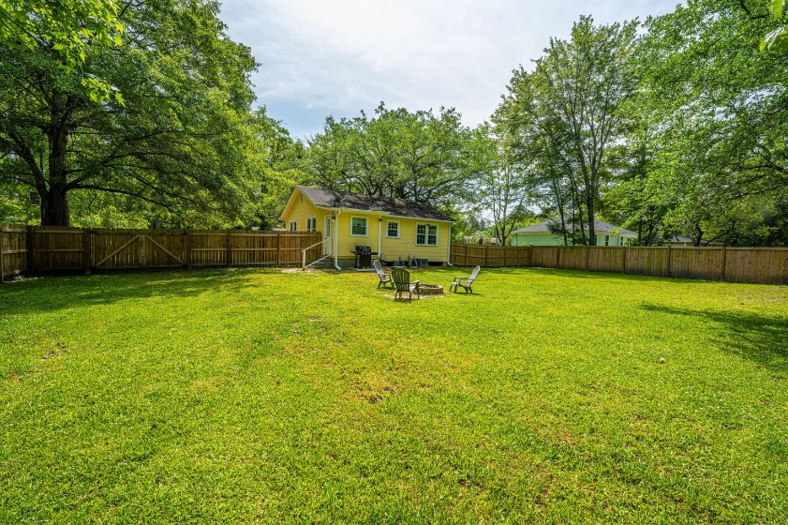
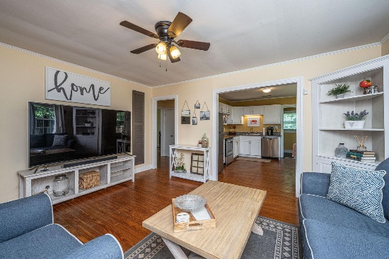
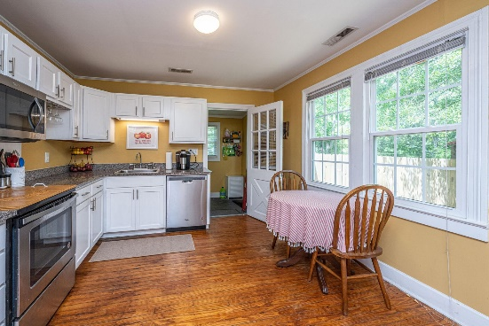
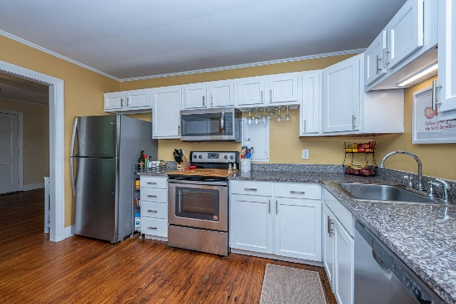
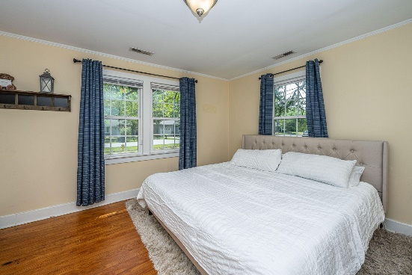
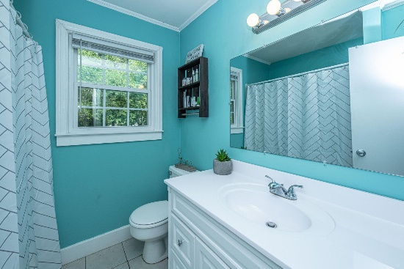
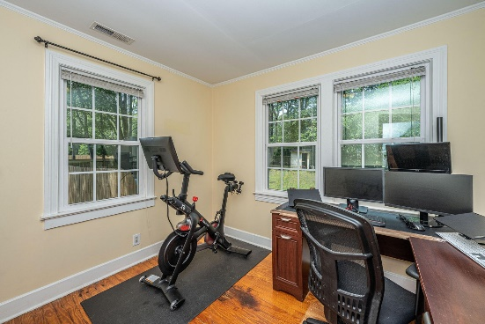



Why wait for new construction?
This Park Circle area home is LESS THAN 2 YEARS!
Summerville House - $230,000
108 Pinewood Drive
Warington · Summerville, SC 29483 · MLS# 22011409
Welcome to 108 Pinewood Drive in beautiful Summerville, SC! This 2 bedroom, 1 bath home sits on 0.45 acres with a fully-fenced in backyard. You have to schedule a showing to see how big it is. Along with the huge lot, the house has a great floorplan. Please check out the Matterport visual tour. The windows have been updated, roof is about 5 years old and the water heater was replaced in 2020. The location is great as you are 5 mins from downtown Summerville or 2 miles. Several great restaurants are nearby as well as a grocery store.
Take a Virtual Tour: https://my.matterport.com/show/?m=hzr9MdPxCyy
Del Shaffer
843.408.6821
dshaffer@carolinaoneplus.com
2713 Highway 17 North
Mt. Pleasant, SC 29466

