Slide 1

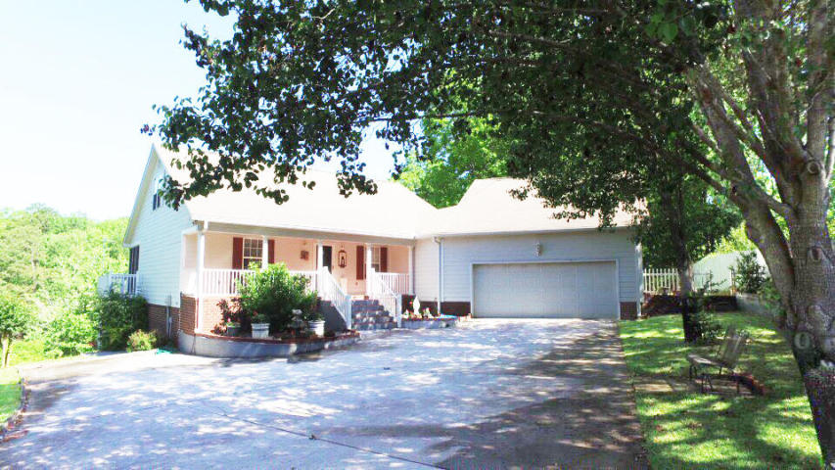
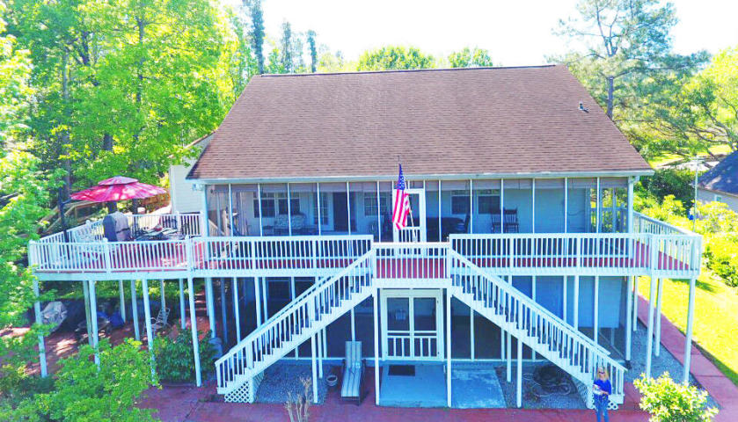
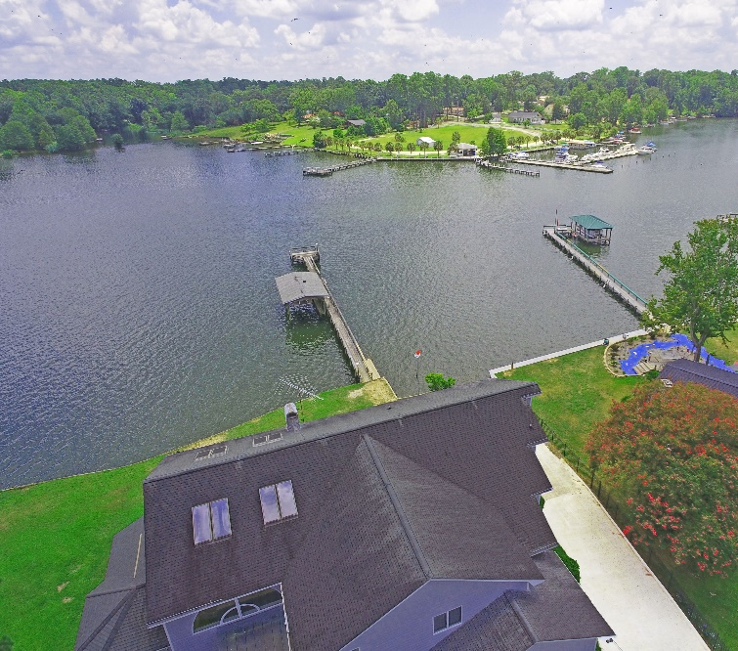
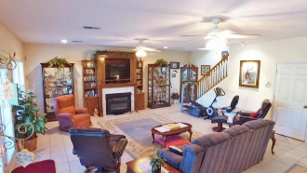
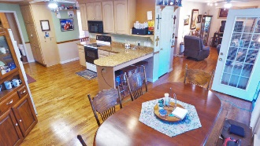
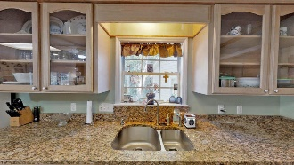
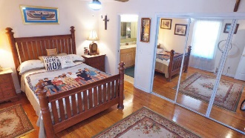
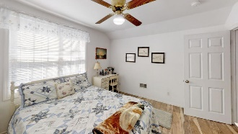
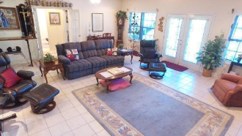
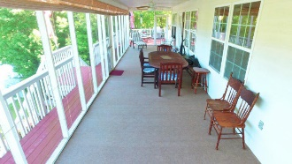
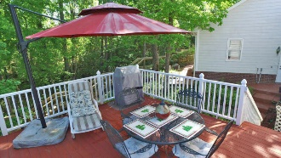

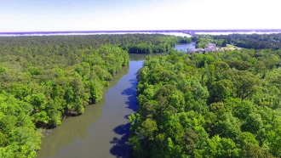

Waterfront Lake Marion Under 400k
1090 Chapel Branch Road
Chapel Branch ~ Santee, SC 29142 ~ MLS# 19028239 ~ $379,900
This 3 story Waterfront home on DEEDED lot on LAKE MARION will offer a relaxed life enjoying the best the lake can offer. This home has 2 fully screened in porches over looking the lake with dock and boat house. On the main (street level) has master bedroom, master bath, sitting area, dinning, kitchen laundry and 2nd full bath along with oversized garage. Down stairs offers a large Den with wet bar, full bath and 2 bedrooms. Up stairs (top floor) has sitting room, full bath and 2 bedrooms. See 3D tour to do a virtual walk through of the home. Picture yourself home!
Virtual Tour: https://my.matterport.com/show/?m=TzhnppuyJcL
Lake Homes Realty, LLC
Elloree, SC 29047
www.SCLakeLife.com
Kristie Anderson
(803) 387-9459
kristie@sclakelife.com

