Slide 1
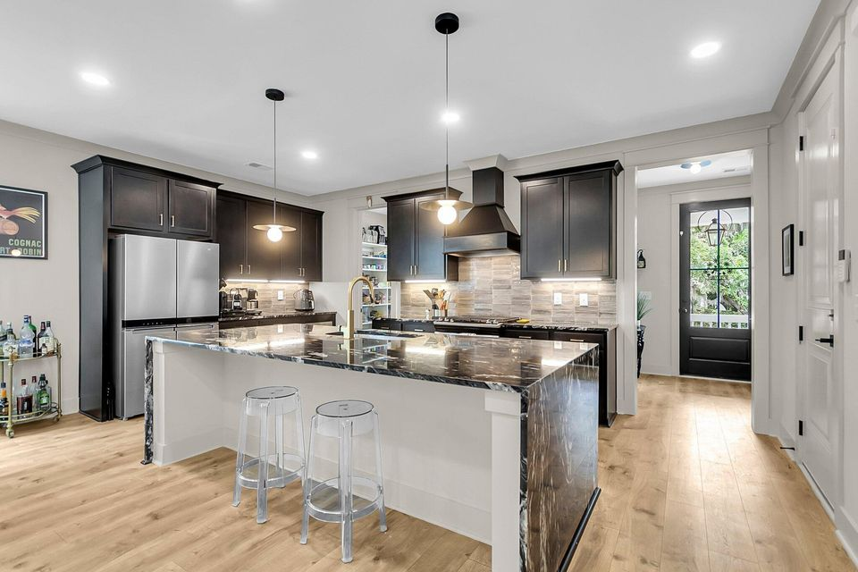
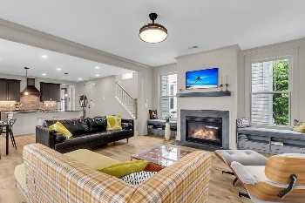
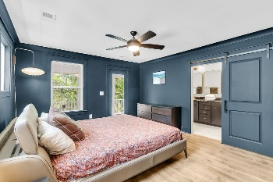
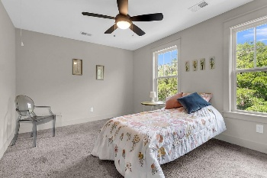
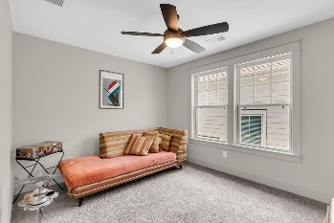
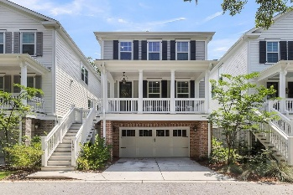

1093 Ave Of Oaks
Avenue of Oaks · Charleston, SC 29407 · MLS# 25014649 · $995,000
Just Listed Amazing Marsh Views West Ashley 2.5% Co-op
Breathtaking Marsh-View Home Nestled Among Grand Oaks. Experience stunning marsh views in this elevated home, seamlessly tucked among majestic Grand Oak trees. With four inviting porches to choose from, simply sitting outside immerses you in the coastal breeze and tranquil scenery. This picturesque residence offers excellent curb appeal, a full front porch, and an abundance of natural light that fills the home. Inside, you'll find 3 spacious bedrooms plus a dedicated office, complemented by custom gold-accented lighting and hardware, along with rich hardwood floors throughout the main level, upstairs hallway, and primary suite. The gourmet kitchen is a chef's dream, featuring beautiful granite countertops, an elegant waterfall-edge island, striking dark 42'' cabinets, a stylish tile backsplash, gas stove, stainless steel appliances, a generous walk-in pantry, and a bright eat-in dining area. Open to the oversized great room, the space includes a cozy gas fireplace and flows effortlessly to a serene screened-in porch with breathtaking marsh views. The luxurious primary suite offers a private balcony and a spa-inspired bath with dual vanity sinks, a dazzling tiled shower with a frameless glass door, tiled floors, and an expansive walk-in closet. Two additional bedrooms share a beautifully finished full bath with a granite dual-sink vanity and beautiful tile flooring. The oversized garage accommodates up to 5 vehicles and is pre-wired for EV charging, with additional parking space for two more vehicles in the driveway. Don't miss the opportunity to make this coastal retreat your own - with unmatched views, timeless design, and light-filled living spaces, schedule your private tour today and discover the magic of marshside living!
Stan Huff
843-670-2835
stan.huff@agentowned.com
Jill Marcacci
843-297-5590
jill@agentowned.com
www.agentownedrealty.com
AgentOwned Realty Co. Preferred Group, Inc. | 824 Johnnie Dodds Blvd | Mt Pleasant, SC 29464

