Slide 1
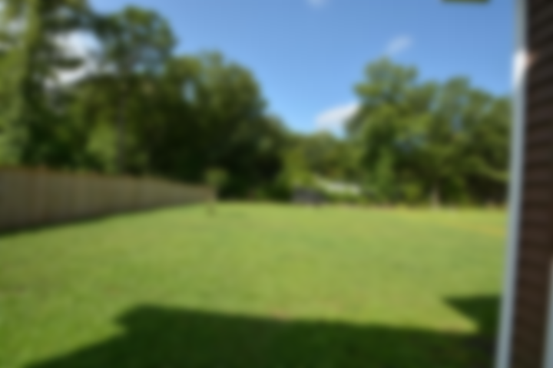
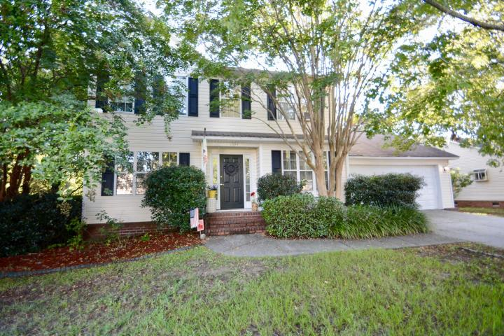
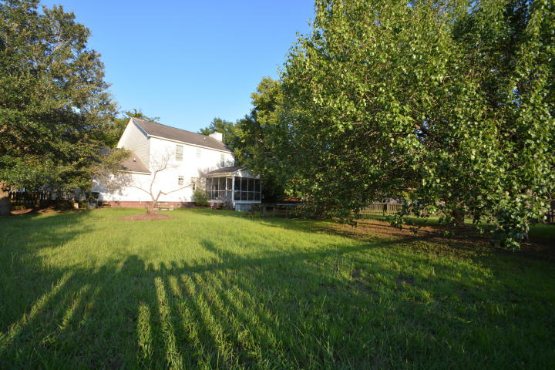
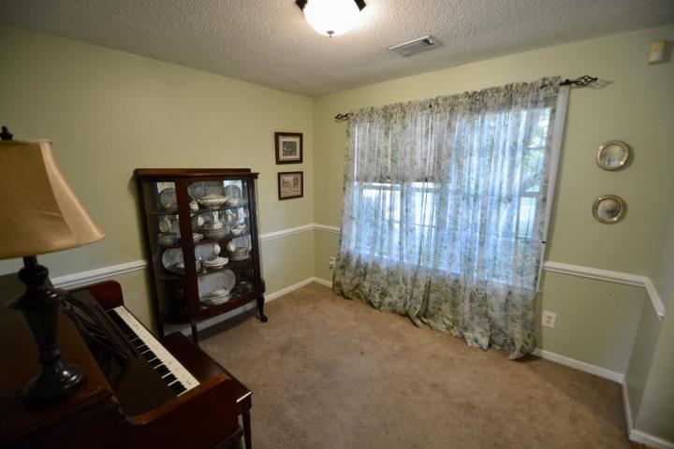
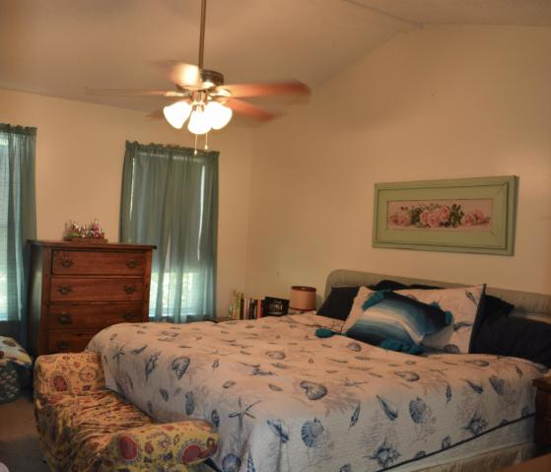
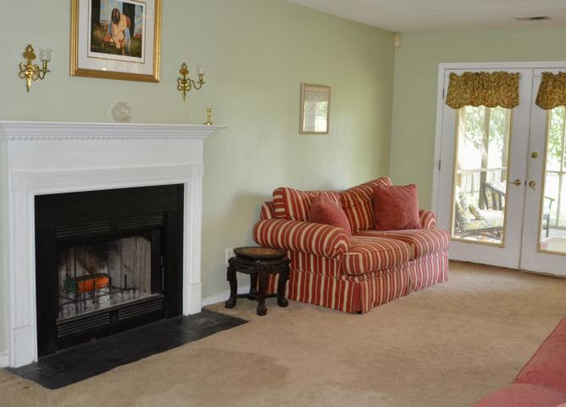
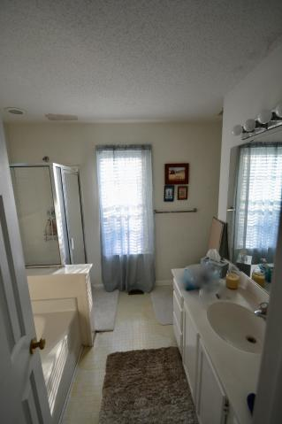
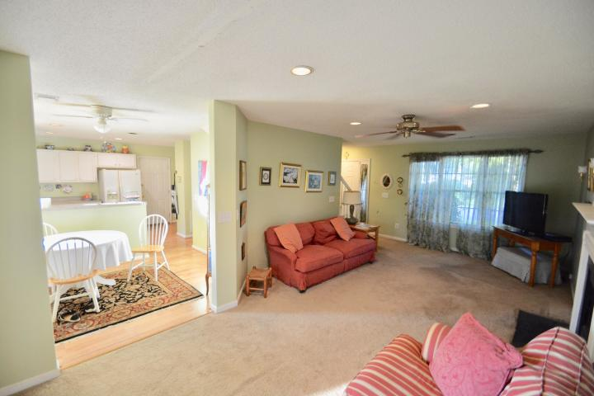
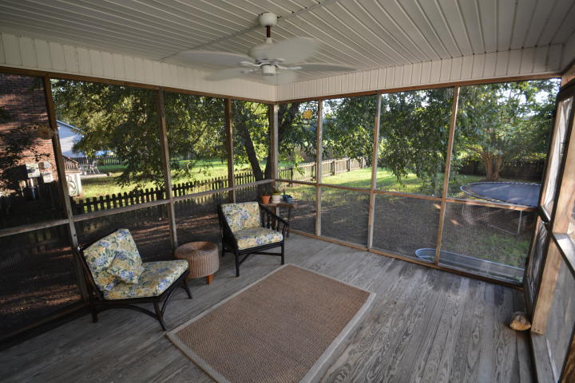
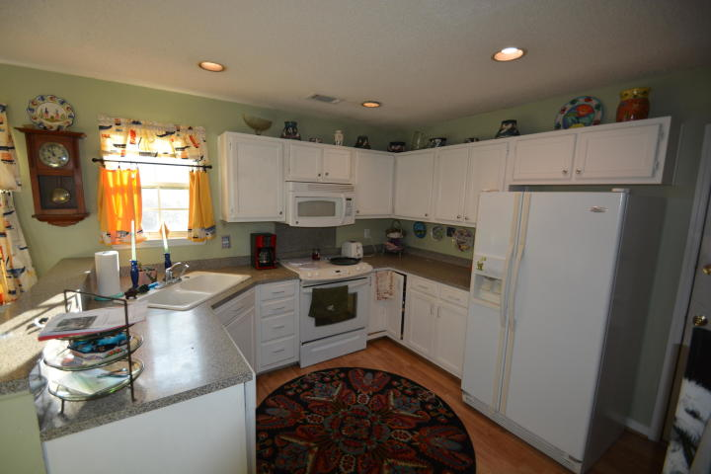
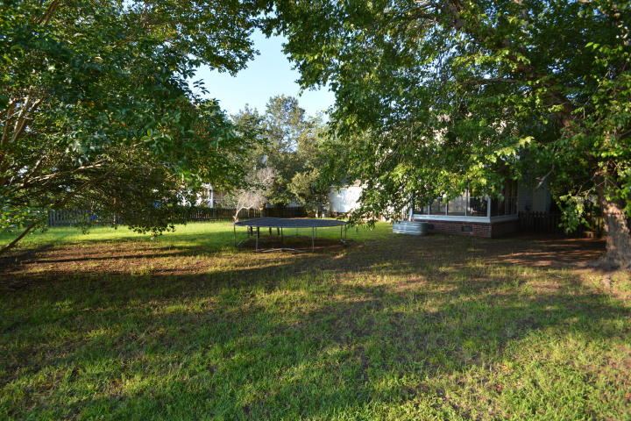
Location is Everything
1094 Wayfarer Lane
Bayview Farms ~ Charleston, SC 29412 ~ MLS# 19024886 ~ $334,900
Located in desirable Bayview Farms on James Island. Just minutes to Folly Beach or Downtown Charleston.
3 bed 2.5 baths 1392 sq ft. You can entertain your friends and family on the large screened porch & fenced-in backyard!
Short bike ride to Stiles Point Elementary and James Island Charter High School. The neighborhood amenities include a clubhouse, tennis courts, play ground, fishing ponds, sidewalks, two large pools & a baby pool and no thru streets.
James Island Yacht Club, Sunrise Park, James Island Rec. Center & Soccer complex are all nearby! This home is ready for a new owner to make it their own!
Patricia "Patti" Nickerson
(843) 312-7478
pattinickerson@hotmail.com
Brand Name Real Estate
4 Carriage Lane Suite #106
Charleston, SC 29407
Michael Albenesius
(843) 343-5870
m.albenesius@gmail.com

