Slide 1
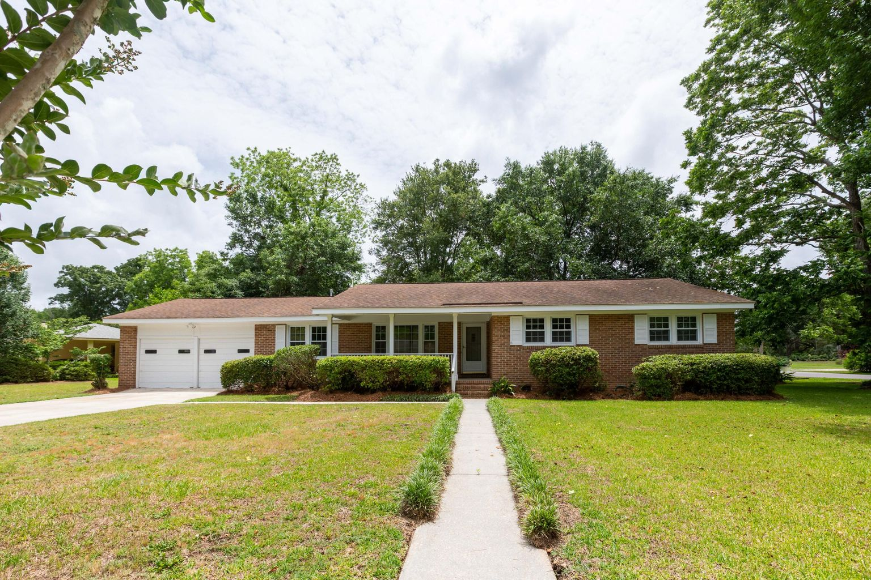
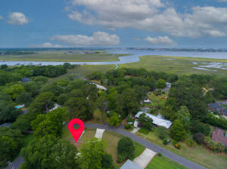
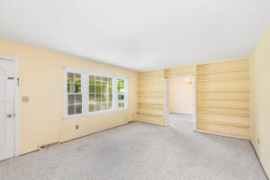
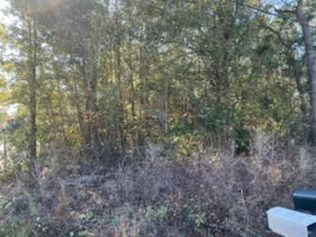
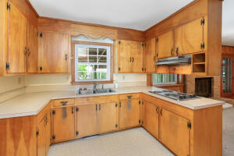
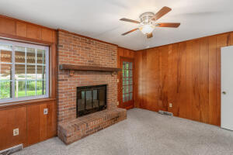
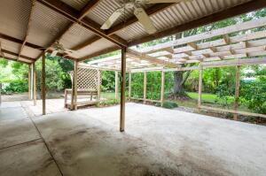
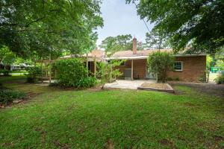


Just Listed on James Island!!
Reduced!
1095 Winslow Drive
Lawton Bluff · Charleston, SC 29412
MLS# 22013519 · $645,000
Michael Dew
O 843-769-5100
M 843-870-7000
michaeledew@gmail.com
www.michaeldewrealestate.com
Great opportunity to own on James Island!
4 bed 2 bath ranch in Lawton Bluff.
Great corner lot. Formal living room, separate dining, and family room with gas fireplace.
Patio overlooking beautiful back yard. 2 car attached garage.
Convenient to downtown and Folly Beach!
AgentOwned Charleston Group
902 Savannah Hwy
Charleston, SC 29407
Real Estate ● Mortgage
Insurance ● Business Brokerage

