Slide 1
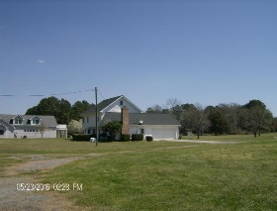
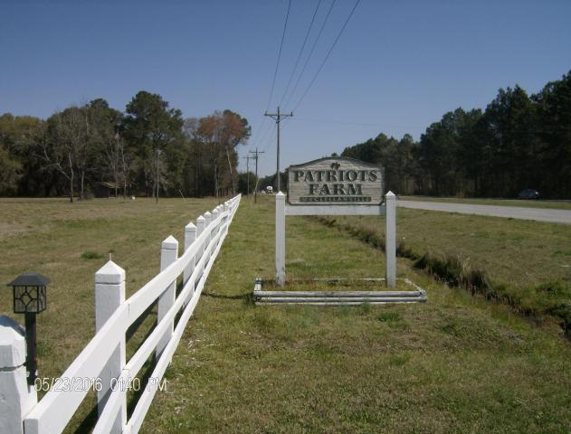
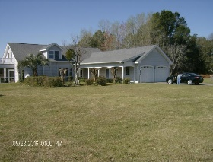
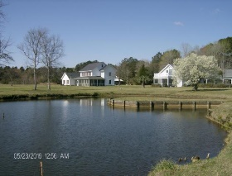
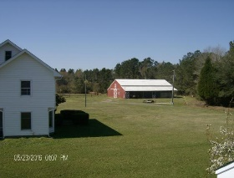
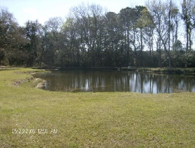
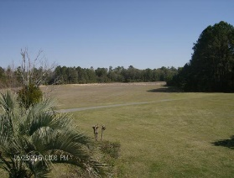
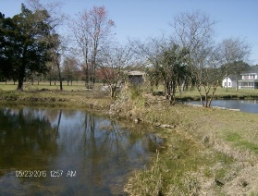
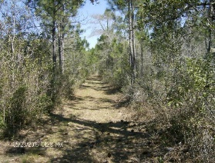
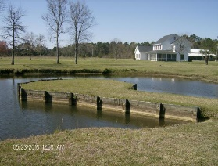
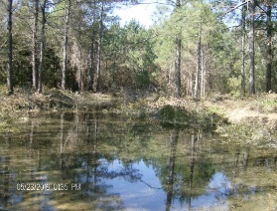
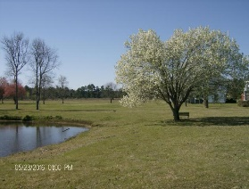
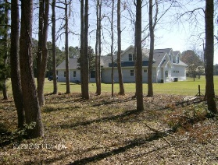
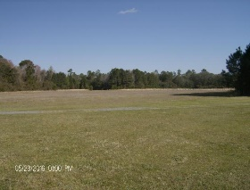
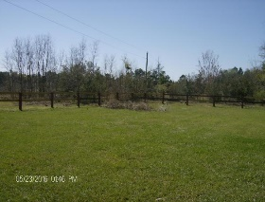

10970 N Highway 17
McClellanville, SC 29458
MLS# 16007673
$2,500,000
Welcome to Patriot Farm Plantation
A flag flying proudly will give notice you have arrived. This wonderful tract of land has two homes, each home is 4 bed and 2 full baths. Plus a huge barn 36'x72' and additional stables and corral. A true working farm for many years, it can be whatever your vision allows. Consider this retreat for corporate outings, event venue, equestrian boarding & riding, organic farm, family gathering, hunting lodge or just a peaceful get away from the city. Come visit the plantation and start your dream of all it could be you. Backing up to the National Forest allows plenty of privacy and the multiple ponds provide a great space to sit back with a beverage to enjoy the wildlife. Book a showing now with your agent and prepare to spend time viewing the future.
George Arlet
(843) 452-7200
georgearlet@comcast.net
Joe Arlet
(843) 226-4141
joe.arlet@carolinaone.com
Carolina One Real Estate
2713 Highway 17 North
Mt. Pleasant, SC 29466

