Slide 1
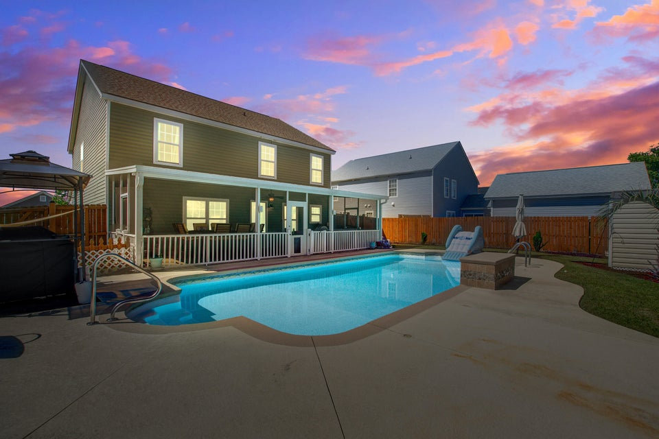



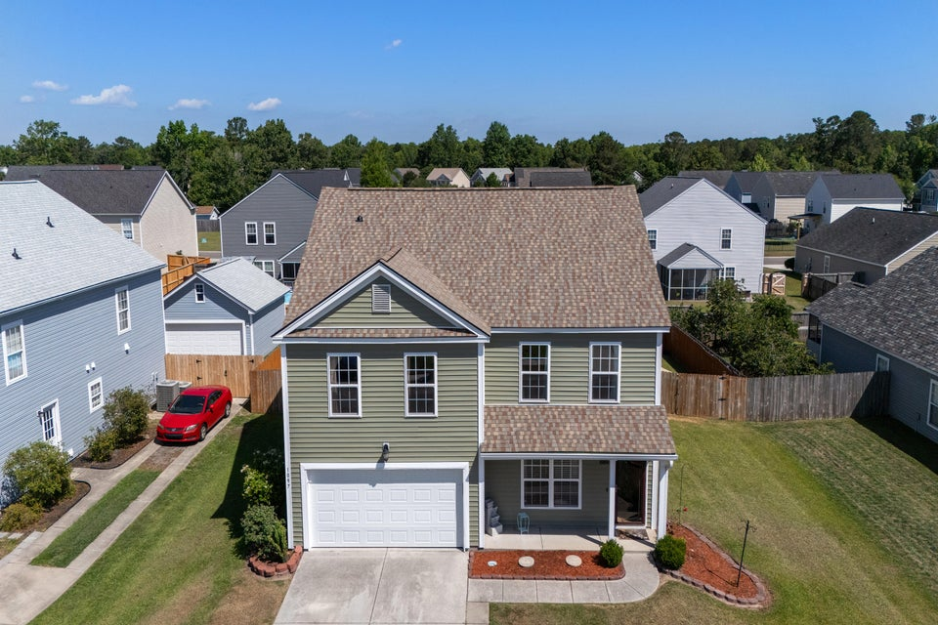
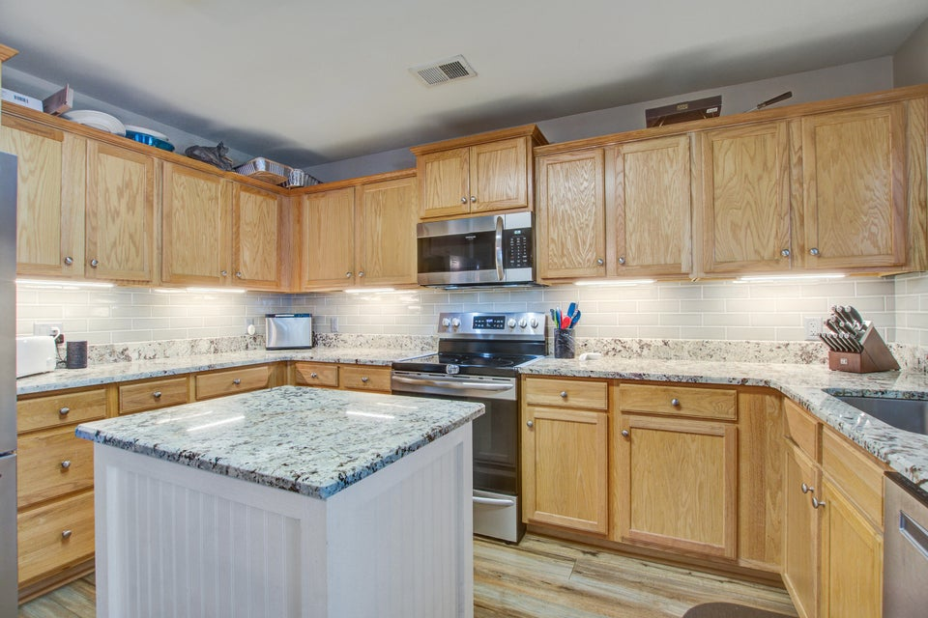
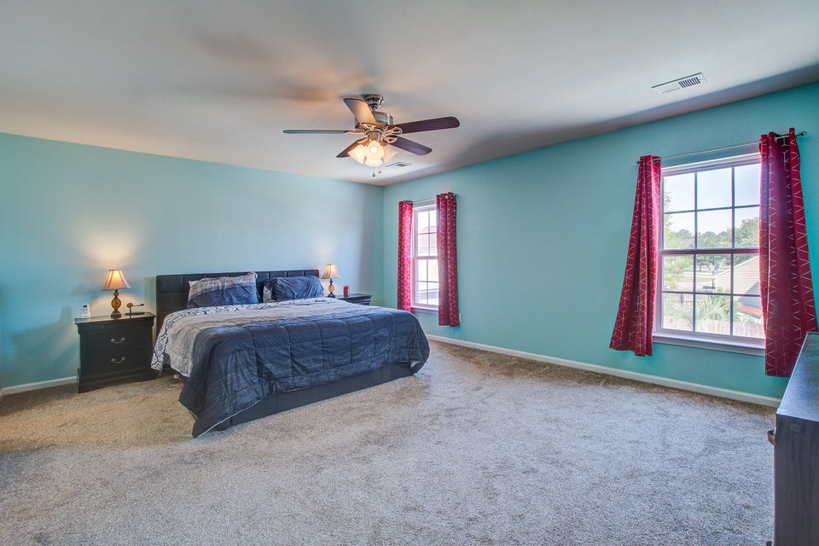
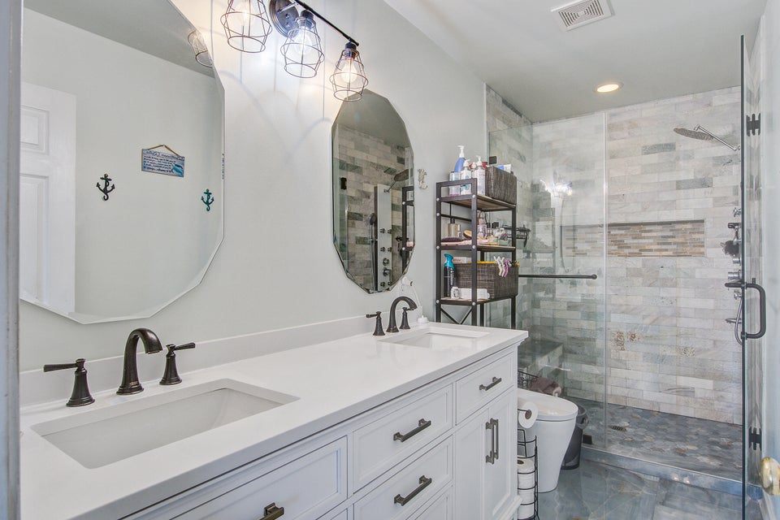



HOT SUMMER DEAL
1097 Briar Rose Lane
Hunters Bend ■ Ladson, SC 29456 ■ MLS# 25010412 ■ $425,000
This stunning, move-in ready home truly checks all the boxes — and then some! From the moment you arrive, you'll be captivated by its impressive curb appeal, featuring a brand-new upgraded roof, stylish new vinyl siding, fresh trim, and newly installed windows. Step into a beautifully updated interior, where luxury vinyl plank flooring flows seamlessly throughout the main level, creating a warm and inviting atmosphere. The updated kitchen (renovated in 2019) offers both style and functionality, perfect for everyday living and entertaining. The spacious upstairs loft provides an ideal space for a game room, media area, or second living room — a true bonus for any lifestyle.
The generous master suite is a serene retreat, complete with a remodeled ensuite bathroom featuring an upgraded showerhead and a brand-new custom built-in closet system. Three additional large bedrooms share a fully updated hall bath, making room for everyone to live comfortably.
Outside, your private oasis awaits. The massive in-ground saltwater pool with a new pump is the ultimate luxury for hot summer days. Overlooking it all is a full-width back porch perfect for morning coffee, weekend barbecues, or evening relaxation.
Additional highlights include:
Smart toilets for a modern touch
Window added to the garage in 2023
New garage flooring
New garage door opener installed in 2025
Jeannene Ondrasek
843-259-8973
jondrasek@carolinaone.com
jocarolinahomes.com
Carolina One Real Estate
567 Crowfield Blvd
Goose Creek, SC 29445

