Slide 1

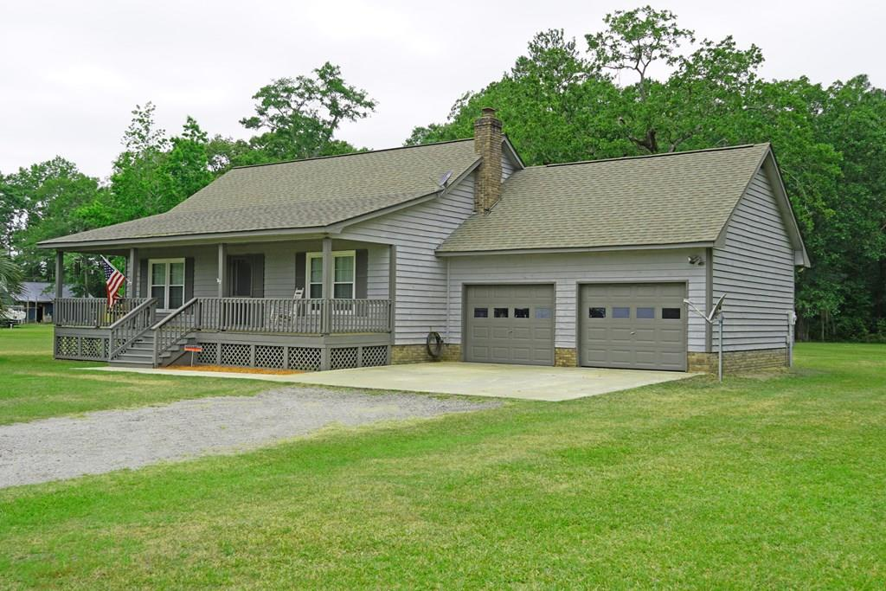
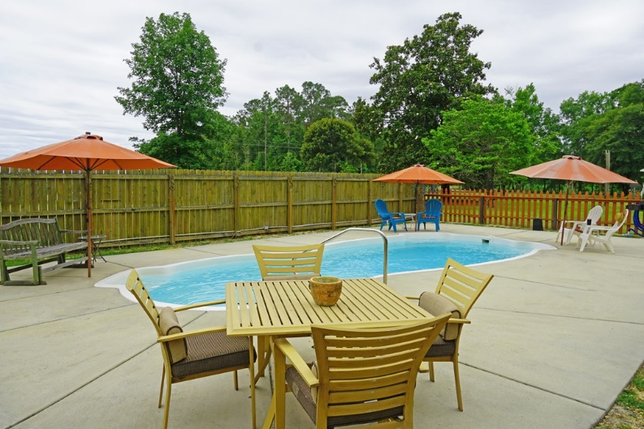
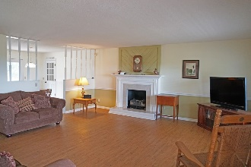
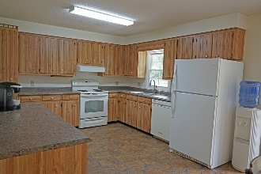
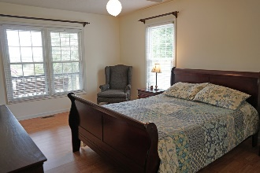
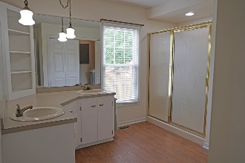
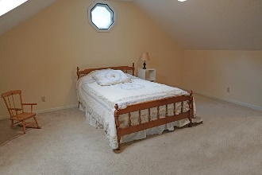
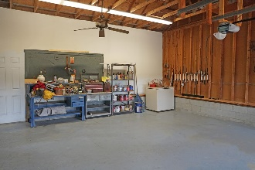
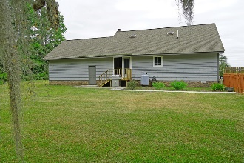
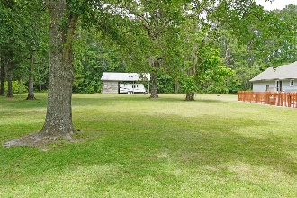
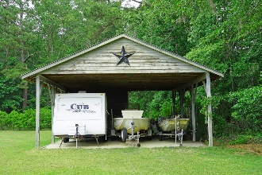

Open House June 3rd From 2-5pm
All Offers To Be Submitted By 5pm June 4th
1098 Pickett Level Rd
Elloree, SC 29047 ~ MLS# R147797A ~ $235,000
Country cottage in Elloree in Calhoun county with a pool. Property has blueberry bushes for fresh jam making. Open floor plan with large Den, Kitchen and Bedroom on 1st level. RV shed on property for big enough to hold the RV and the Boat. Groomed yard with lots of green space. Only 1 hour from Charleston and Columbia. Just off hwy 6 and 176.
Lake Homes Realty, LLC
Elloree, SC 29047
www.SCLakeLife.com
Kristie Anderson
(803) 387-9459
kristie@sclakelife.com

