Slide 1

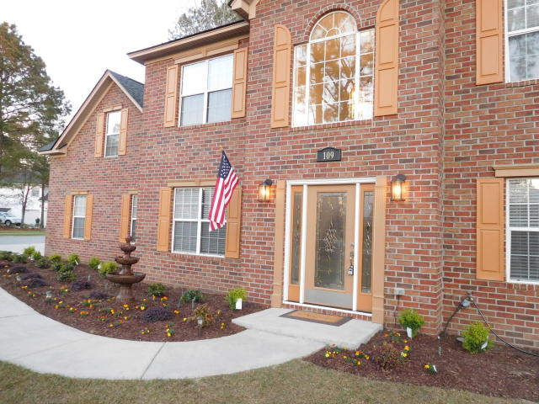
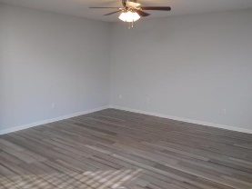
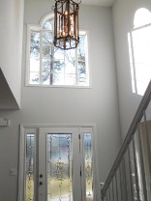
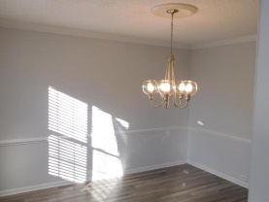
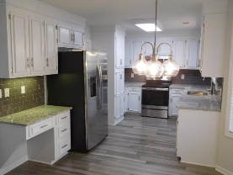
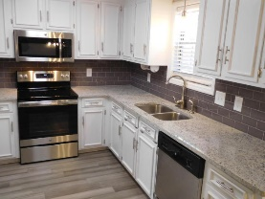
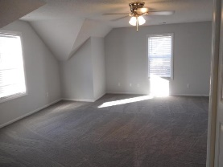
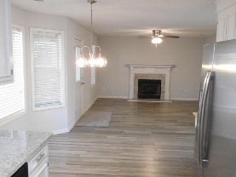
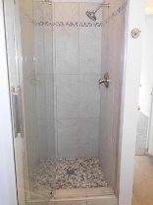
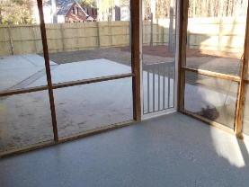
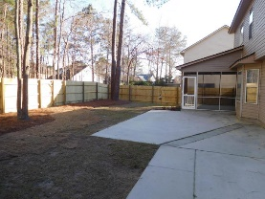
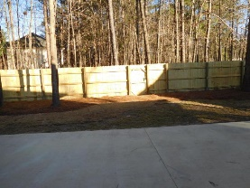
Don C. Mason, CIAS, CNE
(843) 364-9090 nibsc@aol.com
Gorgeous 4 Bed ~ 3½ Bath
Renovation In The Hamlets
109 Jillian Circle
Crowfield Plantation | Goose Creek | MLS# 18005812 | $329,900
WOW!! Fresh, Clean, Modern, Move in ready. All new distressed bamboo floors through out the entire downstairs. Freshly painted a nice light neutral gray. Freshly painted white kitchen cabinets with new hardware. New granite tops with sub way tiled backsplash. All new stainless appliances to include a side by side fridge. Matching granite placed around the fireplace. All new carpet in all the bedrooms. All new lights, ceiling fans. New granite tops, tiled floor, and a beautiful tiled master shower. A full bathroom was added in the huge frog to make it the perfect man cave, or mother in law suite. New screen door and all new screen on back porch. all new built privacy fence. 30 year arc. shingled roof. all new blinds at every window. topped with professional landscaping.
Real Estate Advocates LC
7613 Hwy 544 | Myrtle Beach, SC 29588
www.realestateadvocates.com

