Slide 1
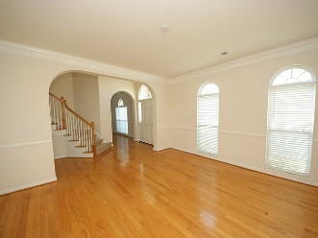
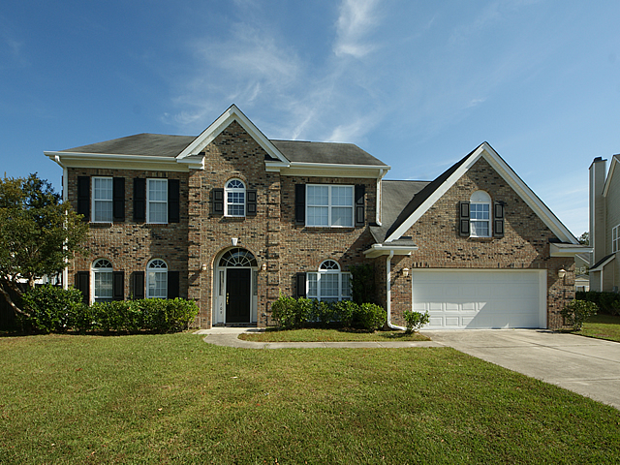
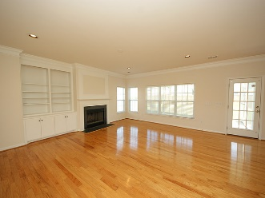
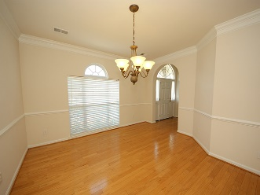
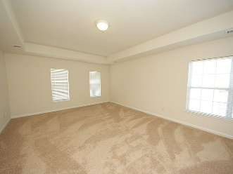
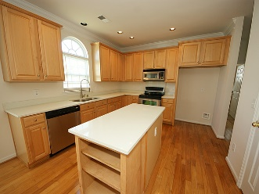
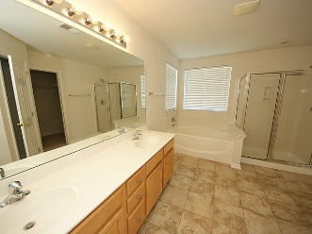
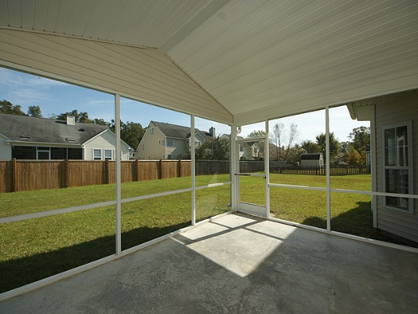
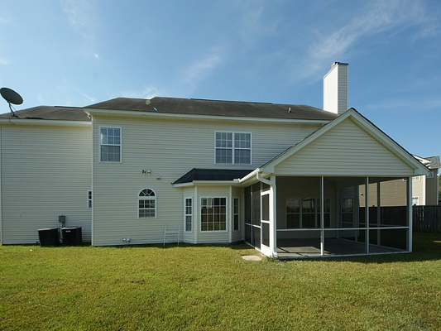
Be ready to be impressed!
210 Barberry St
White Gables
Summerville
MLS# 1417492
$209,900
109 Keller Spring Court
Bridges of Summerville ~ Summerville
MLS# 16027848 ~ $319,000
OPEN HOUSE SUNDAY FEBRUARY 12th 1-4pm
DORCHESTER DISTRICT 2 SCHOOLS – The Alexandria floor plan located on a cul-de-sac says WELCOME the moment you pull in the driveway. This spacious 5BR, 2.5BA brick home shows like a model but offers a relaxed lifestyle with beautiful hardwood floors on the first floor. Formal dining room is adjacent to the eat-in kitchen with stainless appliances, workstation and island. Large family room complete with fireplace and book shelves leads to the screen porch. Over-sized 5th bedroom with access from kitchen or upstairs hall could be used as a bonus room. Master bedroom located on second floor has double trey ceilings with ceiling fan and deluxe master bath with garden tub and shower. Faux wood blinds throughout.
Diane Watkins, ABR
Cell: 843-813-0276
Office: 843-821-1111
diane@milerproperties.com www.milerproperties.com
Miler Properties | 625 Old Trolley Rd | Summerville, SC 29485

