Slide 1
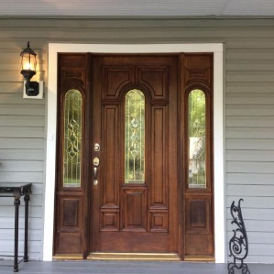
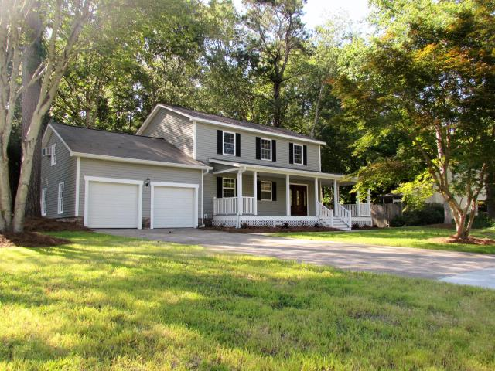
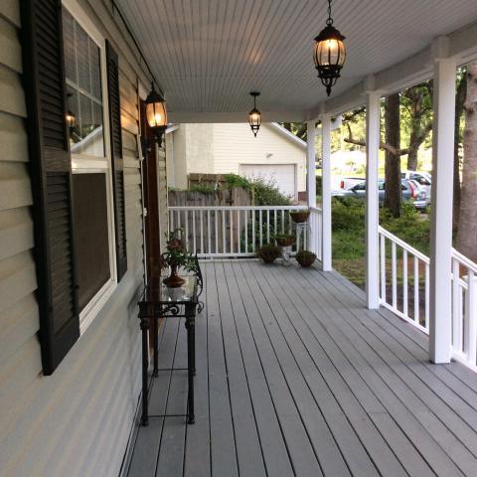
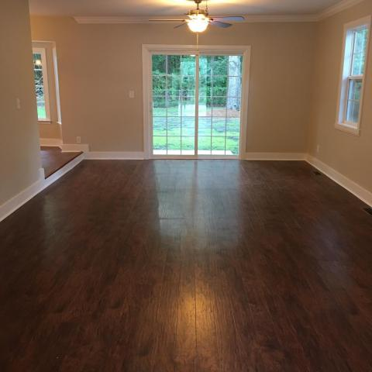
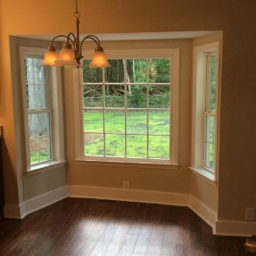
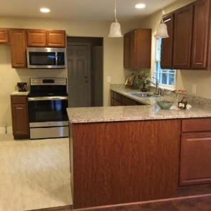
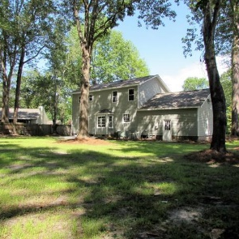

Just listed
109 Red Fox Run
Quail Arbor
Summerville, SC 29485
MLS# 16013387 ~ $250,000
3,285 Sq Ft ~ 4 Bedrooms ~ 2½ Baths
Newly remodeled, traditional home, in Quail Arbor.
Dorchester 2 school district. So welcoming, is the full front porch, that wraps one side of the home. An open floor plan, that flows from the spacious family room into the eating area, into the kitchen. Gleaming wood floors downstairs.
New kitchen cabinets, new granite, new appliances, new fixtures, new, new, new. The large FROG can be the 4th bedroom, or just a bonus room. Low E windows, all but 2. Two car finished garage. Great central location, close to town of Summerville, Dorchester Rd., Hwy 61, or I-26.
All this, and it could be yours!
HORNE REALTY, LLC
133 E. 1st‎ N. St
Ste 5
Summerville SC 29483
Deborah Swails
Realtor
Mobile - (843) 709-5056
seeswails@aol.com

