Slide 1
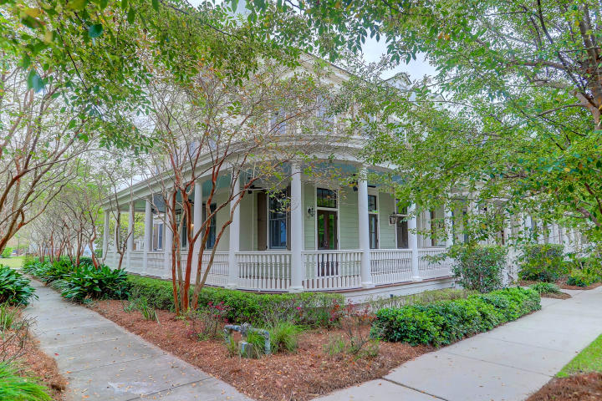
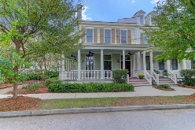
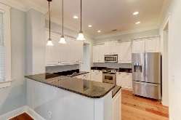
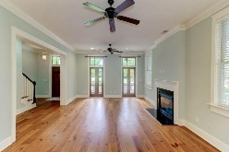
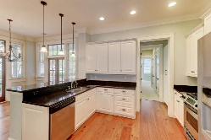
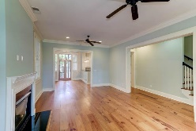
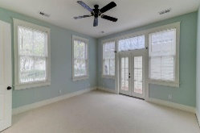
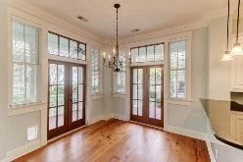
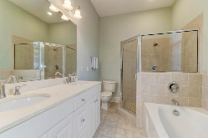
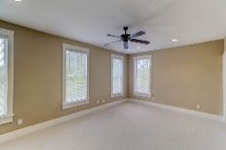
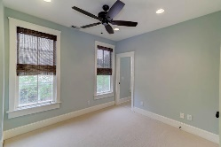
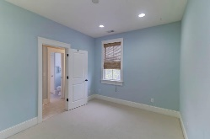
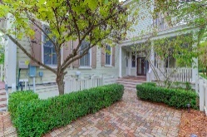
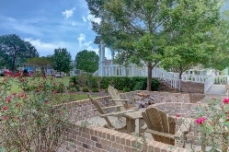
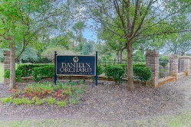



Back on the Market!
Southern Charm
109 Sabal Court
Daniels Orchard | Summerville | MLS# 19029179 | $389,000
Charming southern style architecture welcomes you home with a beautiful wrap around porch, multiple French Doors, and a beautiful brick courtyard . This spacious end unit townhome has 4 bedrooms and 3.5 baths. Located in the highly sought-after Daniels Orchard neighborhood of Summerville. The outside of this magnificent home features stately columns, beadboard porch ceiling, private fenced courtyard, expert landscaping, and a detached 2 car garage. The high level of detail and craftsmanship continues inside the home, 10' ceilings, antique heart pine floors, architectural crown moldings, custom window and door casings and recessed lighting throughout the downstairs level. The first story boasts an open floor plan and features a grand foyer, gracious living room, gas fireplace, laundry and powder room too. The kitchen features granite counters, a gas range, stainless steel appliances, and a breakfast bar. The bright and airy master suite is downstairs with a spa-like bathroom. The second story of the home houses the remaining three bedrooms and 2 full baths, including the guest room with en suite bathroom. HVAC unit was recently replaced in 2017.
A $1950 Lender Credit is available and will be applied towards the Buyer's closing costs and pre-paids if the Buyer chooses to use the Seller's preferred Lender. The credit is in addition to any negotiated Seller concessions.
Elaine Nugent
(843) 330-7044
enugent@carolinaone.com
John Nugent
(843) 304-2061
john.nugent@carolinaone.com
nugentknowsrealestate.com
Carolina One Real Estate | 628 Long Point Rd | Mt Pleasant, SC 29464

