Slide 1
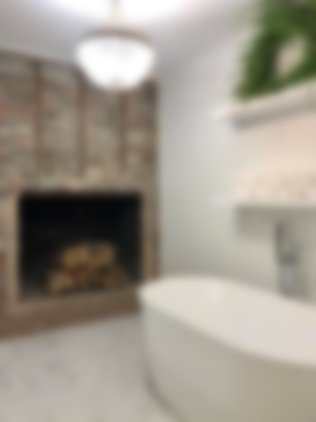
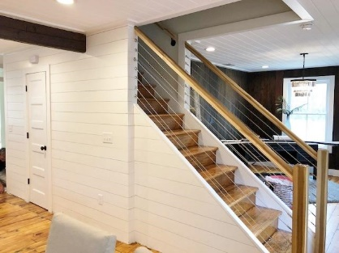
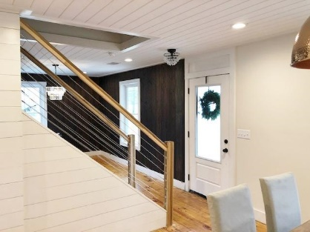
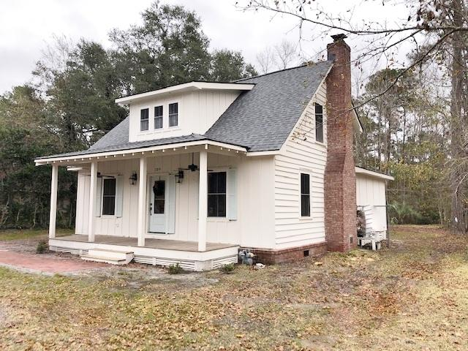
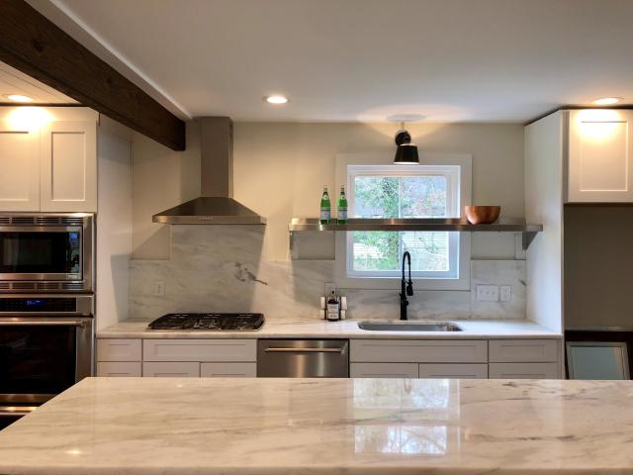
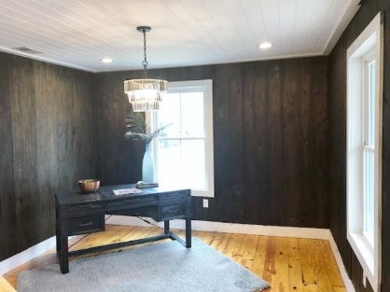
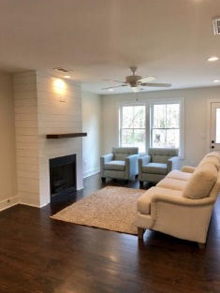
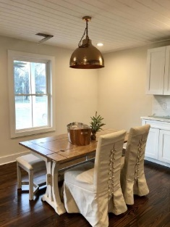
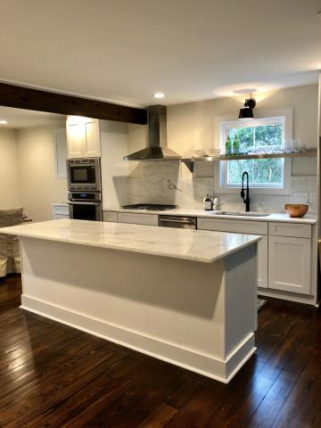
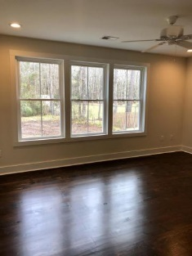
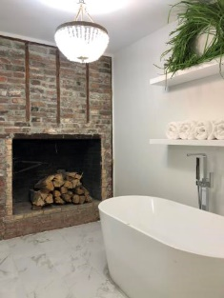
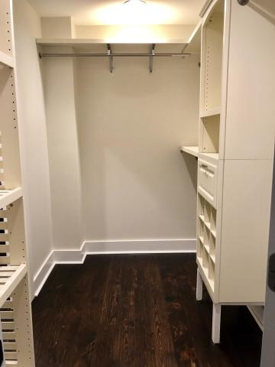


Adorable Completely Renovated Cottage!
No HOA!
109 Tupalo Drive
Summerville Farms | Summerville, SC 29483 | MLS# 19033865 | $324,000
2,116 SF home with 3 bedroom, 2.5 bath, separate dinning room, and master down! Close to town but not in an HOA! 1/2 ACRE lot. COMPLETELY gutted and rebuilt! BRAND NEW 2019 ALL Electric, HVAC and Duct, Plumbing, and gas. ALL NEW Windows throughout. NEW ROOF. New doors. ALL NEW 2019. BRAND NEW energy efficient R-19 Insulation throughout. New 2019 Septic Tank. NEW Hardi Board exterior. NEW Rinnai Tank-less Water Heater. Gourmet style kitchen with Thermador Wall Microwave and Double Oven. MARBLE Counter-tops and back-splash. Gorgeous Master Suite Downstairs! Multiple Dryer connections in laundry. Beautiful Details. REAL Wood flooring throughout. This is a custom home.
Chris Garcia
Office (843) 557-7100
Mobile (843) 557-7100
cmcdaid1@yahoo.com
RE/MAX Pro Realty
9209 University Blvd.
N Charleston, SC 29406

