Slide 1
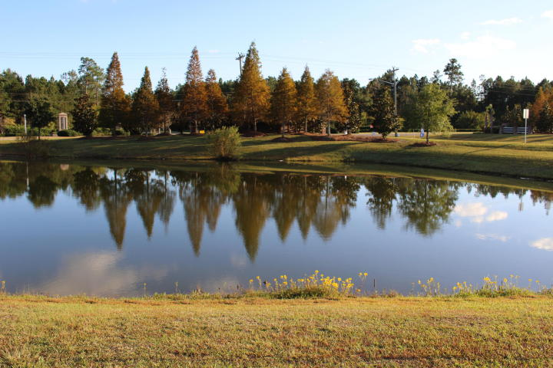
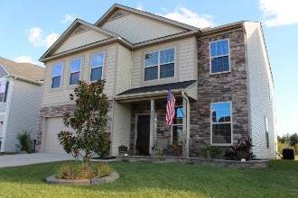
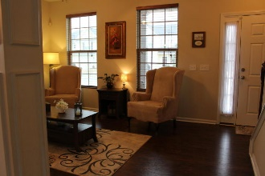
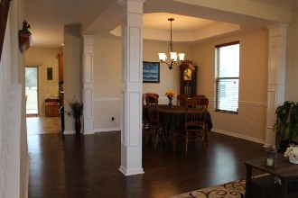
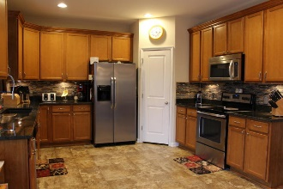
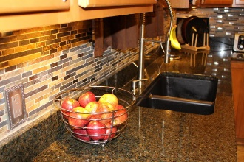
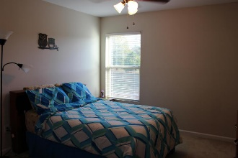
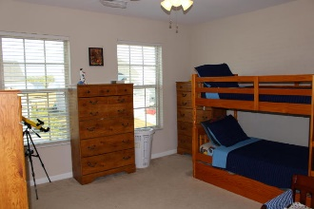
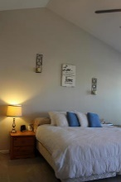
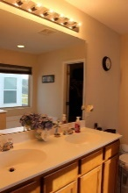
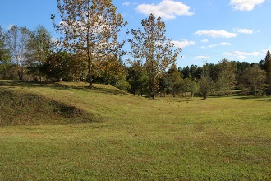




MONCKS CORNER GEM! GREAT VALUE!
109 Weeping Cypress Drive
Cypress Grove | MLS# 18003503 | $250,000
This fabulous home boast Charleston Charm and is TURN KEY READY, can CLOSE QUICK in 25 days or LESS! Why wait for a new build when you can have this Gorgeous, Meticulously Maintained Stone Front home that’s located in Cypress Grove? This unique neighborhood is perfectly situated between Highways 52 & 17-A making for easy access to Naval Weapons Station, Goose Creek, Summerville, and I-26. This area of Moncks Corner is rapidly growing! If you work at Google this home is also a short bike ride to work. Shopping and dining are at your fingertips. Relax with surrounding serene wooded areas, pond and community pool. Four spacious bedrooms, 2.5 large bathrooms. Open floor plan starting with beautiful flooring that meets you at the front door and goes through out the main level, opens to formal dining room with exquisite columns. Four spacious bedrooms, 2.5 large bathrooms. Open floor plan starting with beautiful flooring that meets you at the front door, opens to formal dining room and sitting area with beautiful exquisite columns. Gorgeous kitchen that is sure to impress offering 42" maple color cabinets that provides plenty for storage, Luxurious NEW GRANITE counter tops with complementary eye catching tile back splash, under cabinet lighting, stainless steel appliances including a smooth top stove, dishwasher, built-in microwave. Lots of counter-top space while cooking or entertaining, large pantry, eat-in-kitchen that opens to the family room with gas fireplace for those cozy nights. Covered patio that makes for great outdoor living space and grilling and you can also enjoy the stunning view of pond especially at sunset! The Master Suite is more like a private retreat that has soaring ceiling with shelf space, extra sitting area if wanted because of the massive size of room, plenty of space in the walk-in closet that is like a room all of its' own, master deluxe bathroom has raised vanity with double sinks, separate shower and tub. Large laundry room that provides lots of extra storage space. Fourth bedroom is currently being used as an office. The huge loft is perfect for your family needs. There are ceiling fans in almost every room. This WONDERFUL home has so many upgrades and is Smoke Free and Pet Free. This highly sought-after neighborhood offers sidewalks, 3 big ponds, and community pool with a cabana. Schedule to see this one today!
Gina Brammer, Realtor
(843) 437-7828
ginabrammer1@gmail.com
AgentOwned Premiere Group | 1800 Trolley Rd | Summerville, SC 29485

