Slide 1
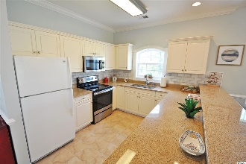
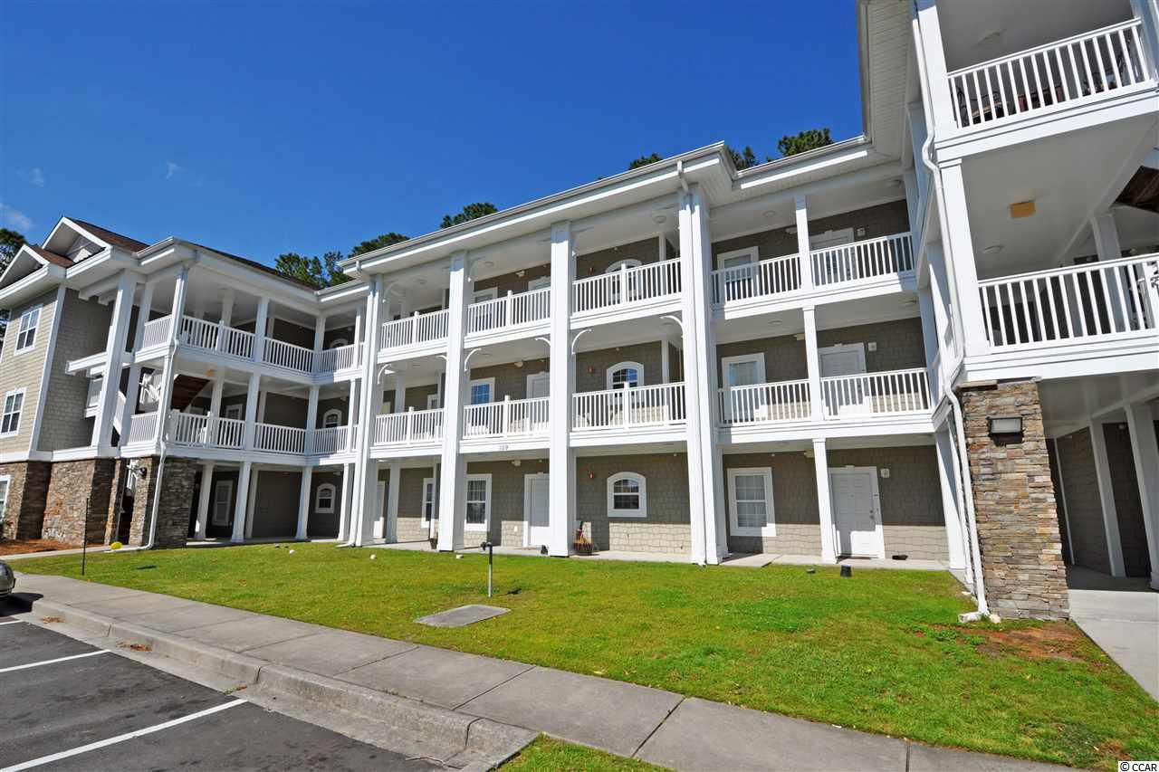
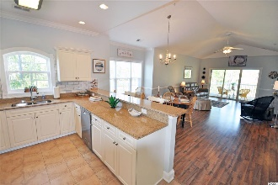
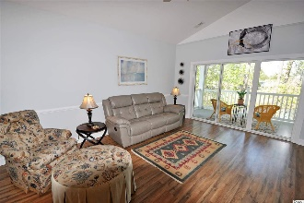
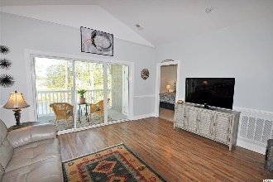
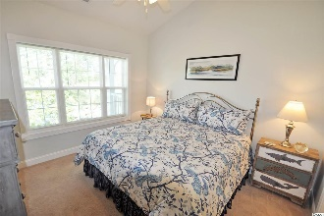
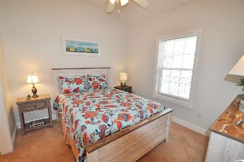
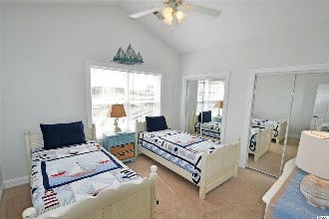
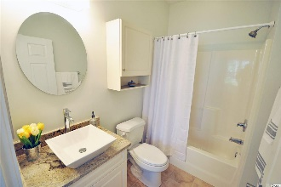
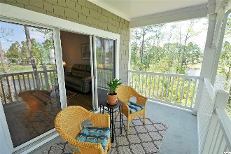
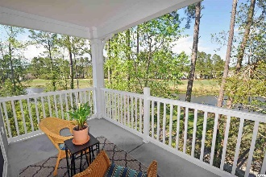


109 South Shore Blvd #301
Tullamore Lakes ~ Longs SC 29568
MLS# 1908301 ~ $128,900
A FIRST? In Tullamore Lakes of Sun Colony, a completely renovated, true luxury beach-golf penthouse 3 bedroom end unit is being sold completely turnkey with upscale furnishings, decor, artwork, and sumptuous bedding! This large, open and airy 1,400-sq.-ft.-stunner features high-end granite in both the kitchen and in the two baths; the baths surprise, too, with tile floors and gleaming-white vessel sinks with designer faucets. Also breathtaking from the moment you walk in the foyer from the front door into the great room is a popular top-of-the-line beautiful high-tech manufactured laminate floor throughout, easy care, moisture proof and perfectly paired to the simple elegance of the pleasing gray and misty light-blue ocean theme of the entire home -- with fun pops of accent colors -- corals and teals. Upon entry, view the kitchen -- lots of light from a charming window with view over the double stainless-steel sink, big breakfast bar, stainless steel appliances, Carrera-marble-inspired subway tile back splash, and excellent functionality. It is the kitchen everyone dreams of! To the left is the third bedroom, in the preferred separate-bedroom floor plan; it has lots of light as well, is spacious yet private for guests and features a cathedral ceiling, ceiling fan, mirrored closets, and a nice nautical motif. Return to the main living room for a gathering-size, welcoming dining area, seating six or easily more -- and an inviting bay window with seating for two for morning coffee -- and with a view of the golf course and the meandering lake. You will notice the light fixtures are all new and hand-selected to compliment each room, such as the lovely dining-room chandelier. A substantial easy chair with unique ottoman and a fabulous stately leather couch with two built-in recliners are the heart of the beautiful, open and comfortable living room. The artwork and the other furnishings are memorable and so livable. The entire great room is wonderful for a family or a foursome! The chair rail and the moldings are specialty and are reminiscent of colonial carvings; the ceilings are cathedral with fans in the living and all bedrooms, and every detail of furniture and planned function amaze. Take, for instance, the two main bedrooms and baths. There are two masters. One overlooks the golf course and lake and has an en suite with a walk-in shower, walk-in closet with more storage and an additional coat or linen closet. Unique specially-selected furniture and artwork with a bit of whimsy adorn this bedroom, fit for a king and, of course, with a luxurious king bed. The second lovely master has a tub/shower in the second bath that can be closed off for an en suite or open from the hallway for guests. It accommodates a nice laundry closet with new washer and dryer. There's more. The outdoors opens seamlessly up to a GREAT view of the Palmetto Greens Golf Course from the rear porch off of the great room from large sliding doors. There is lots MORE of that natural light bathing the living space, therefore. The porch overlooks the ladies tee and has a splendid infinity view of the woods and soothing lake. It is a remarkably peaceful enclave for relaxation also. Plus, there is an additional closet off the porch, big enough for household, beach, golf and more storage items. Simply gorgeous and immaculate, this rare find is located just minutes to Cherry Grove Beach, named one of the nation's best; shopping; entertainment; parks and recreation including numerous golf courses; dining and all major highways! The school system is North Myrtle Beach, and medical care is nearby, provided primarily by the McLeod Seacoast Hospital system. Tullamore Lakes are mid-rise condominiums, upscale quality but still highly affordable. This villa really has it all, a first? See it today and decide for yourself if is perfect for your home, second home or beach-investment. But, most especially, do not let this luxury at this price get away!
Deborah Collins
843-424-9013
dctidewater@yahoo.com
Connie Ross-Karl
702-306-2643
conniesross@aol.com
NEW WAY PROPERTIES MYRTLE BEACH

