Slide 1
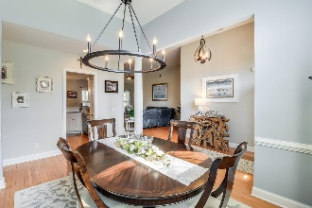
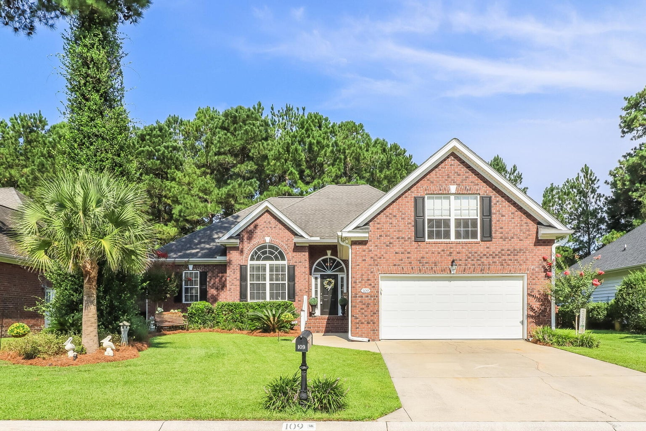
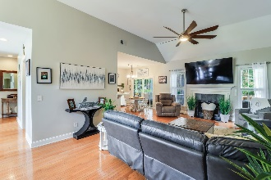
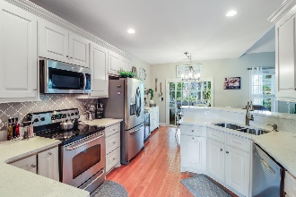
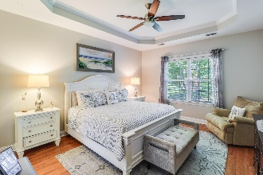
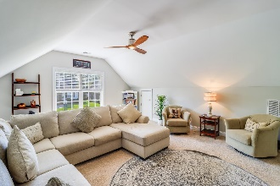
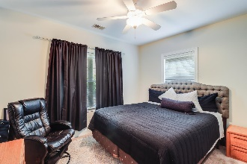
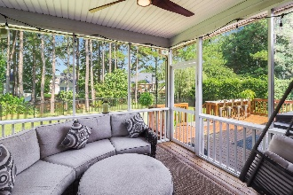
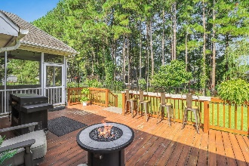
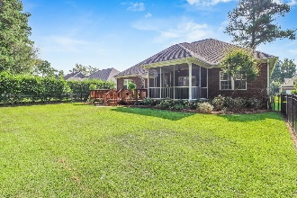


109 Amen Corner Pine Forest Country Club Summerville, SC 29483 MLS# 23019383 | $525,000
BACK ON THE MARKET!
NO FAULT OF THE SELLER!
Open House
Wednesday, 7/20
3-5PM
Welcome to elegant living in this beautiful brick ranch home located within the prestigious Pine Forest Country Club community. This home offers 4 bedrooms and 3 full bathrooms spread across 2,356 sq ft of living space, this residence has a versatile frog space that can adapt to your desires, whether it's an additional bedroom, a children's playroom, a sophisticated man cave, or a space tailored to your lifestyle. Upon entry through the welcoming foyer, you'll find a formal dining room, perfectly suited for hosting special gatherings or a family holiday dinner. The flowing layout leads to the heart of the home, an open concept living and kitchen area that promotes a sense of spaciousness and airiness.
High ceilings grace the living room, creating an expansive ambiance that is both inviting and comfortable. The kitchen features stainless steel appliances, white cabinetry, and quartz countertops. An inviting eat-in area is highlighted by the natural light coming in from the glass door that leads to your backyard oasis. The tranquility of the main floor is pronounced in the master suite, with tray ceilings that create an air of sophistication, and plenty of space to arrange your bedroom furniture. The en-suite bathroom is a retreat, complete with a dual sink vanity, a deep soaker tub and a separate walk-in shower. A large walk-in closet provides ample storage, making sure your personal space remains organized. This well-thought-out floor plan offers a split arrangement with 3 generously sized bedrooms, and 2 additional full bathrooms, accommodating both family members and guests providing privacy for all. For added convenience, the laundry room is thoughtfully situated off the garage. Step outside into your fenced backyard, thoughtfully landscaped with mature foliage. The large screened in porch and expansive deck provide spaces for dining, entertaining, or simply unwinding within nature. Experience the luxurious living in this Pine Forest Country Club gem, where design, versatile spaces, and sophisticated amenities create a truly extraordinary home. Pine Forest Country Club offers the opportunity to purchase club memberships to amenities like, a golf course, clubhouse, tennis courts, and more! Schedule your showing today so you don't miss out on everything this home and area have to offer!
Brandon Ray
(843) 499-1928
brandon.ray@carolinaone.com
www.therightrayhome.com
Carolina One Real Estate
900 N Main St
Summerville, SC 29483

