Slide 1
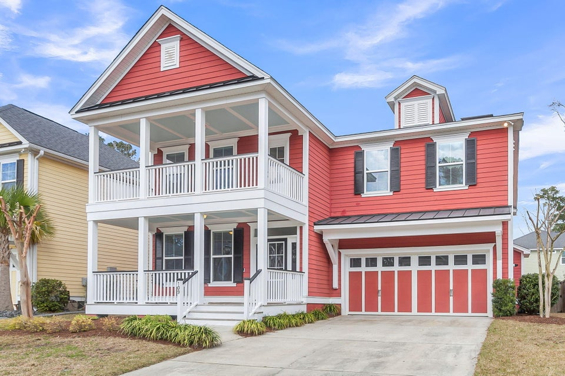

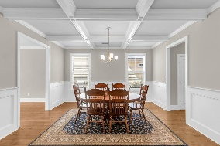
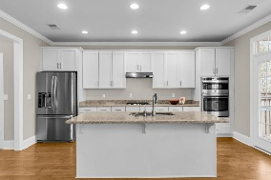
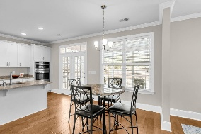
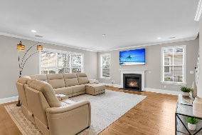
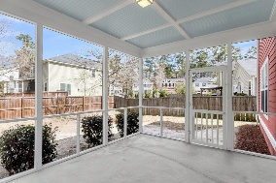
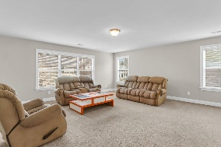
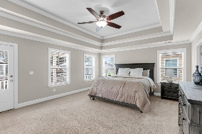
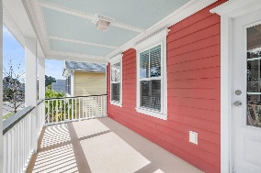
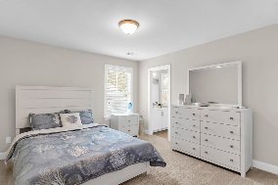
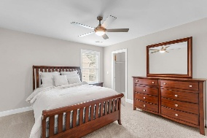
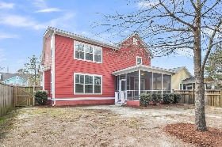


Walk/Bike to Downtown Summerville from this Beauty!
109 Evelyn Joy Drive
Branch Creek
Summerville, SC 29483
MLS# 26006405
$598,000
4 Bedrooms | 3½ Baths | 3,520 sf
Experience the perfect blend of Southern charm and modern convenience in this meticulously maintained home, nestled within a picturesque, sidewalk-lined community. The inviting exterior features dual front porches, offering the ideal spot for morning coffee before stepping inside to a versatile floor plan. The main level boasts a flexible office or formal living space and an elegant dining room adorned with stunning coffered ceilings. Pass through a butler's pantry on your way to the kitchen as well as a large pantry. Perfect for extra storage! At the heart of the home, the gourmet kitchen overlooks a massive family room offering a gas fireplace, creating a seamless flow for entertaining that extends out to a private screened-in back porch and a fully fenced backyard.
The second floor is a true sanctuary, anchored by a sprawling primary suite that features its own private porch access and a spa-like ensuite bathroom complete with dual vanities and a separate tub and shower. The additional living quarters are equally impressive, including one bedroom with a private full bathroom, two bedrooms joined by a functional Jack-and-Jill bath, and a huge bonus room perfect for a media center or play area. Ideally located just minutes from Downtown Summerville and I-26, you'll enjoy easy access to the Sawmill Branch Trail, the new Sawmill shopping center, and all the retail and dining options you could possibly need.
Larry & Kathy Mazalatis
Larry Cell 843-693-0529
Kathy Cell 843-693-0159
mazteamrealty@gmail.com
Flowertown Realty, LLC | 133 Angelica Avenue | Summerville, SC 29483

