Slide 1
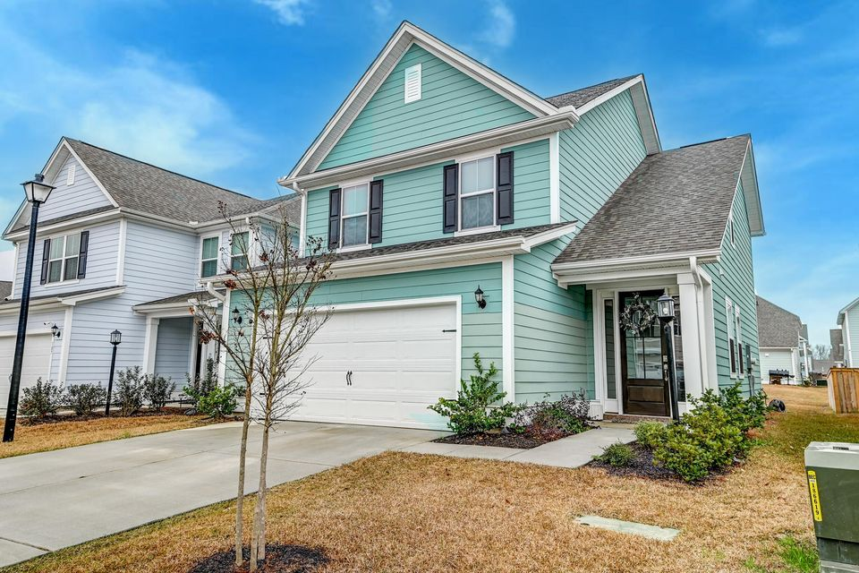

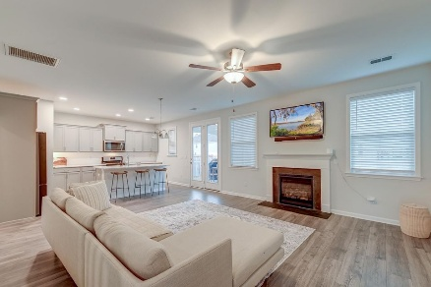
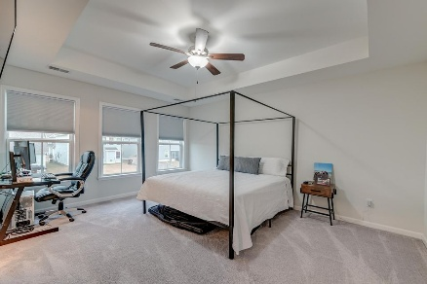
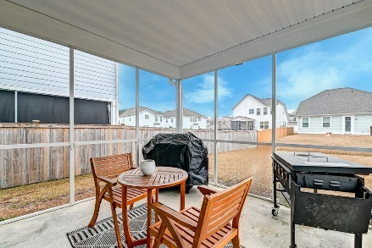
Move-in Ready
OPEN HOUSE
SATURDAY 12-3
Open House Saturday 12-3
109 Forest Springs Road
Foxbank Plantation | Moncks Corner, SC 29461 | MLS# 25005071 | $360,000
Immaculate, like-new 3-bedroom, 2.5-bathroom home, built in 2022 and loaded with upgrades! This move-in-ready home boasts an open-concept layout, pristine laminate floors through the first floor, a stunning kitchen featuring a large island, quartzite countertops, and a gas stove. Cozy up to the gas fireplace or enjoy your screened-in porch year round! Foxbank Plantation offers wonderful community amenities, including a pool, playpark, and walking trails. Foxbank Elementary School and a fire station are located in the community as well. With easy access to grocery stores within five miles, Roper St. Francis Berkeley Hospital just 7.3 miles away, and only 10.9 miles to the E Jarvis Morris Boat Ramp for Lake Moultrie enthusiasts, this home combines comfort and convenience with a truly idyllic setting.
Don't miss out come see this special property today!
Book your showing today!
Amanda Kennedy-Colie akcolie@mattoneillteam.com 843-224-5865

