Slide 1
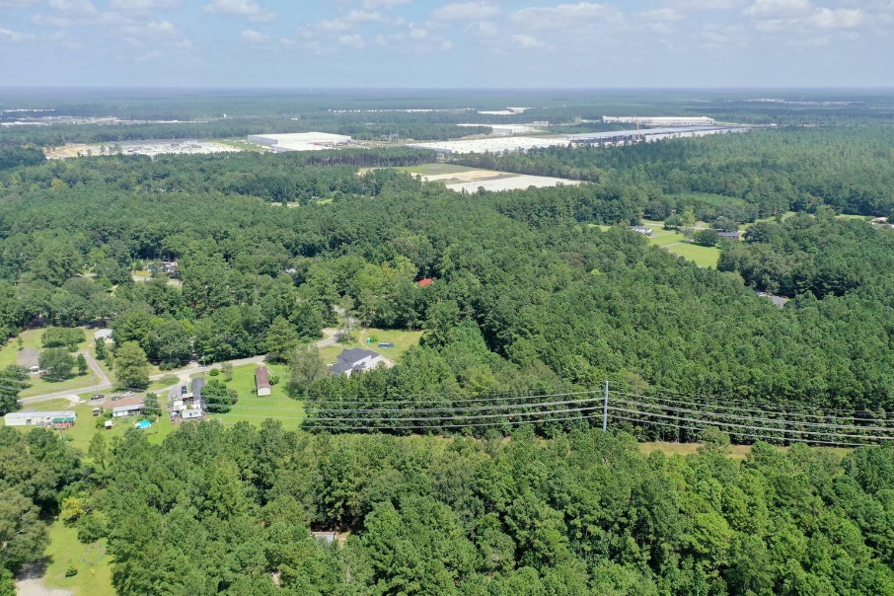
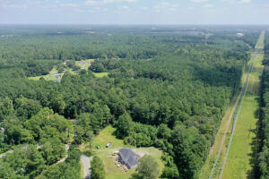
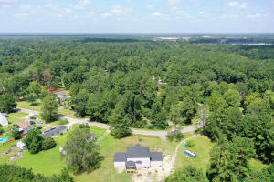
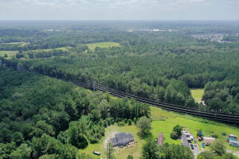
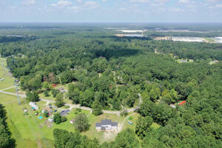
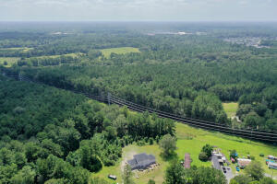
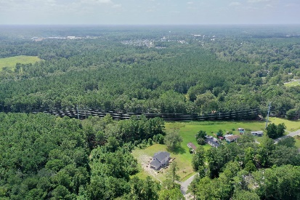
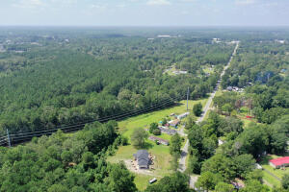
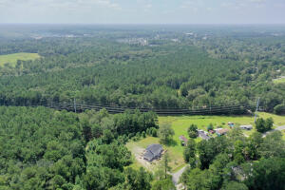



Mixed Use Land in Summerville
109 Glen Street Clemson Terrace
Summerville, SC 29483
MLS# 22000193
$250,000
3.3 Acres
The house IS NOT the property for sale, it's raw land. Very unique piece of land zoned Mixed Use! Includes 109 Glen St and the parcel next door, TMS# 130-01-04-020, total of approximately 3.3 acres. This wonderful tract of land is located in the quiet Clemson Terrace, just minutes away from Nexton and downtown Summerville. The property is zoned for manufactured homes (8.7 dwellings per net acre), multifamily use (13.0 dwellings per net acre), townhomes (5.8 dwellings per net acre), single family homes (2 lots per acre) and many other things! Electricity already on the property and public utilities at the street. Definitely come take a look!
Nick Mazzilli (843) 640-5575
nick@nickmcharleston.com www.mavenrealtysc.com
Maven Realty
2180 McMillan Ave
#71672
Charleston, SC 29405

