Slide 1
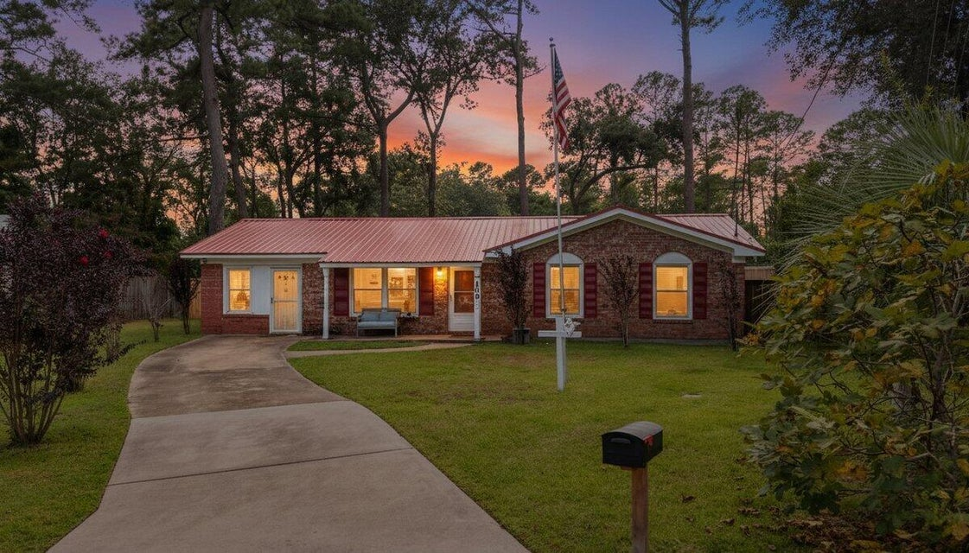



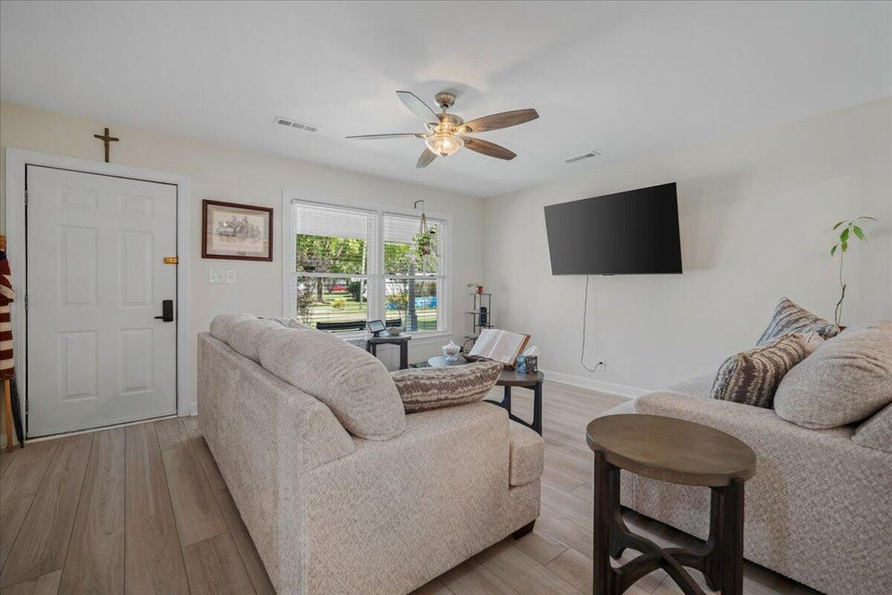
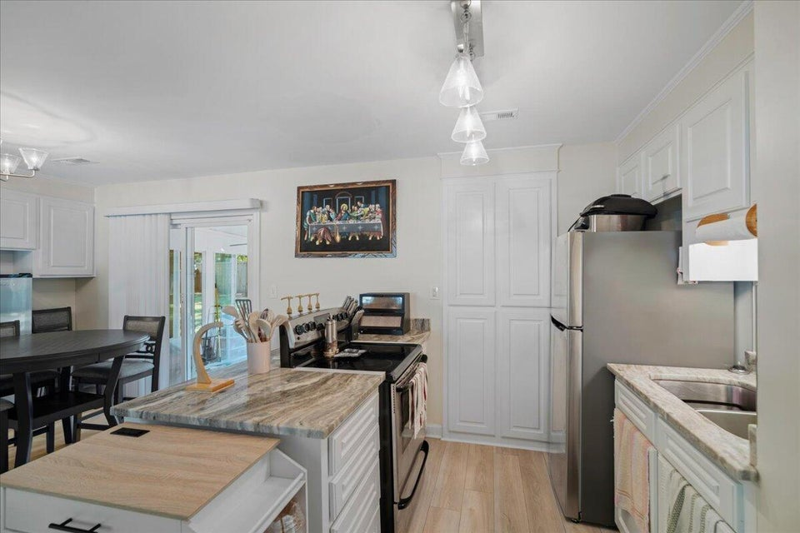
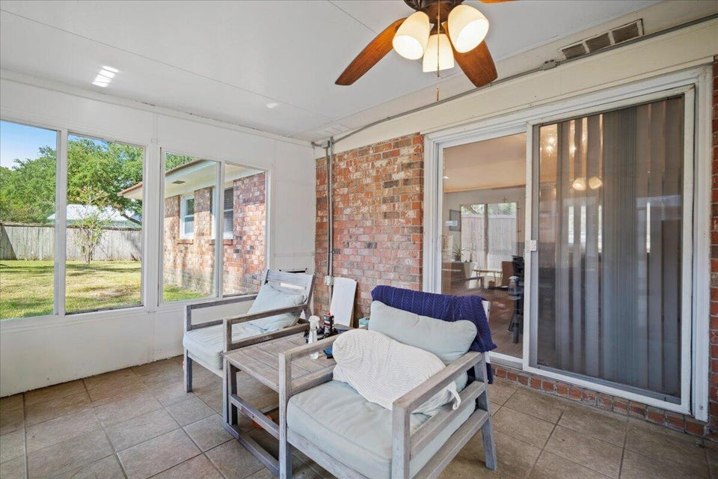
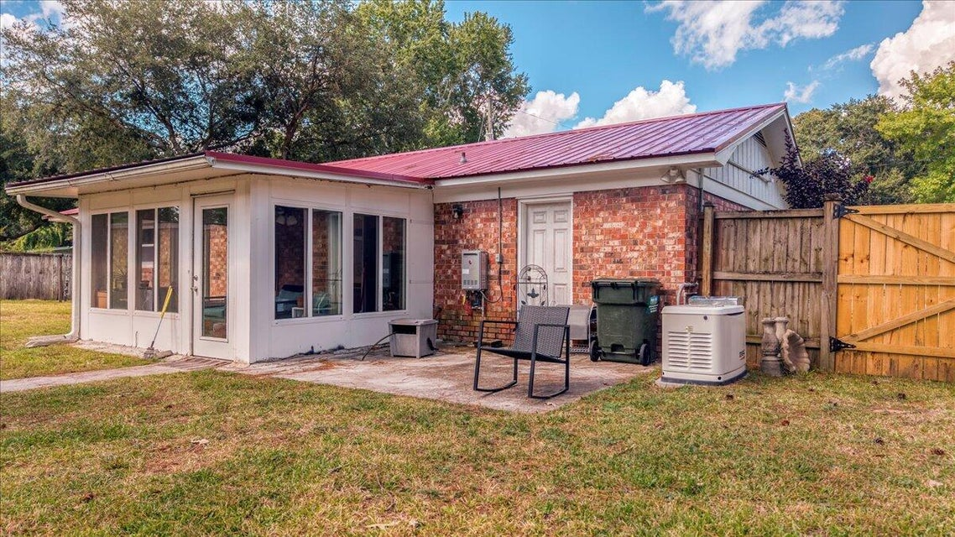


10k Price Improvement
109 Robin Court
Rose Hill | Summerville, SC 29485 | MLS# 25026580 | $289,999
This 3 bedroom, 2 bath brick ranch is packed with high value improvements and sits at the end of a quiet cul-de-sac just minutes from Gahagan Park, shopping, and Downtown Summerville. Recent upgrades include a new metal roof (2025), new HVAC system (2025), and a whole home Generac generator giving you long term durability and energy. Inside, you'll find updated bathrooms, new flooring throughout, and fresh paint. Relax year round on the enclosed porch, overlooking a private backyard with room to garden, grill, or unwind.
VIDEO TOUR
Telecia Bilton
843-412-3586
tmbilton@rogcoastal.com
Realty ONE Group Coastal
1510 Trolley Rd
Summerville, SC 29485

