Slide 1

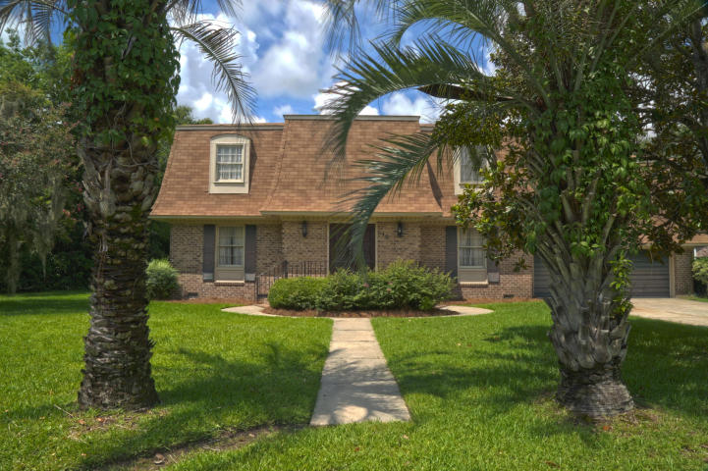
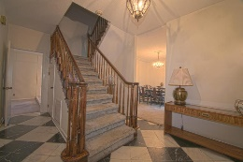
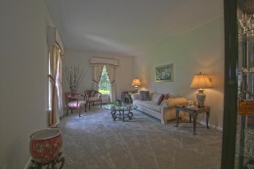
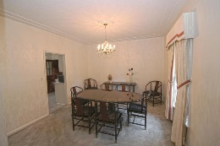
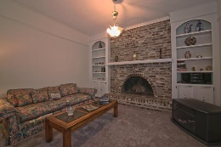
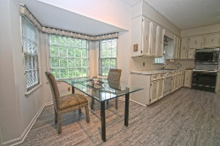
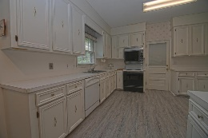
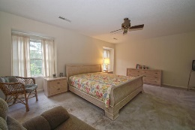
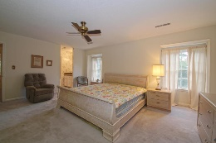
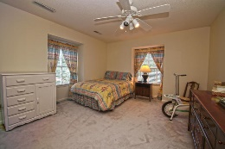
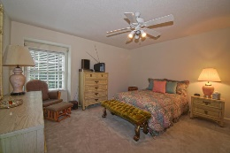
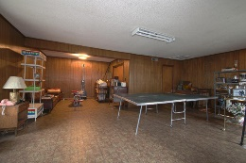
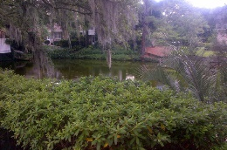


Agent Open House Thursday, September 1st from 11:30-1:30 Light Lunch Catered by Hamby's
10 Fort Royal Avenue Wespanee Plantation • Charleston • MLS# 16019853 • $455,900
This Classic Wespanee Plantation stately brick home located 2 doors down from the cul-de-sac and the beautiful Wespanee Pond offers 4 Bedrooms plus a huge FROG which could be 5 brs~ Such a functional and practical layout of spacious rooms, the comfortable floorplan which includes: a welcoming Foyer with a black and white marble floor, a separate Formal Living Room & separate Dining Room ~ one step down and you are in your sunken Family Room which opens wide to the large well laid out Eat-in kitchen ~ The Family Room has a brick fire place wall and built in cabinets on either side with a French Door opening out to the patio and partially Fenced in Back yard ~ one step up to the Eat-in Kitchen which has a bay window, many cabinets including 2 glass front cabinets and lots of counter space, which lends itself to easy entertaining and family gatherings.
Large Master Bedroom with Master Bathroom and walk-in closet and 3 more spacious Bedrooms upstairs ~ Tiled Full Bathroom w/Tub Shower and double sinks upstairs ~ Large enough to accommodate a ping pong table, weight lifting area and media area along with 2 storage closets the FROG is designed for fun/guest area/playroom or office ~ 2 car garage ~ Hard wood floors under most of the carpet ~ Roof is within 5 years old ~ Termite Bond with Atlantic Pest Control is transferrable~ Bring your own decorator's touch to make this great house your own special family home.~ Centrally located in the heart of West Ashley just minutes to shopping, Charlestowne Landing, Downtown Charleston, I26 & I526!
Elaine Brabham
(843) 209-2347 | ebrabham@findyourcharleston.com
www.findyourcharleston.com
Elaine Brabham and Associates, LLC • 1890 Sam Rittenberg Boulevard, Suite 217 • Charleston, SC 29407

