Slide 1
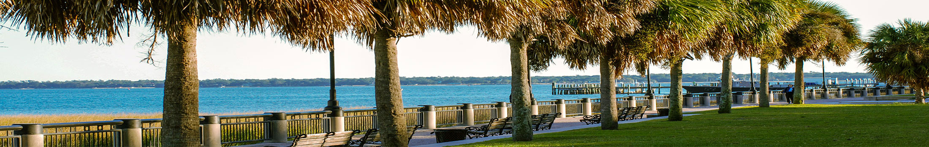




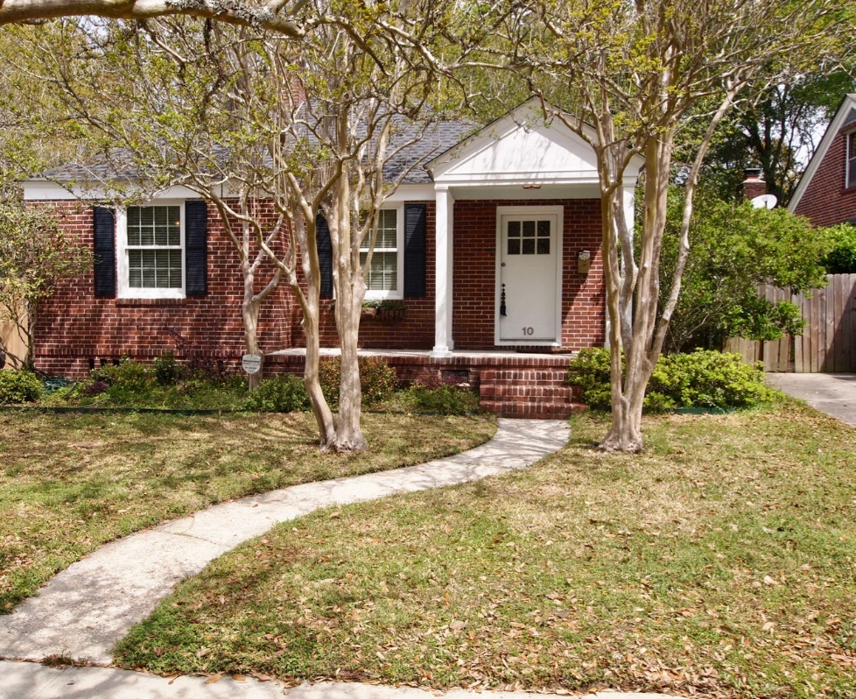
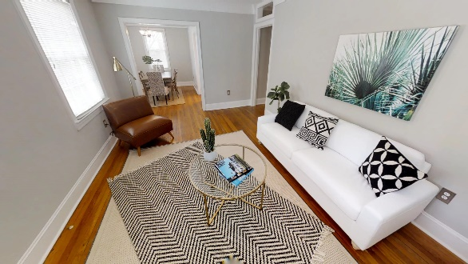
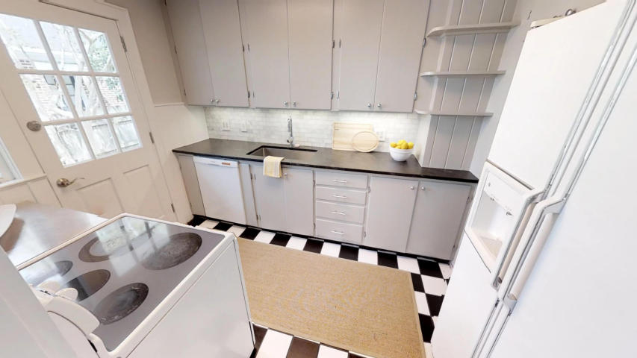
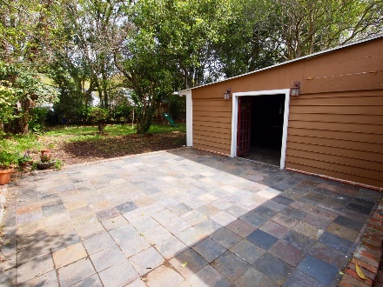
Open House Friday 12-2pm
Kelley Argraves
Lennie Woods & Lauren Gibson
843-693-3346 | kelleyargraves@lowcountrylivinggroup.com
10 Lyttleton Avenue
Byrnes Downs ~ Charleston ~ MLS# 18022219 ~ $389,900
Move in ready home close to everything!
Charleston's favorite neighborhood close to the trendy Avondale shops and restaurants as well as the Charleston greenway. Avoid the traffic and live close to hospitals and the beach or walk/bike to everything you need. This home has fresh repose gray paint and brand new flooring throughout to include tile in the bath and brand new solid wood (not engineered) floors. 3 bedrooms and a Huge yard with a storage building too.

