Slide 1
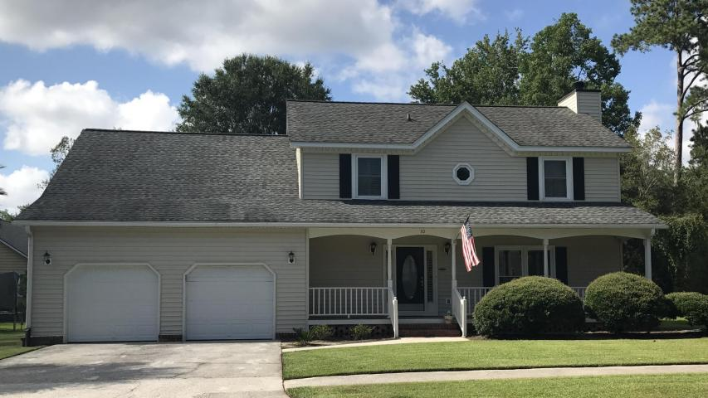
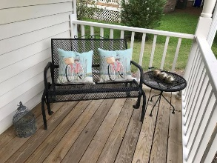
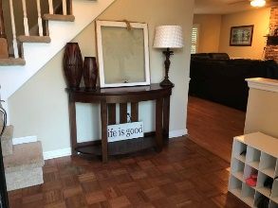
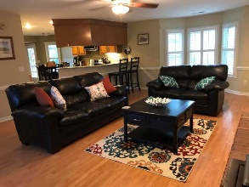
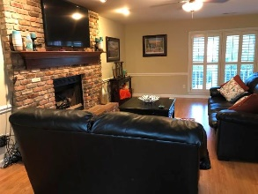
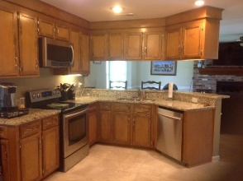
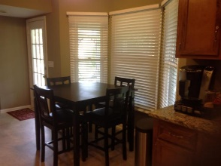
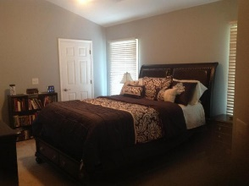
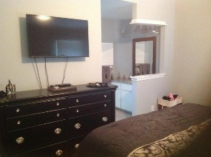
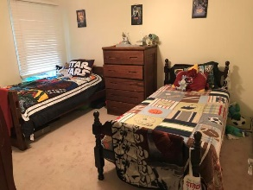
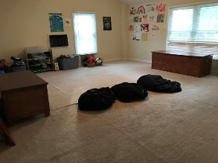
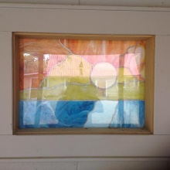

OPEN HOUSE THIS WEEKEND!
SATURDAY 1-4 ~ SUNDAY 10-1
10 Oatly Circle
Shadowmoss Plantation | Charleston | MLS# 17021882 | $285,900
Great house on quiet street in Shadowmoss Plantation! This 3 bedroom, 2.5 bathroom house is the perfect size for any family. This house also has a huge FROG-which could be used as a fourth bedroom, granite counter tops in kitchen, master bath and downstairs bath. All new windows in 2016. 2 new HVAC split systems in 2016. Tank less water heater in 2016. Roof replaced, garage doors replaced, yard has been sodded and gutters run to French drain. Decks have been sealed and exterior painted and screen replaced on the porch. All faucets have been replaced since purchase. Downstairs ceilings have been scraped to be smooth. Interior has also been painted. New floors in bathrooms, kitchen and laundry room. Must see!!!
Carla C Davis
Mobile - (843) 437-4873
gaweber@tds.net
AgentOwned Premiere Group
141 A N. Main Street
Summerville, SC 29483

