Slide 1
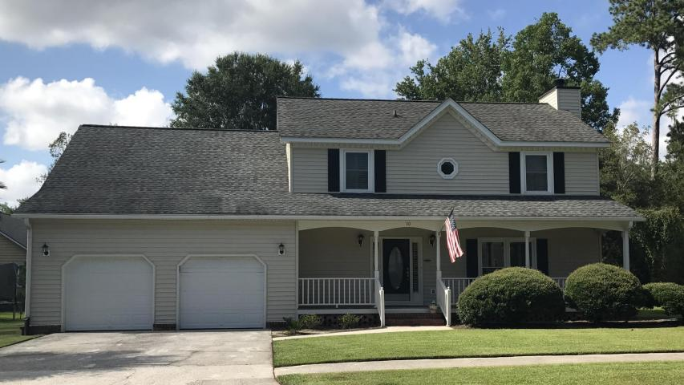
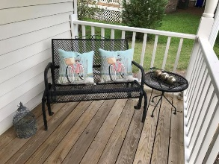
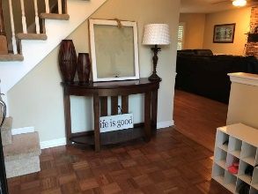
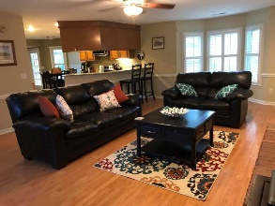
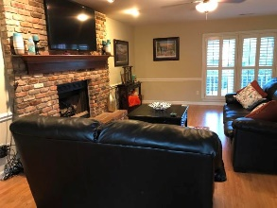
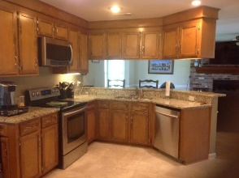
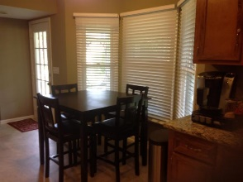
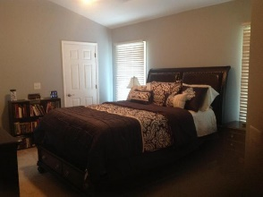
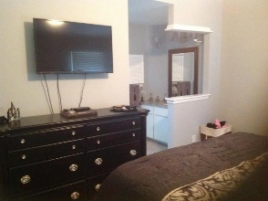
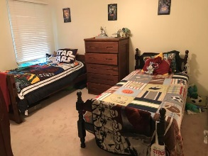
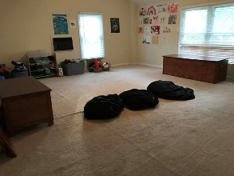
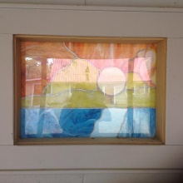

Great House On Quiet Street In Shadowmoss Plantation
10 Oatly Circle
Shadowmoss Plantation | Charleston | MLS# 18002870 | $280,000
This 3 bedroom, 2.5 bathroom house is the perfect size for any family. This house also has a huge FROG, which could be used as a fourth bedroom, granite counter tops in kitchen, master bath and downstairs bath. Home has new windows, 2 new HVAC split systems, Tankless water heater, Roof has been replaced, garage doors replaced, yard has been sodded and gutters run to french drain. Decks have been sealed, exterior painted and screen replaced on the porch. All faucets have been replaced since purchase, Downstairs ceilings have been scraped to be smooth, Interior has also been painted. New floors in bathrooms, kitchen and laundry room. House was recently pressure washed and master bathroom shower regrouted. MUST SEE this home!
Carla C Davis
Mobile - (843) 437-4873
gaweber@tds.net
AgentOwned Premiere Group
141 A N. Main Street
Summerville, SC 29483

