Slide 1

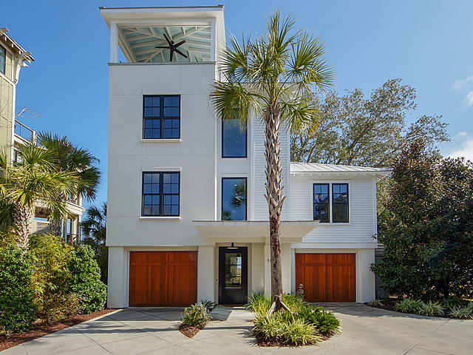
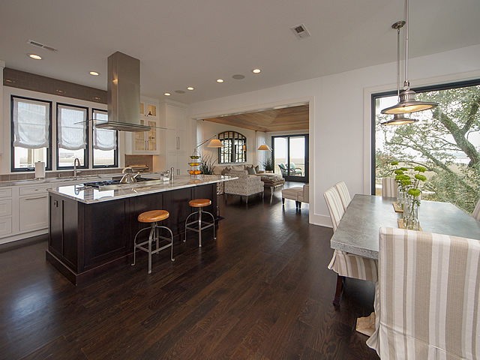
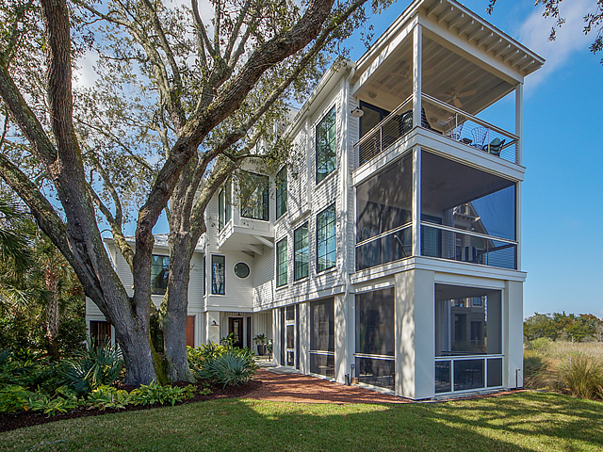
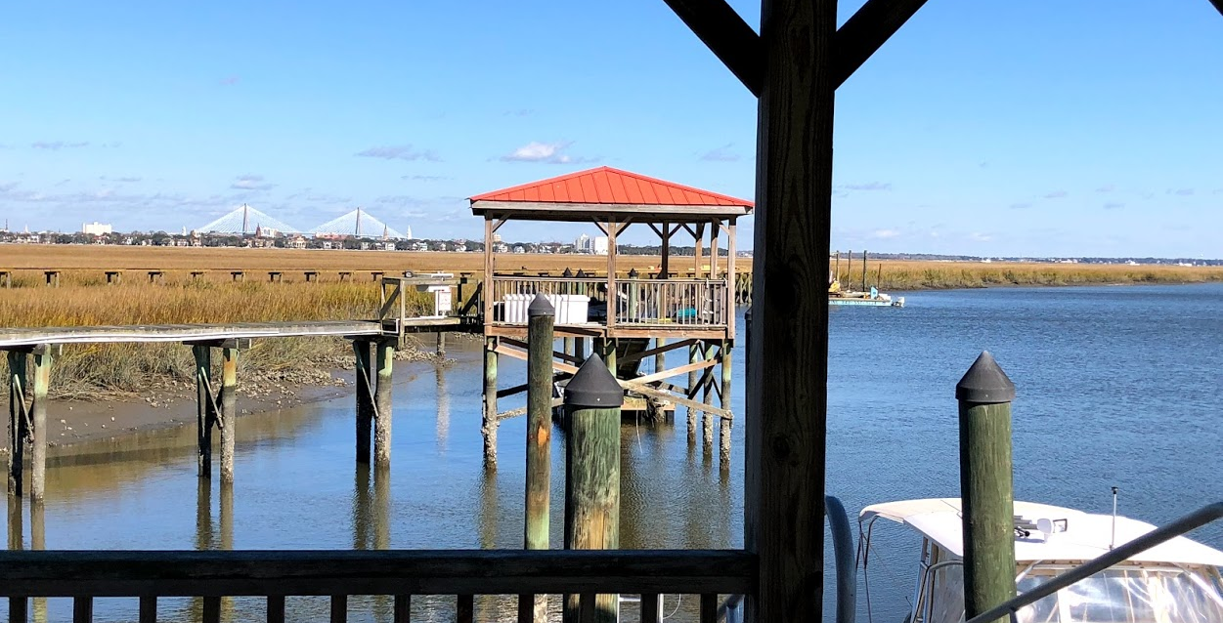
EXCLUSIVE BROKER OPEN
Wednesday, March 13th 4:30-7:30
10 Old Summerhouse Road
Point Verona ~ Charleston
MLS# 19005438 ~ $1,950,000
Stunning, Luxury Property
Enjoy light refreshments from EVO Bakery and cocktails
on one of 4 outdoor porches with spectacular views of Downtown Charleston!
Kara Delpino
(843) 860-4166
kara@hbrtwn.com
www.karadelpino.com
Harbourtowne Real Estate
672 Marina Drive, Ste 110
Daniel Island, SC 29492

